Slide 1
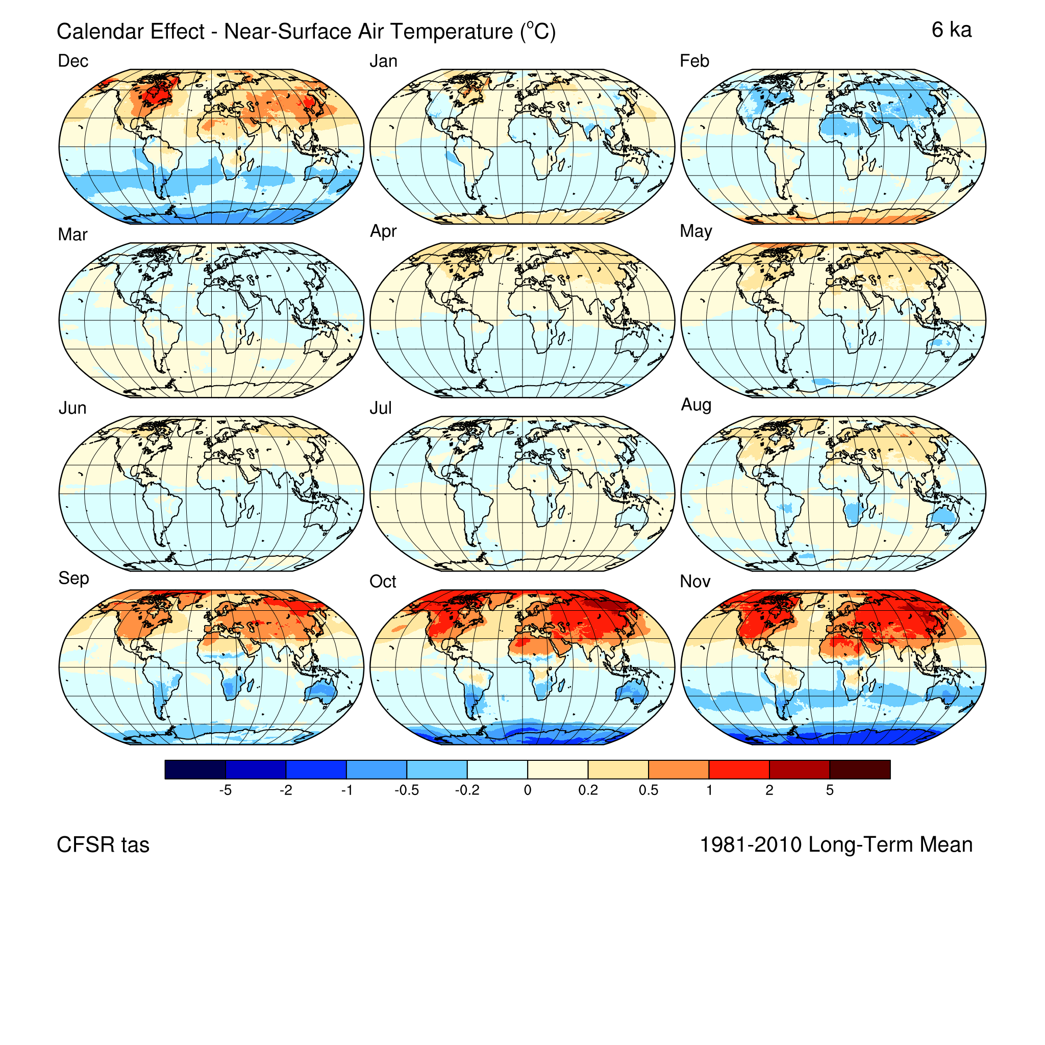
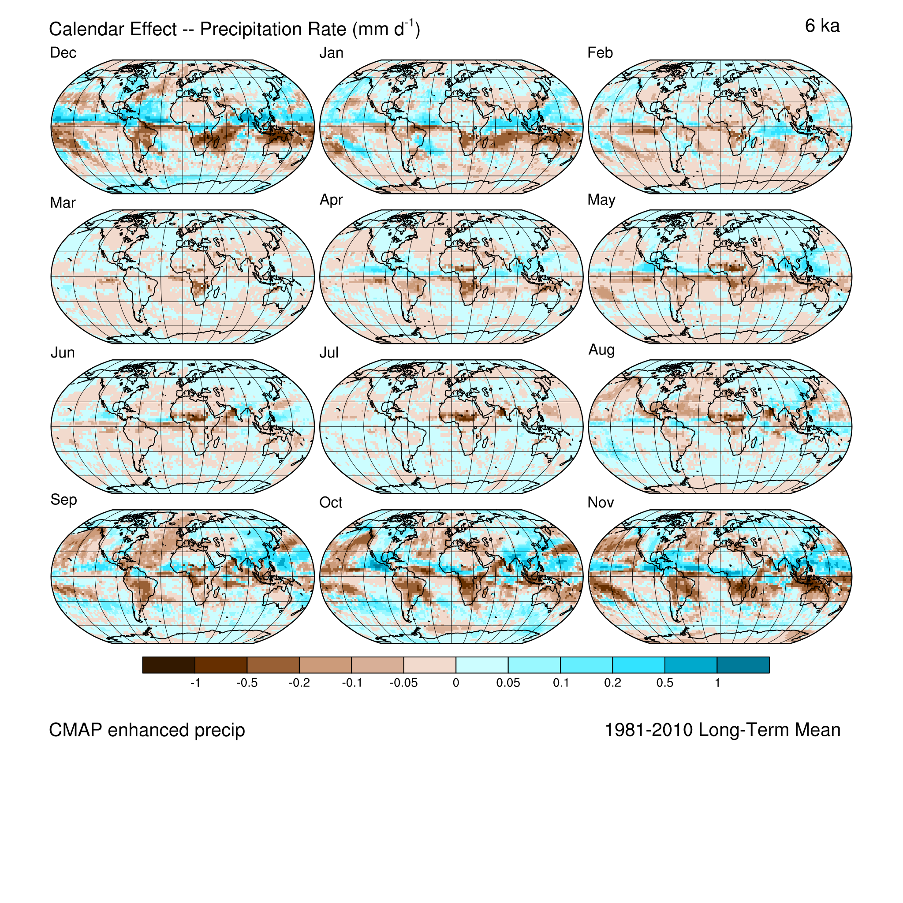
Paleo Calendar Effects on Radiation, Atmospheric Circulation, and Surface Temperature, Moisture, and Energy-Balance Variables Can Produce Interpretable But Spurious Large-Scale Patterns and Trends in Analyses of Paleoclimatic Simulations
Patrick J Bartlein, Dept. Geography, Univ. Oregon, Eugene, OR, United States
Sarah L Shafer, US Geological Survey, Corvallis, OR, United States

Slide 2
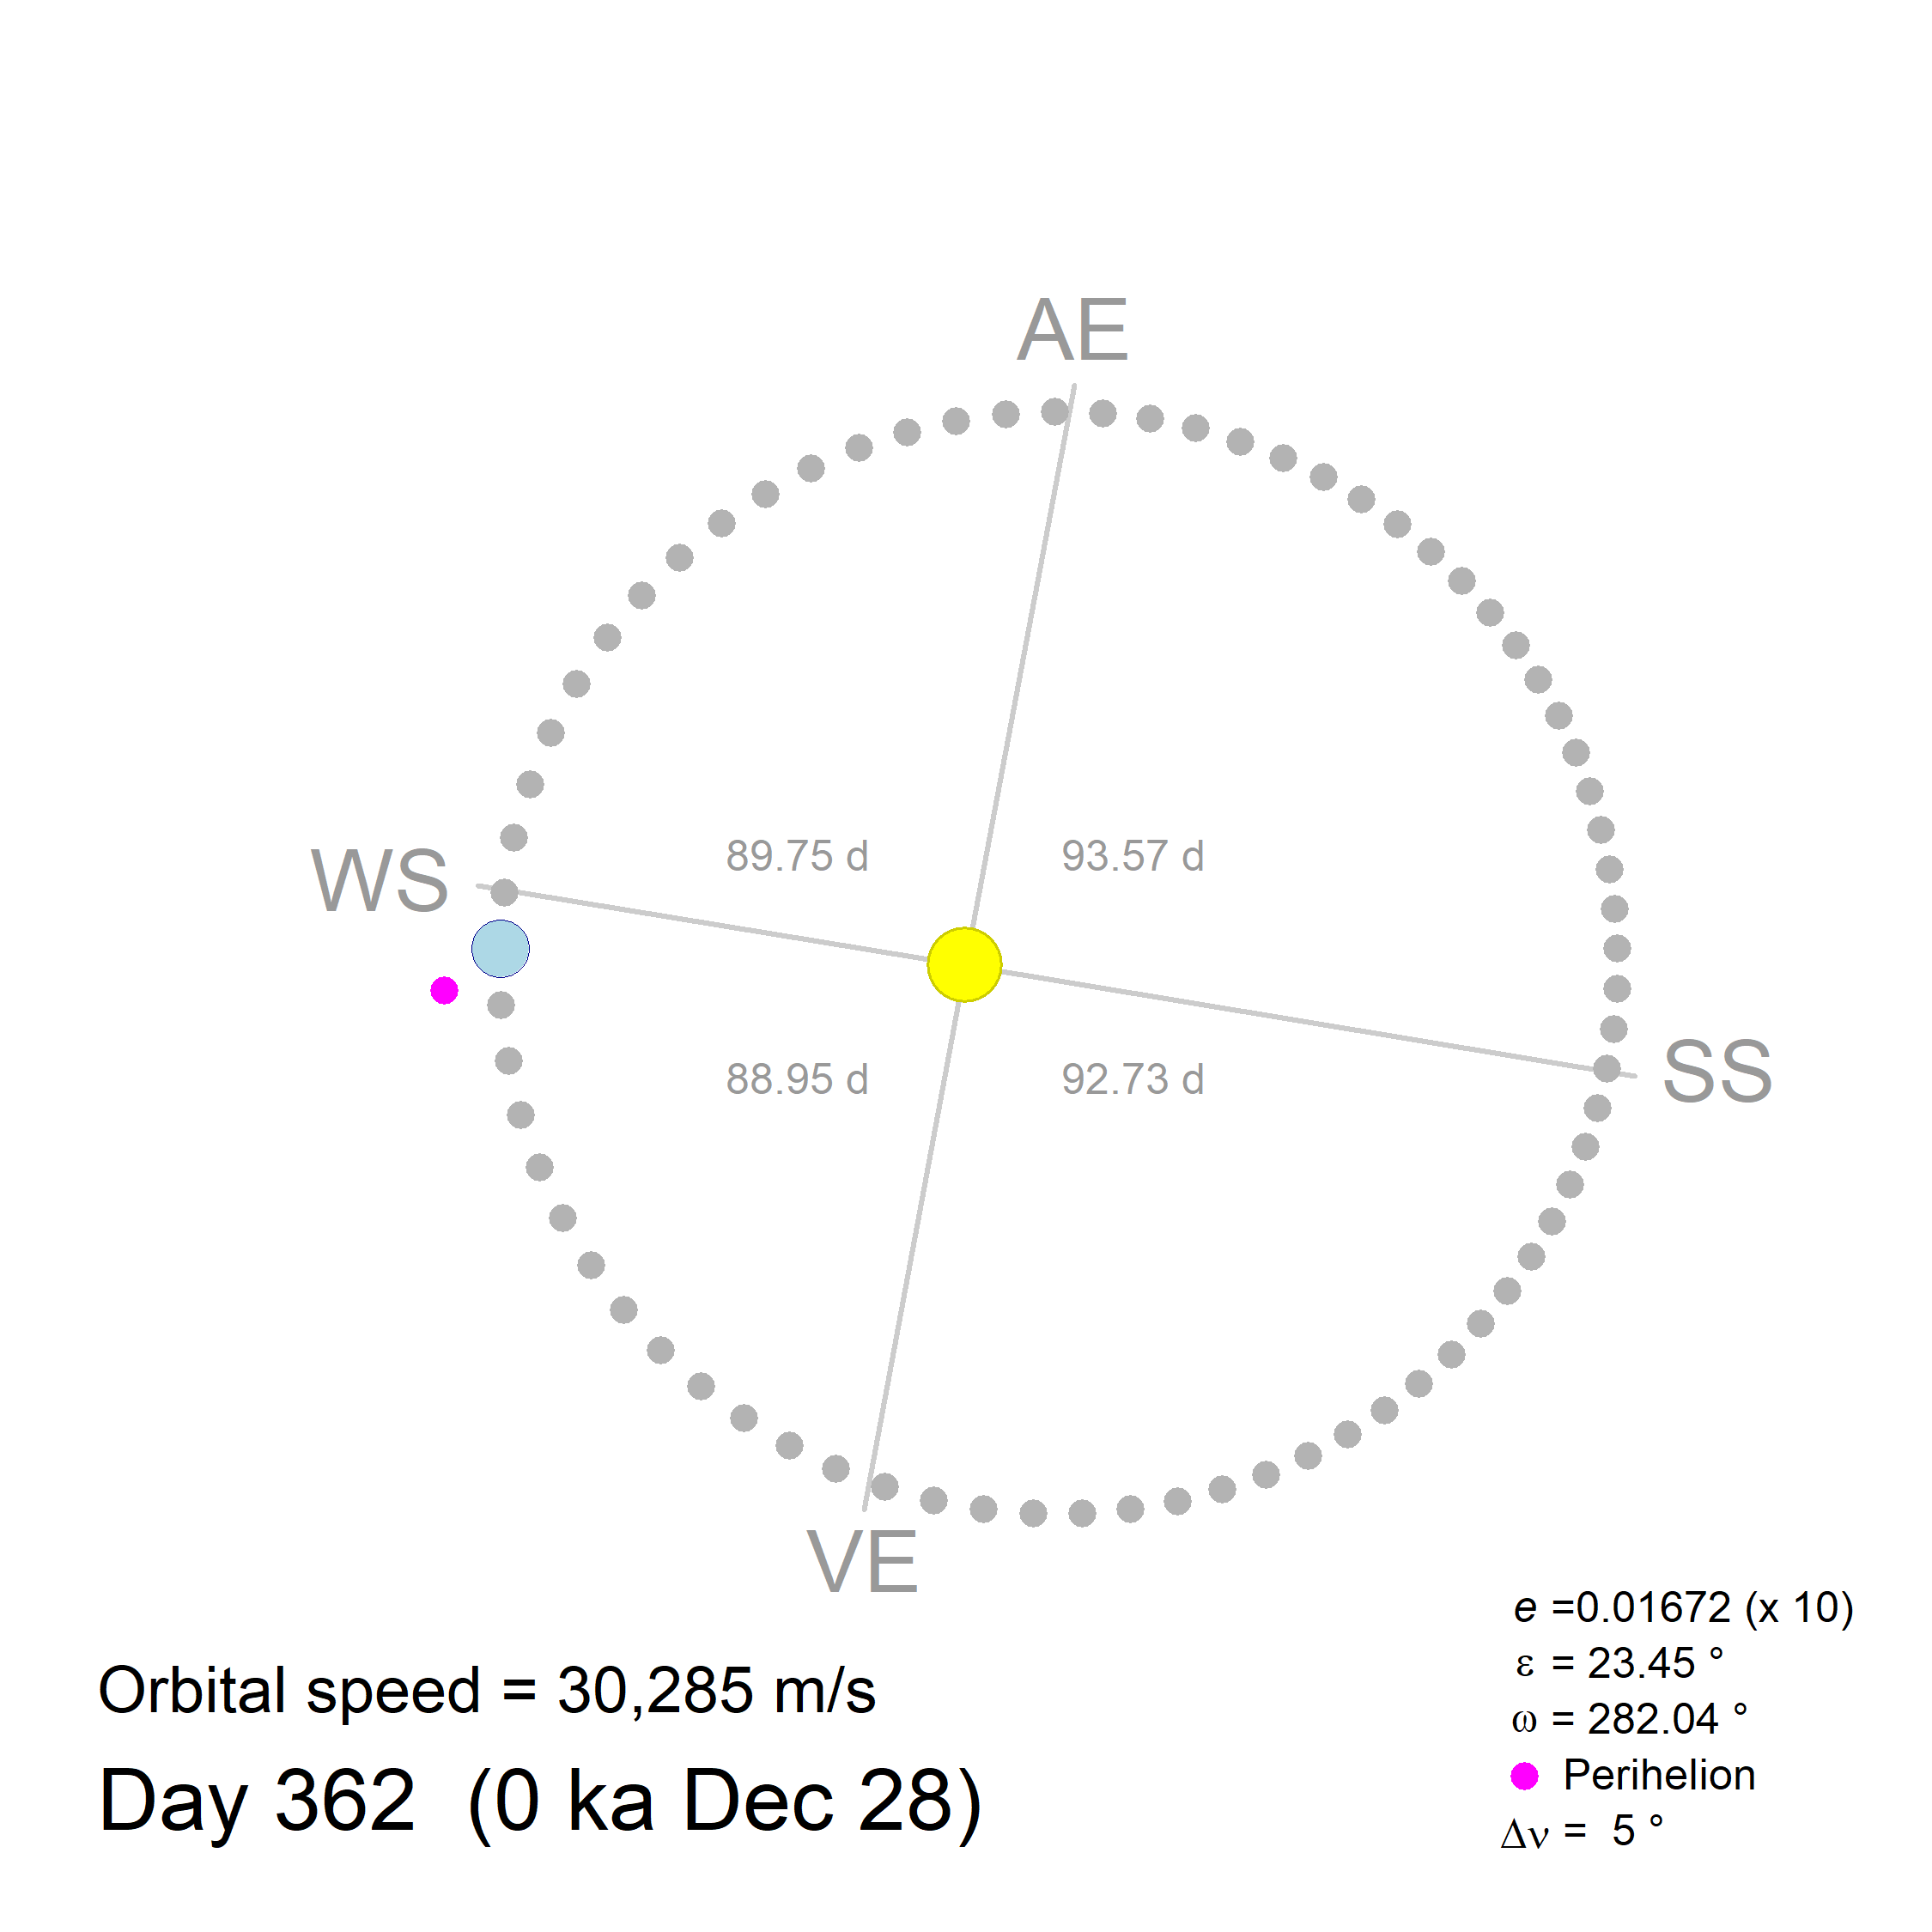
Kepler’s Laws of Planetary Motion
the orbit of every planet is an ellipse (with the Sun at one of the two foci)
a line joining a planet and the Sun ”sweeps out” equal areas during equal intervals of time
the orbital period is proportional to the semi-major axis of the ellipse
The second law implies that Earth moves faster along its orbital path at perihelion, and slower at aphelion.

Slide 3
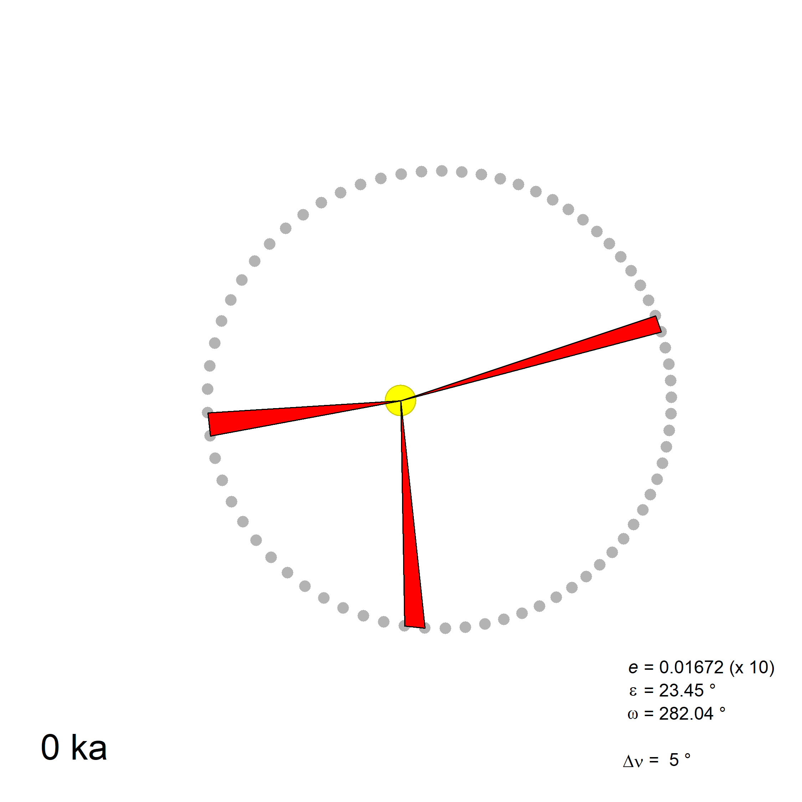
Kepler’s Laws of Planetary Motion
the orbit of every planet is an ellipse (with the Sun at one of the two foci)
a line joining a planet and the Sun ”sweeps out” equal areas during equal intervals of time
the orbital period is proportional to the semi-major axis of the ellipse
The second law implies that Earth moves faster along its orbital path at perihelion, and slower at aphelion.

Slide 4
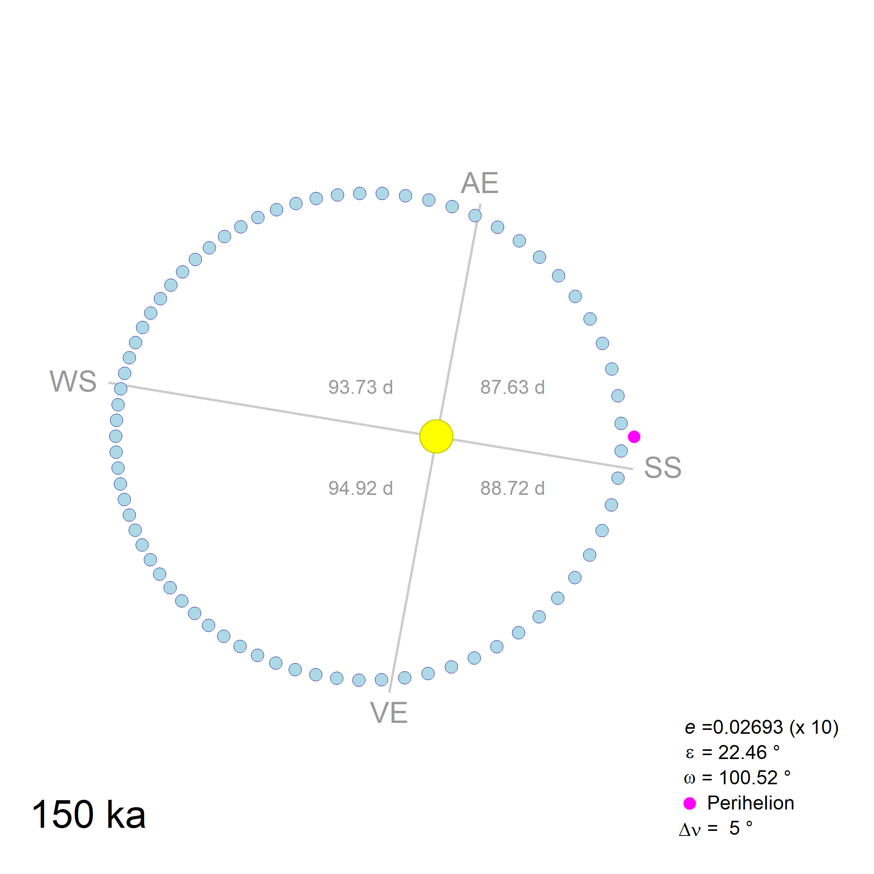
Temporal variations in the orbit
A particular number of solar days (e.g. a month or season’s worth) will sweep out a longer arc of the orbit near perihelion and a shorter arc near aphelion, and these arcs will vary as Earth’s orbit changes over time.
So using a “fixed-length” definition of months (i.e., defined by a fixed number of days), as opposed to a “fixed-angular” or “celestial” definition (i.e., defined by a fixed number of degrees of the Earth’s orbit), will lead to comparisons of data from different positions along the Earth’s orbit when comparing paleo with modern simulations.

Slide 5
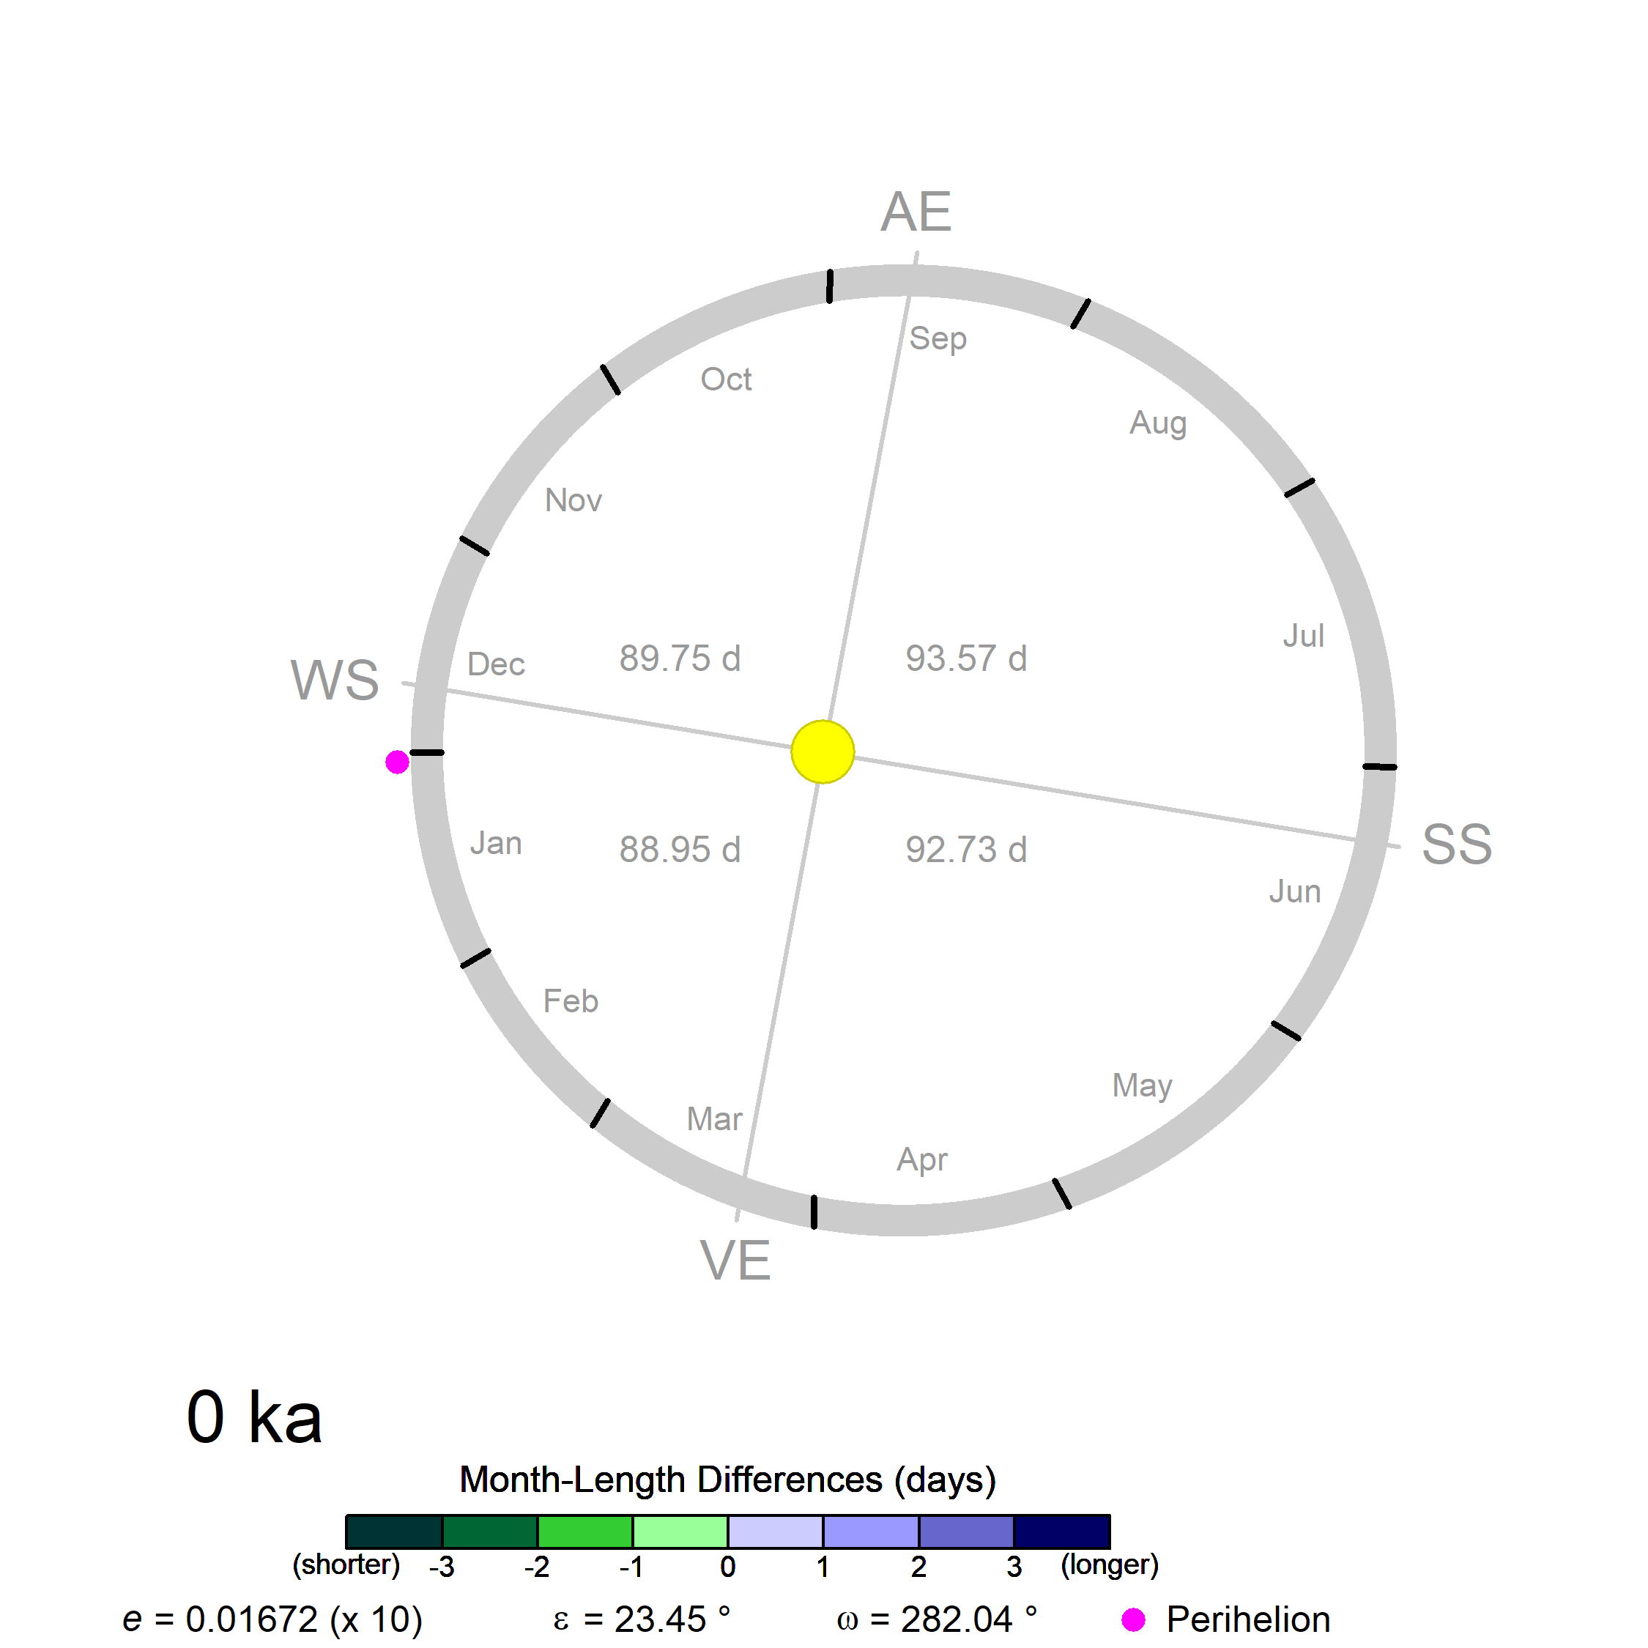
Paleo month-length calculation
Calculate paleo month lengths by
maintaining present-day angular definitions of months, and
using the “traverse time” equation (derived from Kepler’s equation) to determine the length of time required to traverse those angles (at any particular paleo age)
Two notions of a “day”
solar day (noon-to-noon)
1 d = (60 x 60 x 24) s
= 86,400 s
(Curtis, H.D. (2014) Orbital Mechanics for Engineering Students, Elsevier, Ch. 3, eqn 3.13b, 3.14 & 3.15)
July
longer
traverse
time
same angle
2,765,854 s
= 32.01 d
January
shorter
traverse
time
(31 d x 360 º /365 d)
= 30.57 º
2,593,387 s
= 30.01 d
E = 2.0d0 * datan(dsqrt((1.0d0 - eccen) / ! eq 3.13b
(1.0d0 + eccen)) * dtan(theta_rad/ 2.0d0))
M = E - eccen*dsin(E) ! eq 3.14
time = (M / (2.0d0 * pi)) * T ! eq 3.15

Slide 6
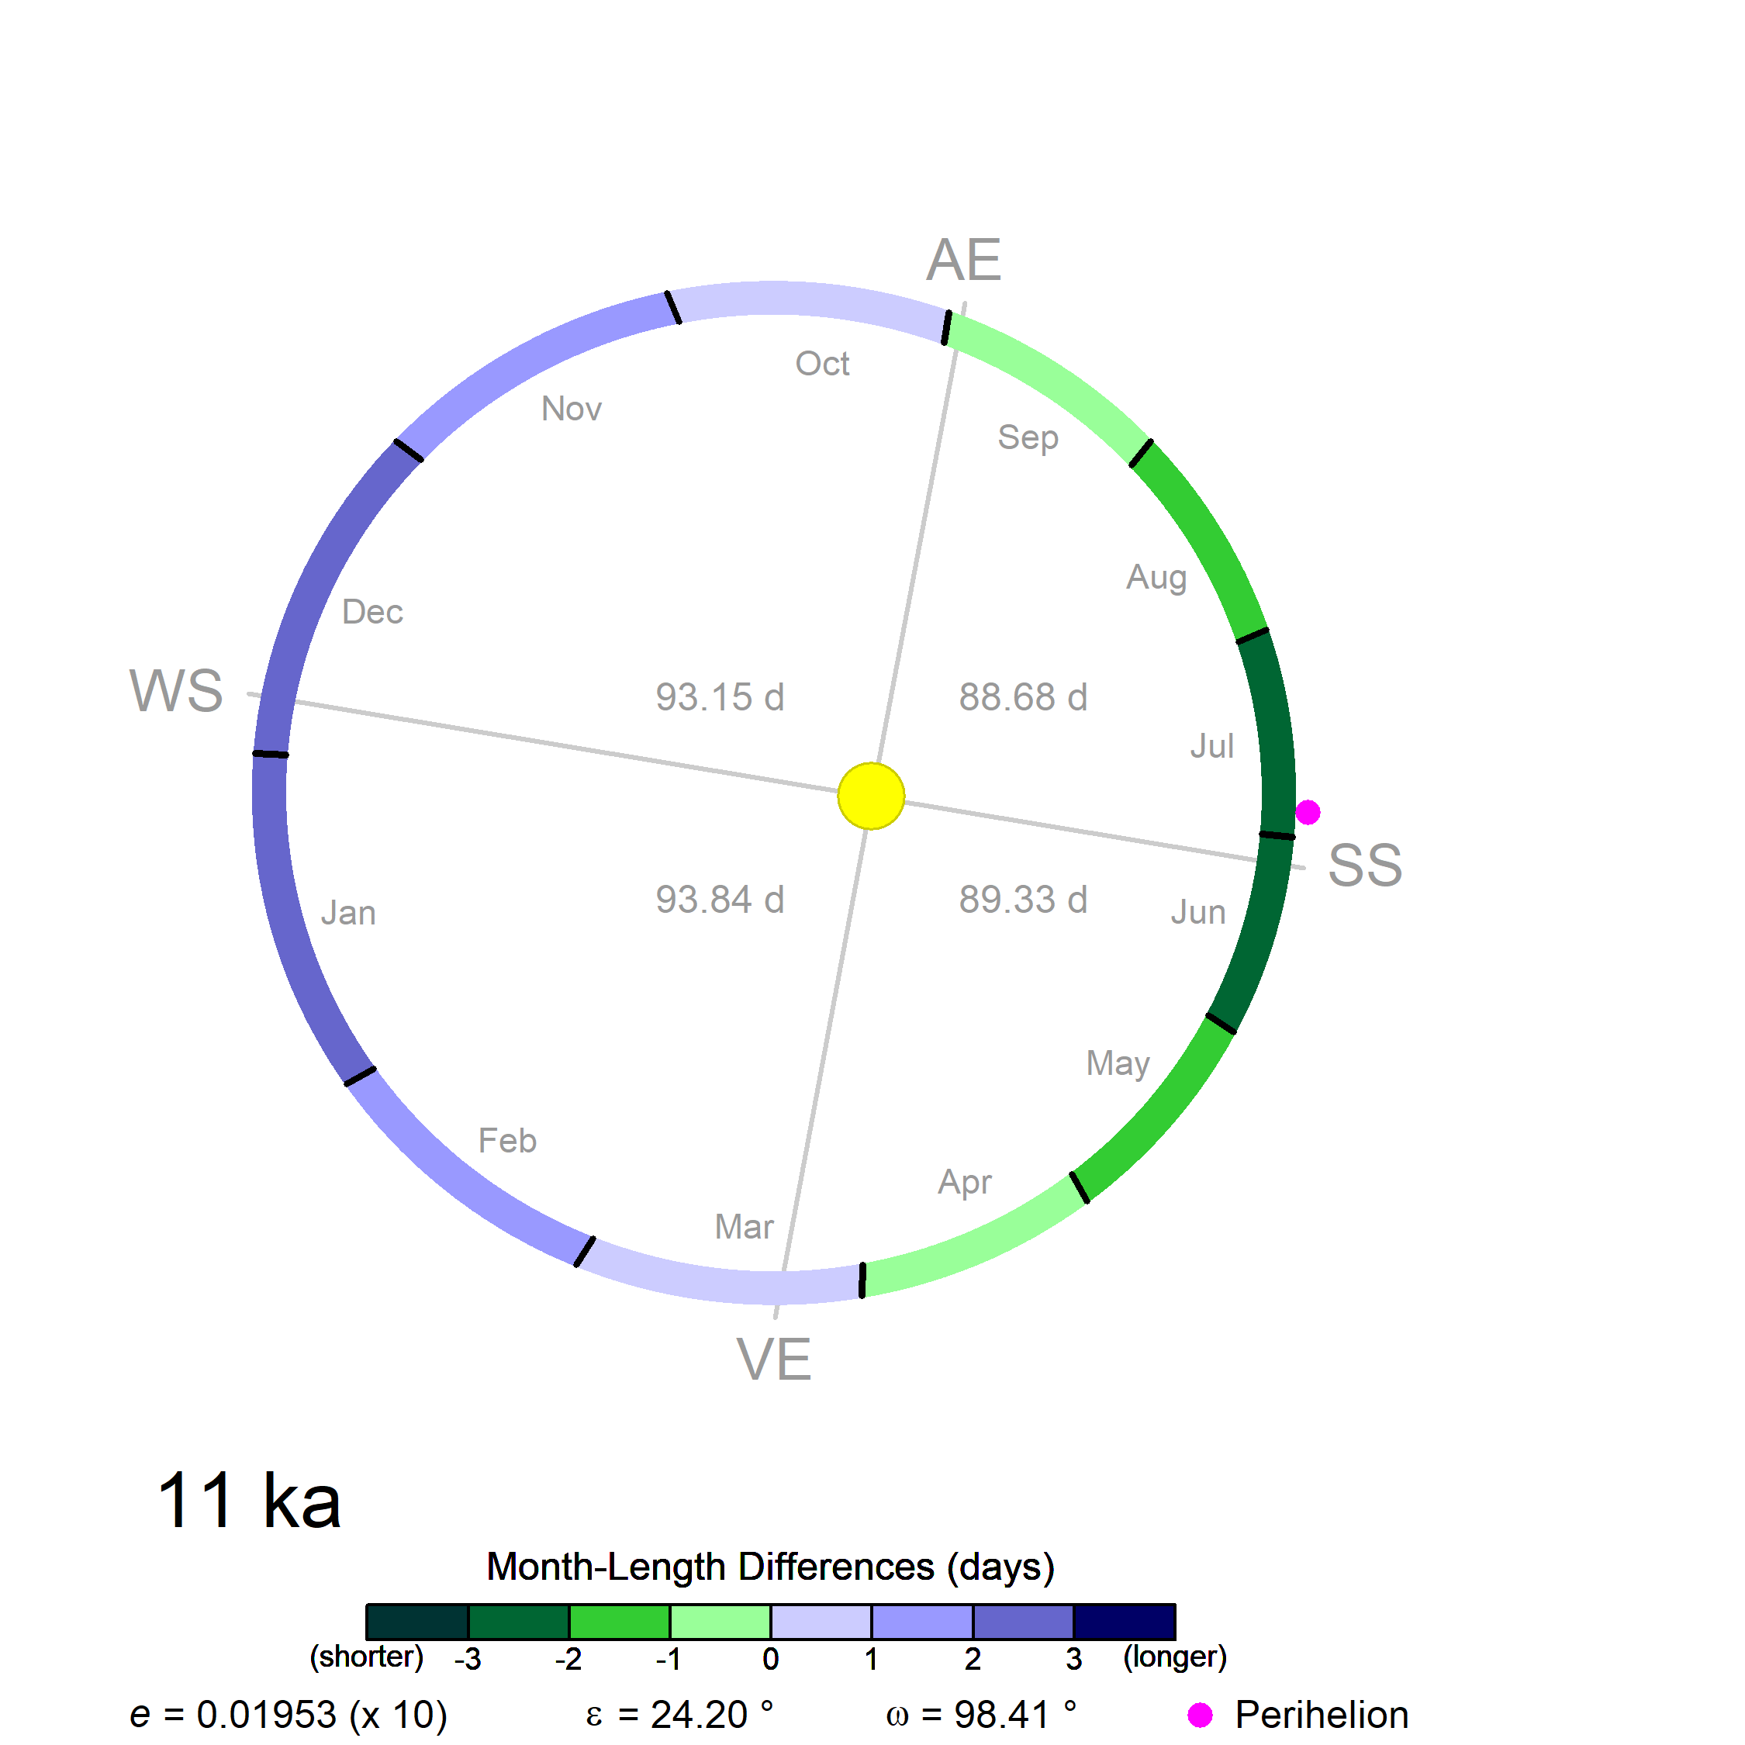
0 ka (perihelion in boreal winter) vs. 11 ka (perihelion in boreal summer)

Slide 7
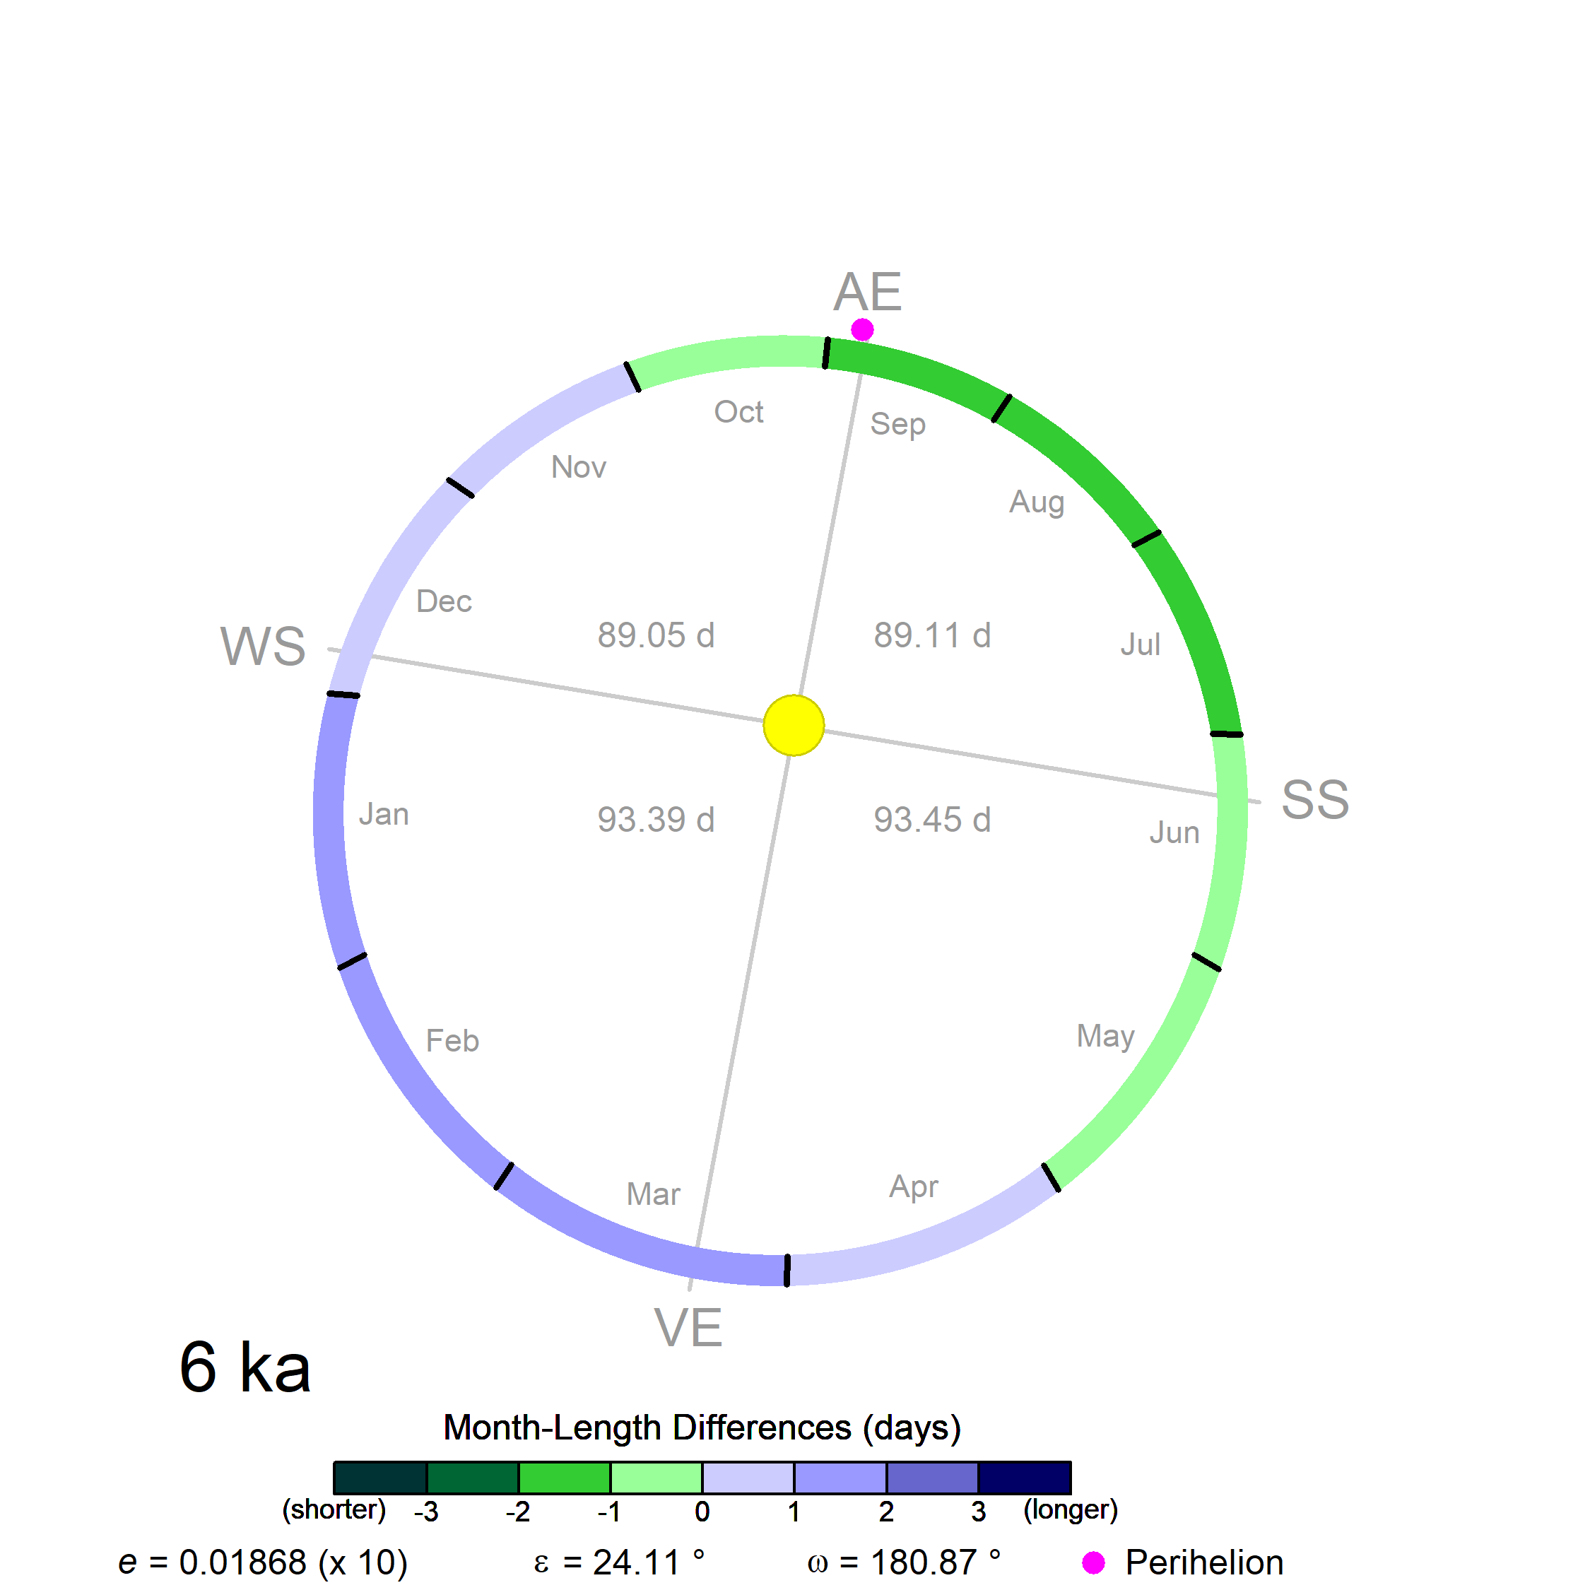
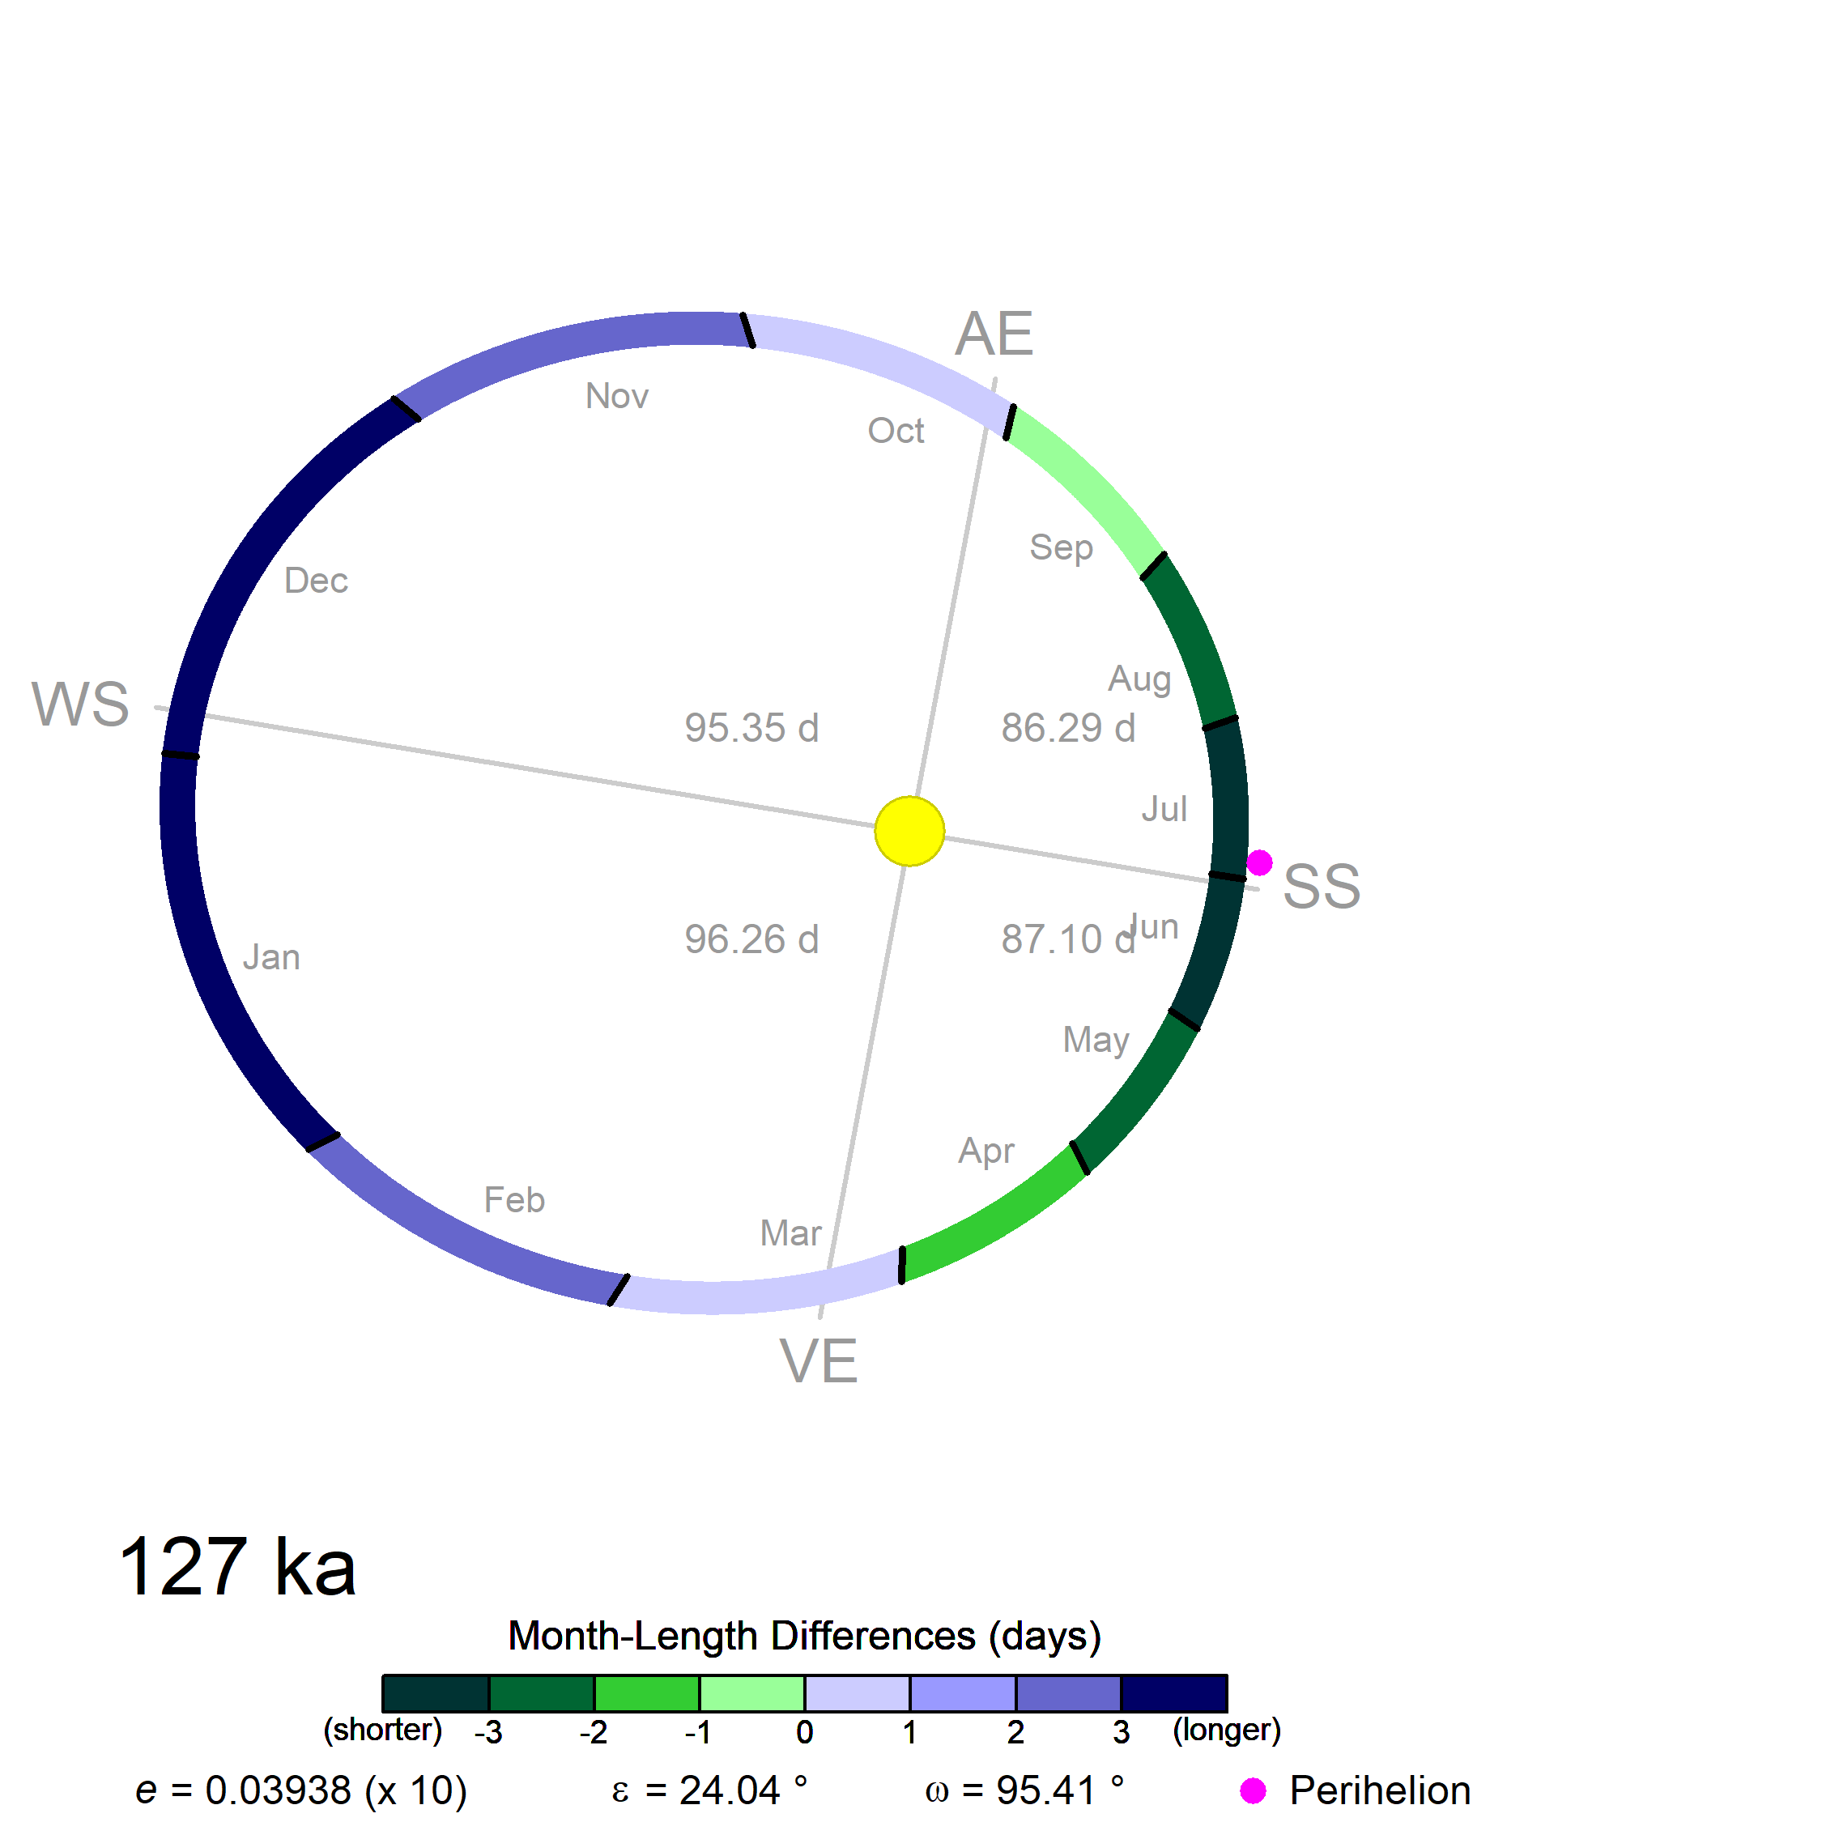
PMIP4 Interglacial Experiments

Slide 8
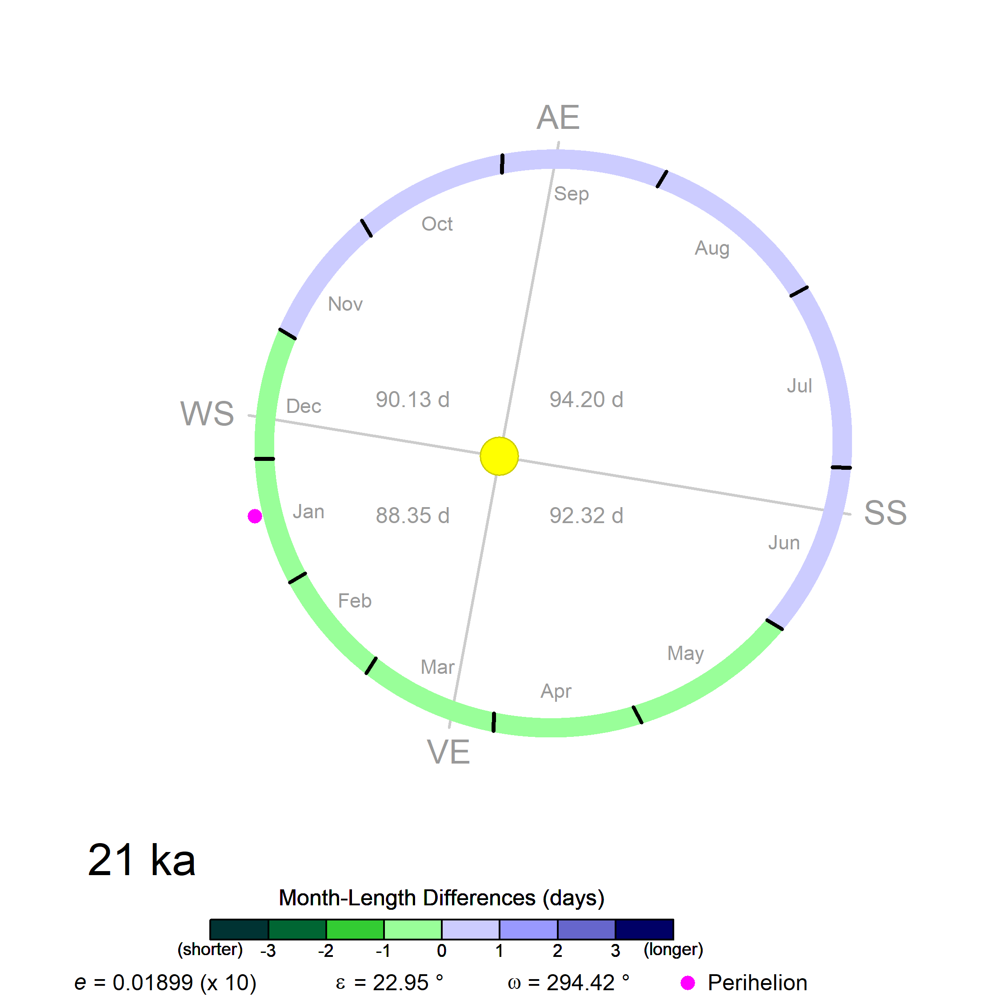
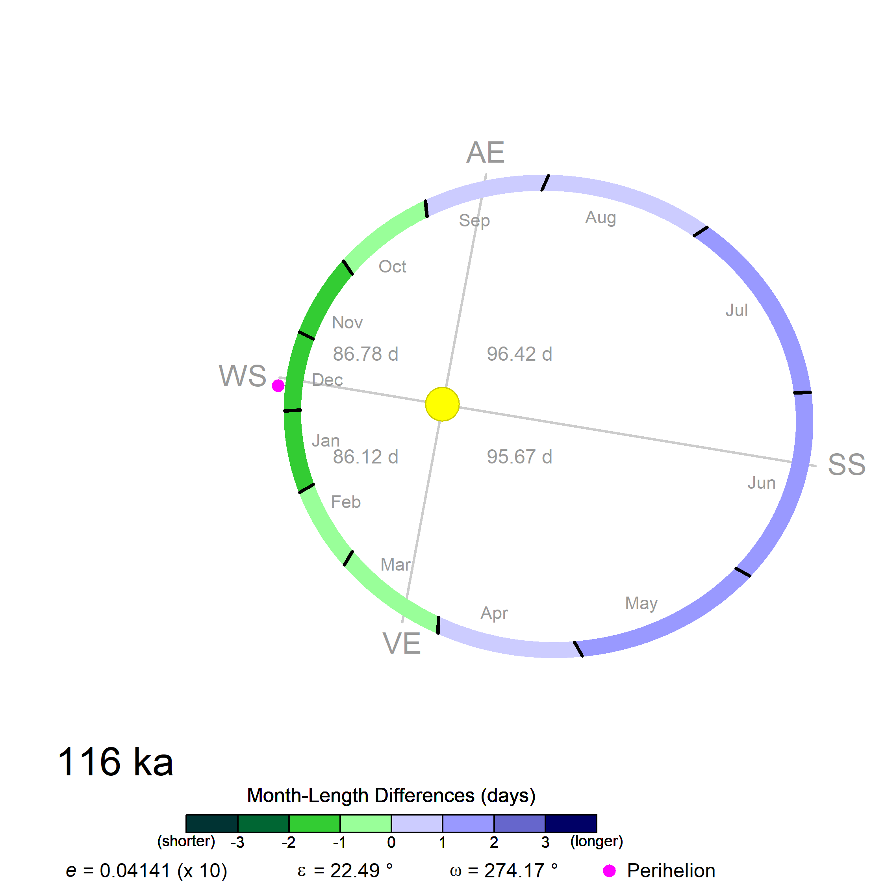
PMIP4 LGM Experiment PMIP4 lig116k (glacial inception)
SS

Slide 9
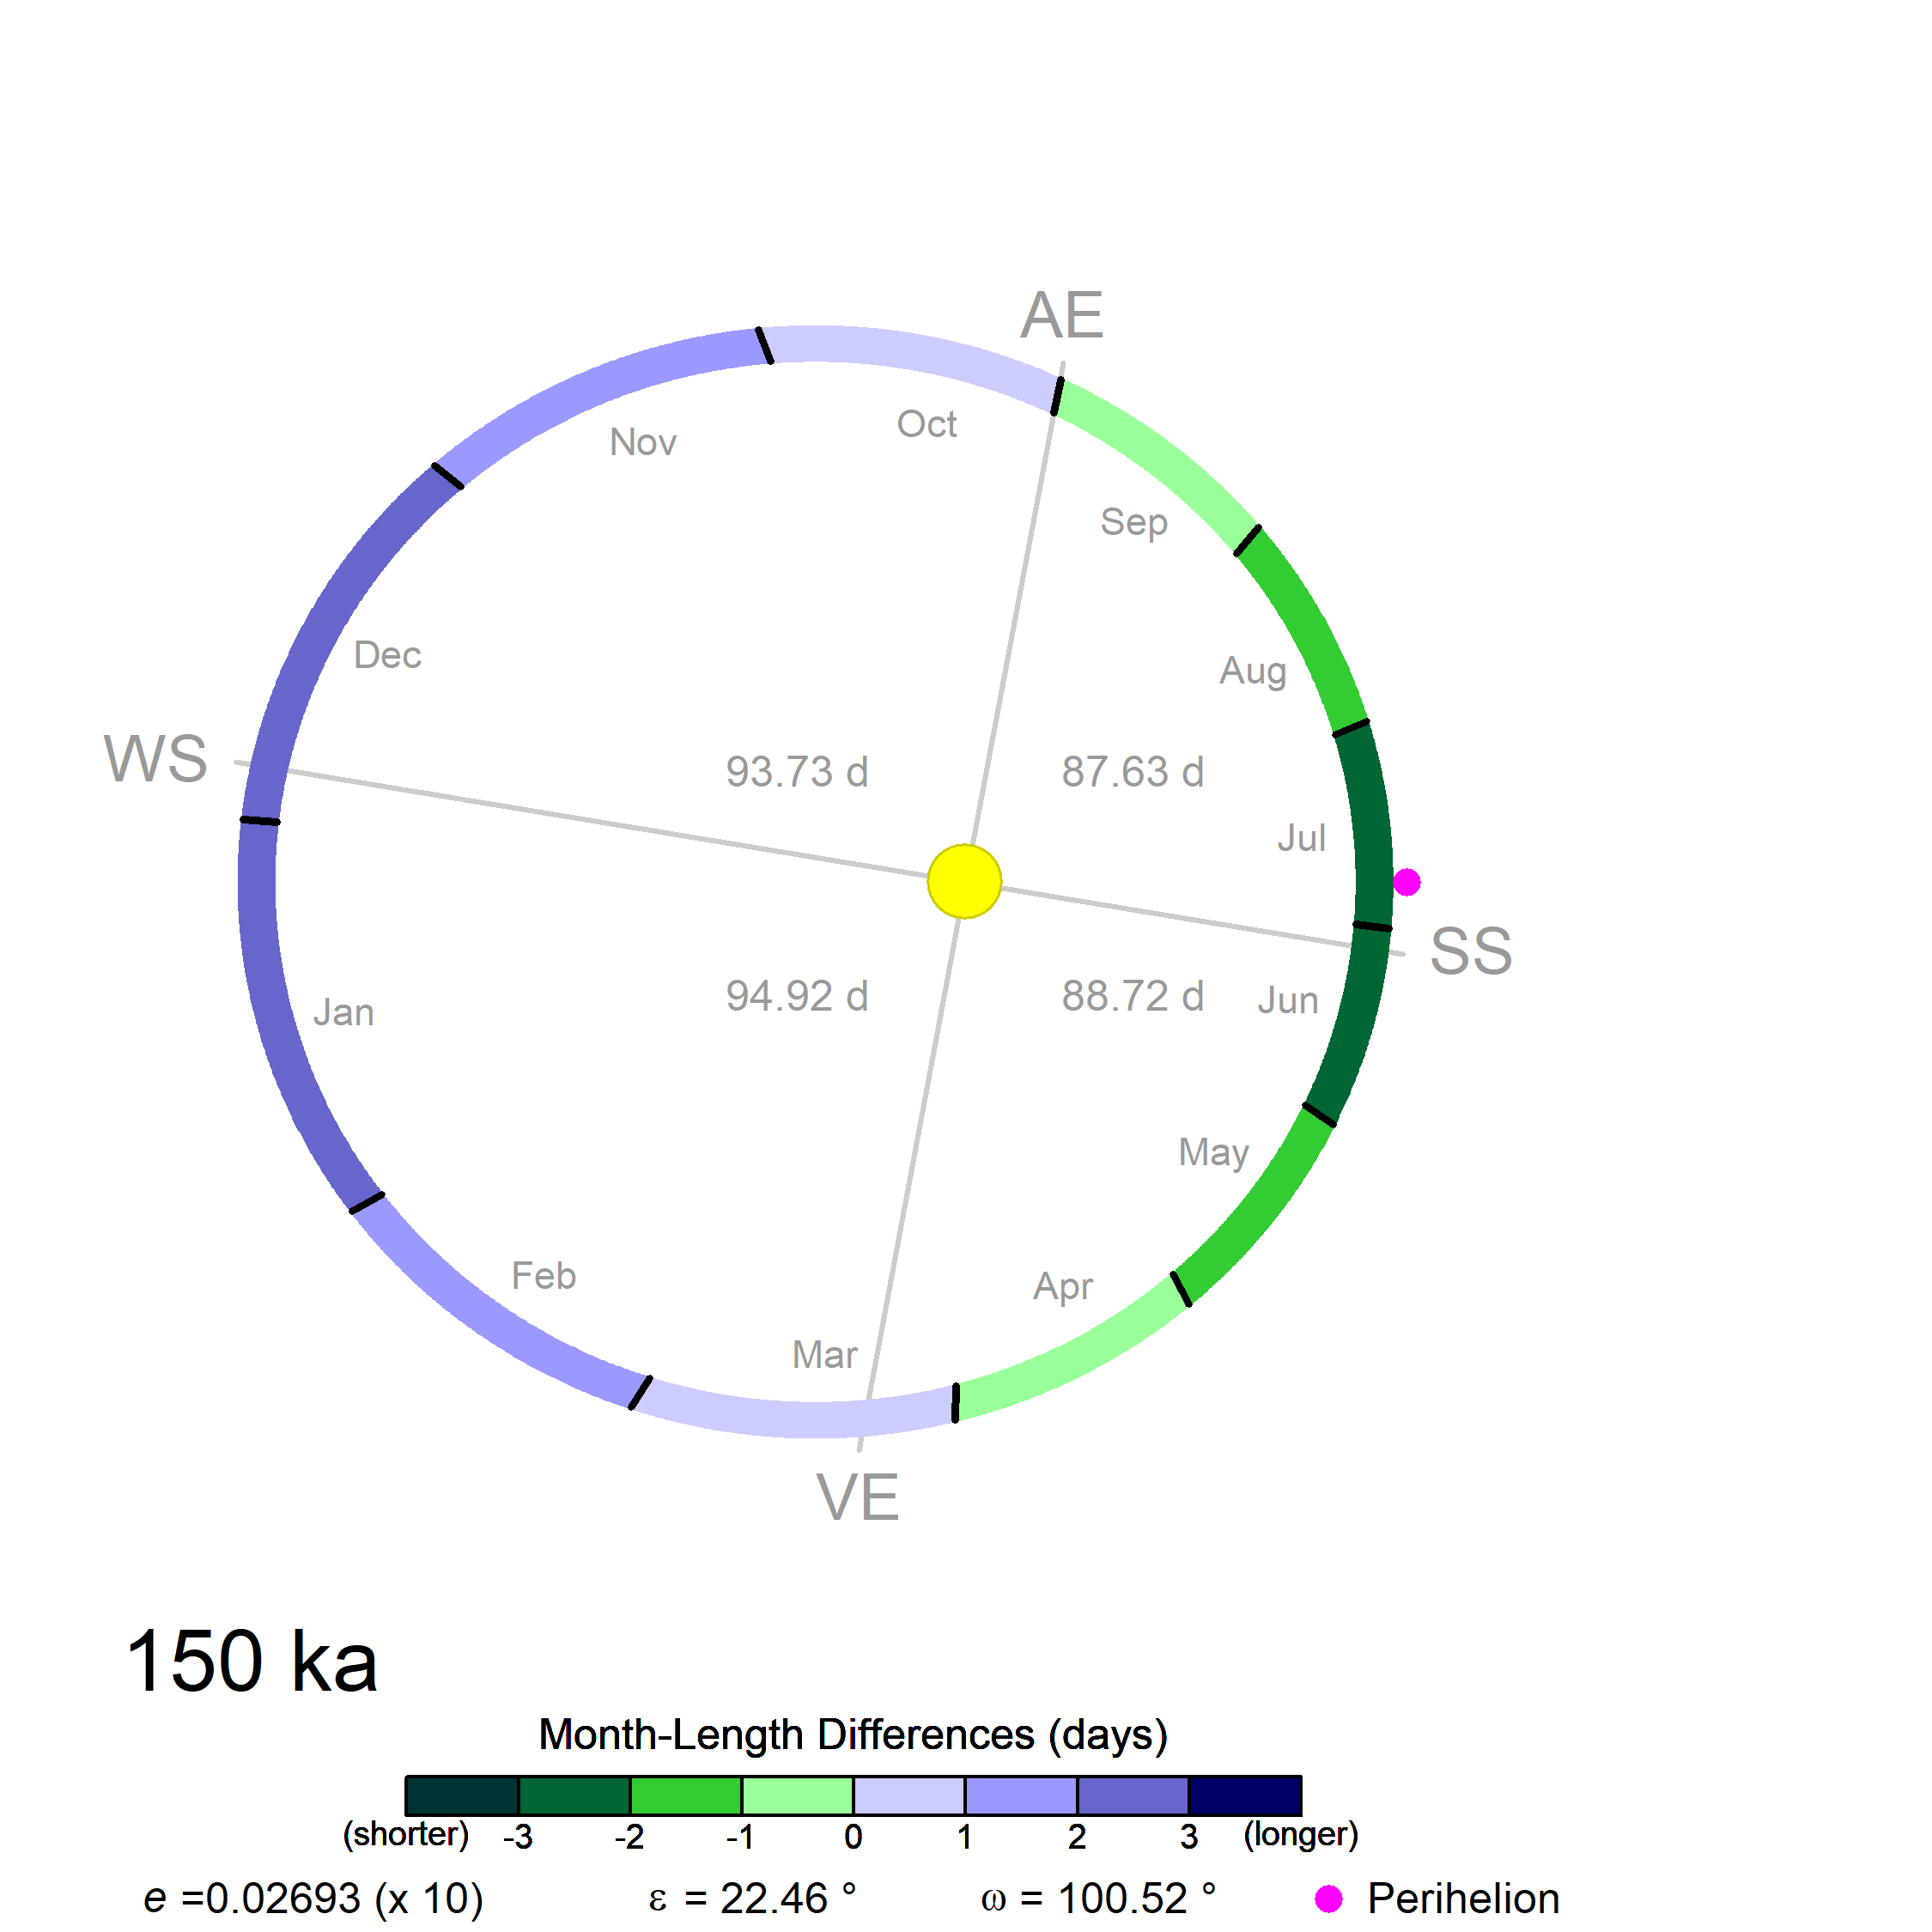

Slide 11
Joussaume & Braconnot (1997)
Berger (1978)
Pollard & Reusch (2002)
Kutzbach & Otto-Bliesner (1982)
Timm et al. (2008)
Kutzbach & Gallimore (1988)
Chen et al. (2011)

Slide 12
Paleo calendar-effect adjustment:
If only monthly (or seasonal) data are available:
1) interpolate to pseudo-daily values, using a “mean-preserving” method
2) reaggregate the pseudo-daily values to months using the appropriate paleo month lengths
If daily data are available:
1) just do the reaggregation step.
Bartlein & Shafer (2019, GMD)

Slide 13
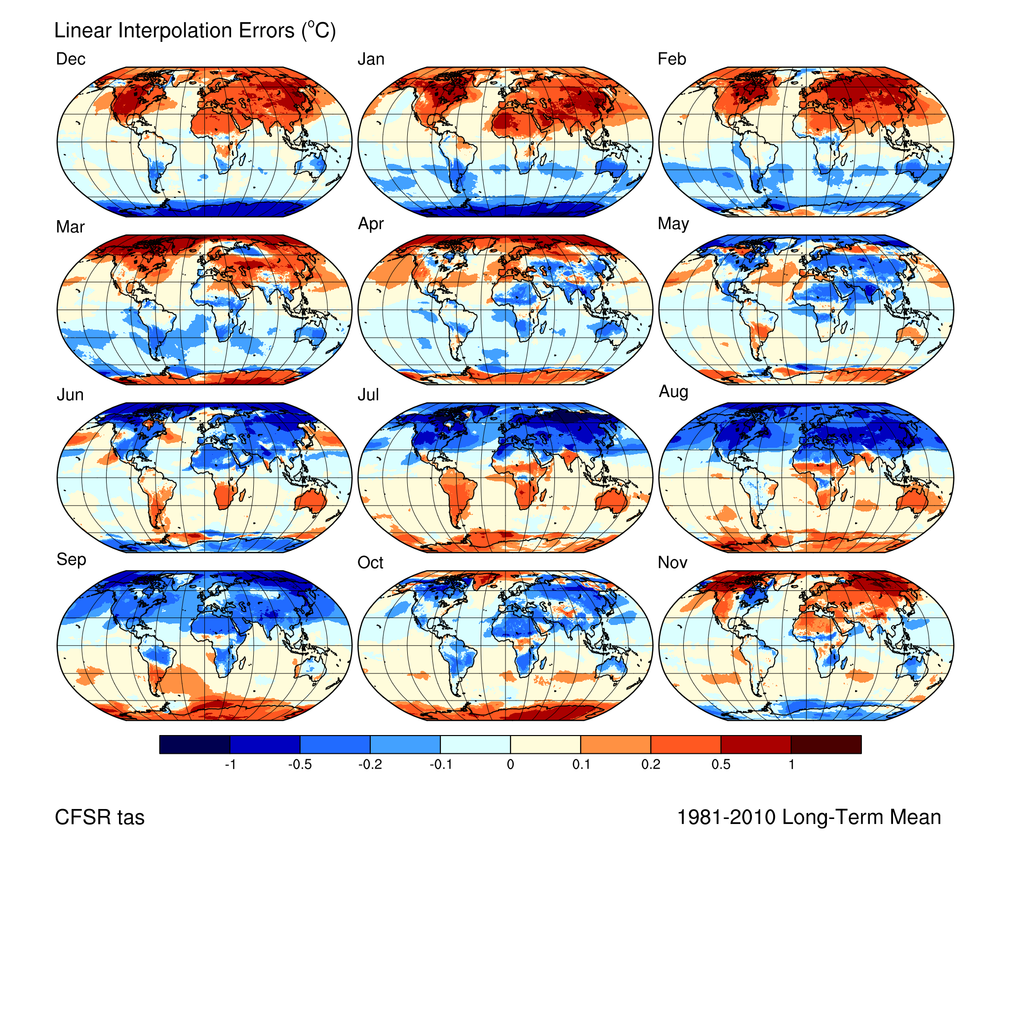
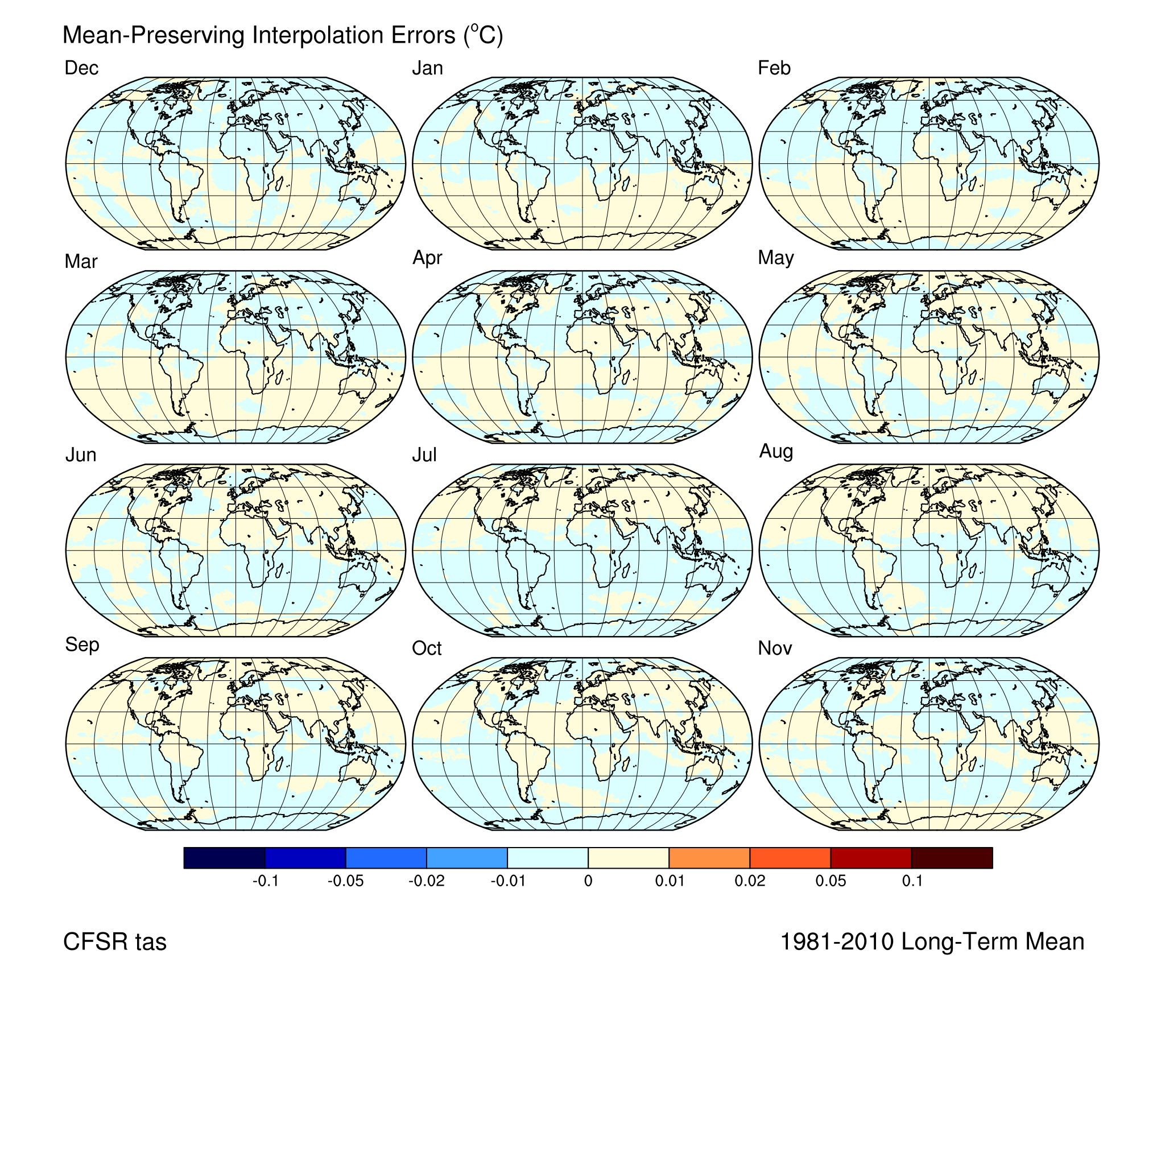
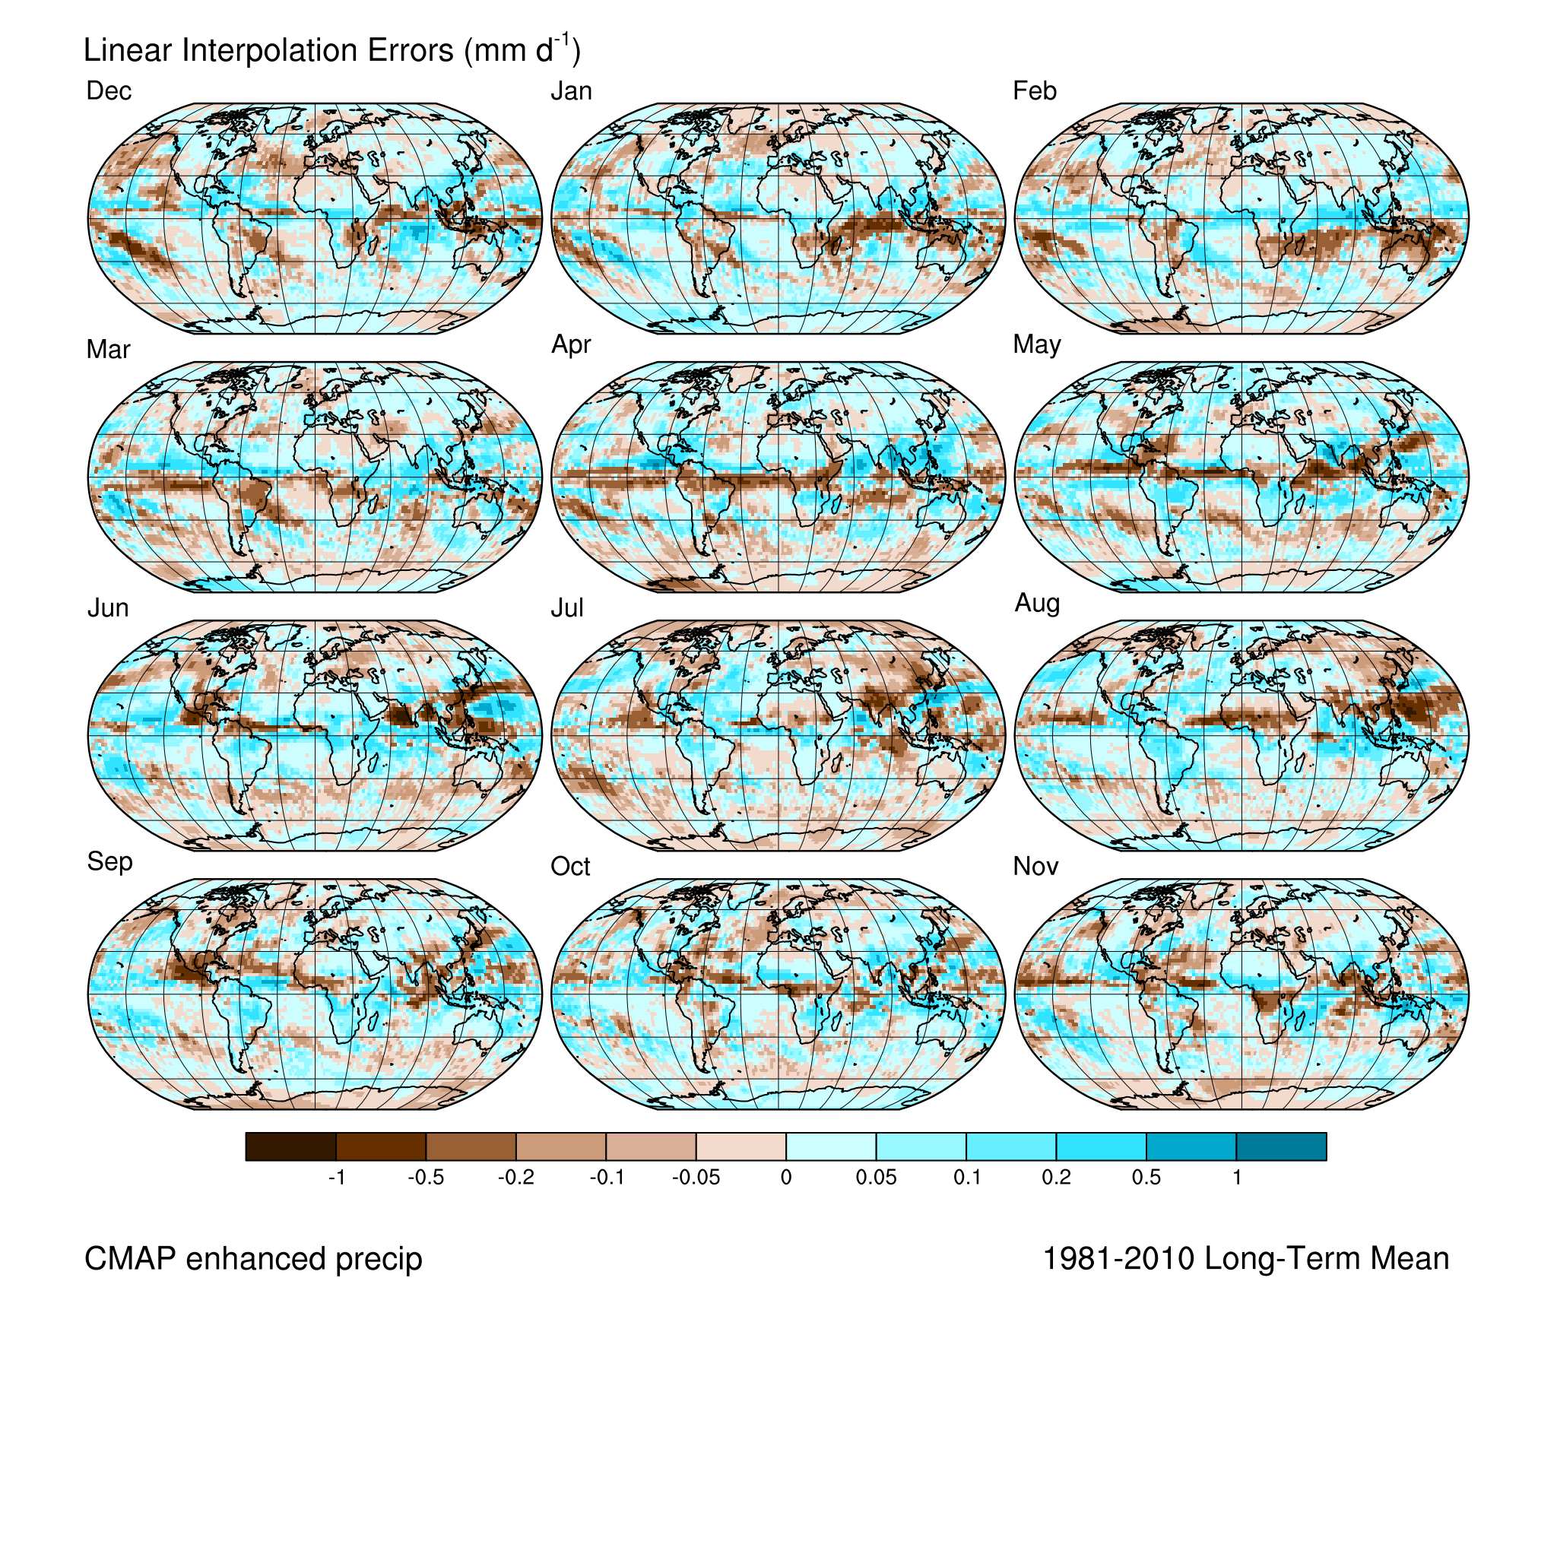
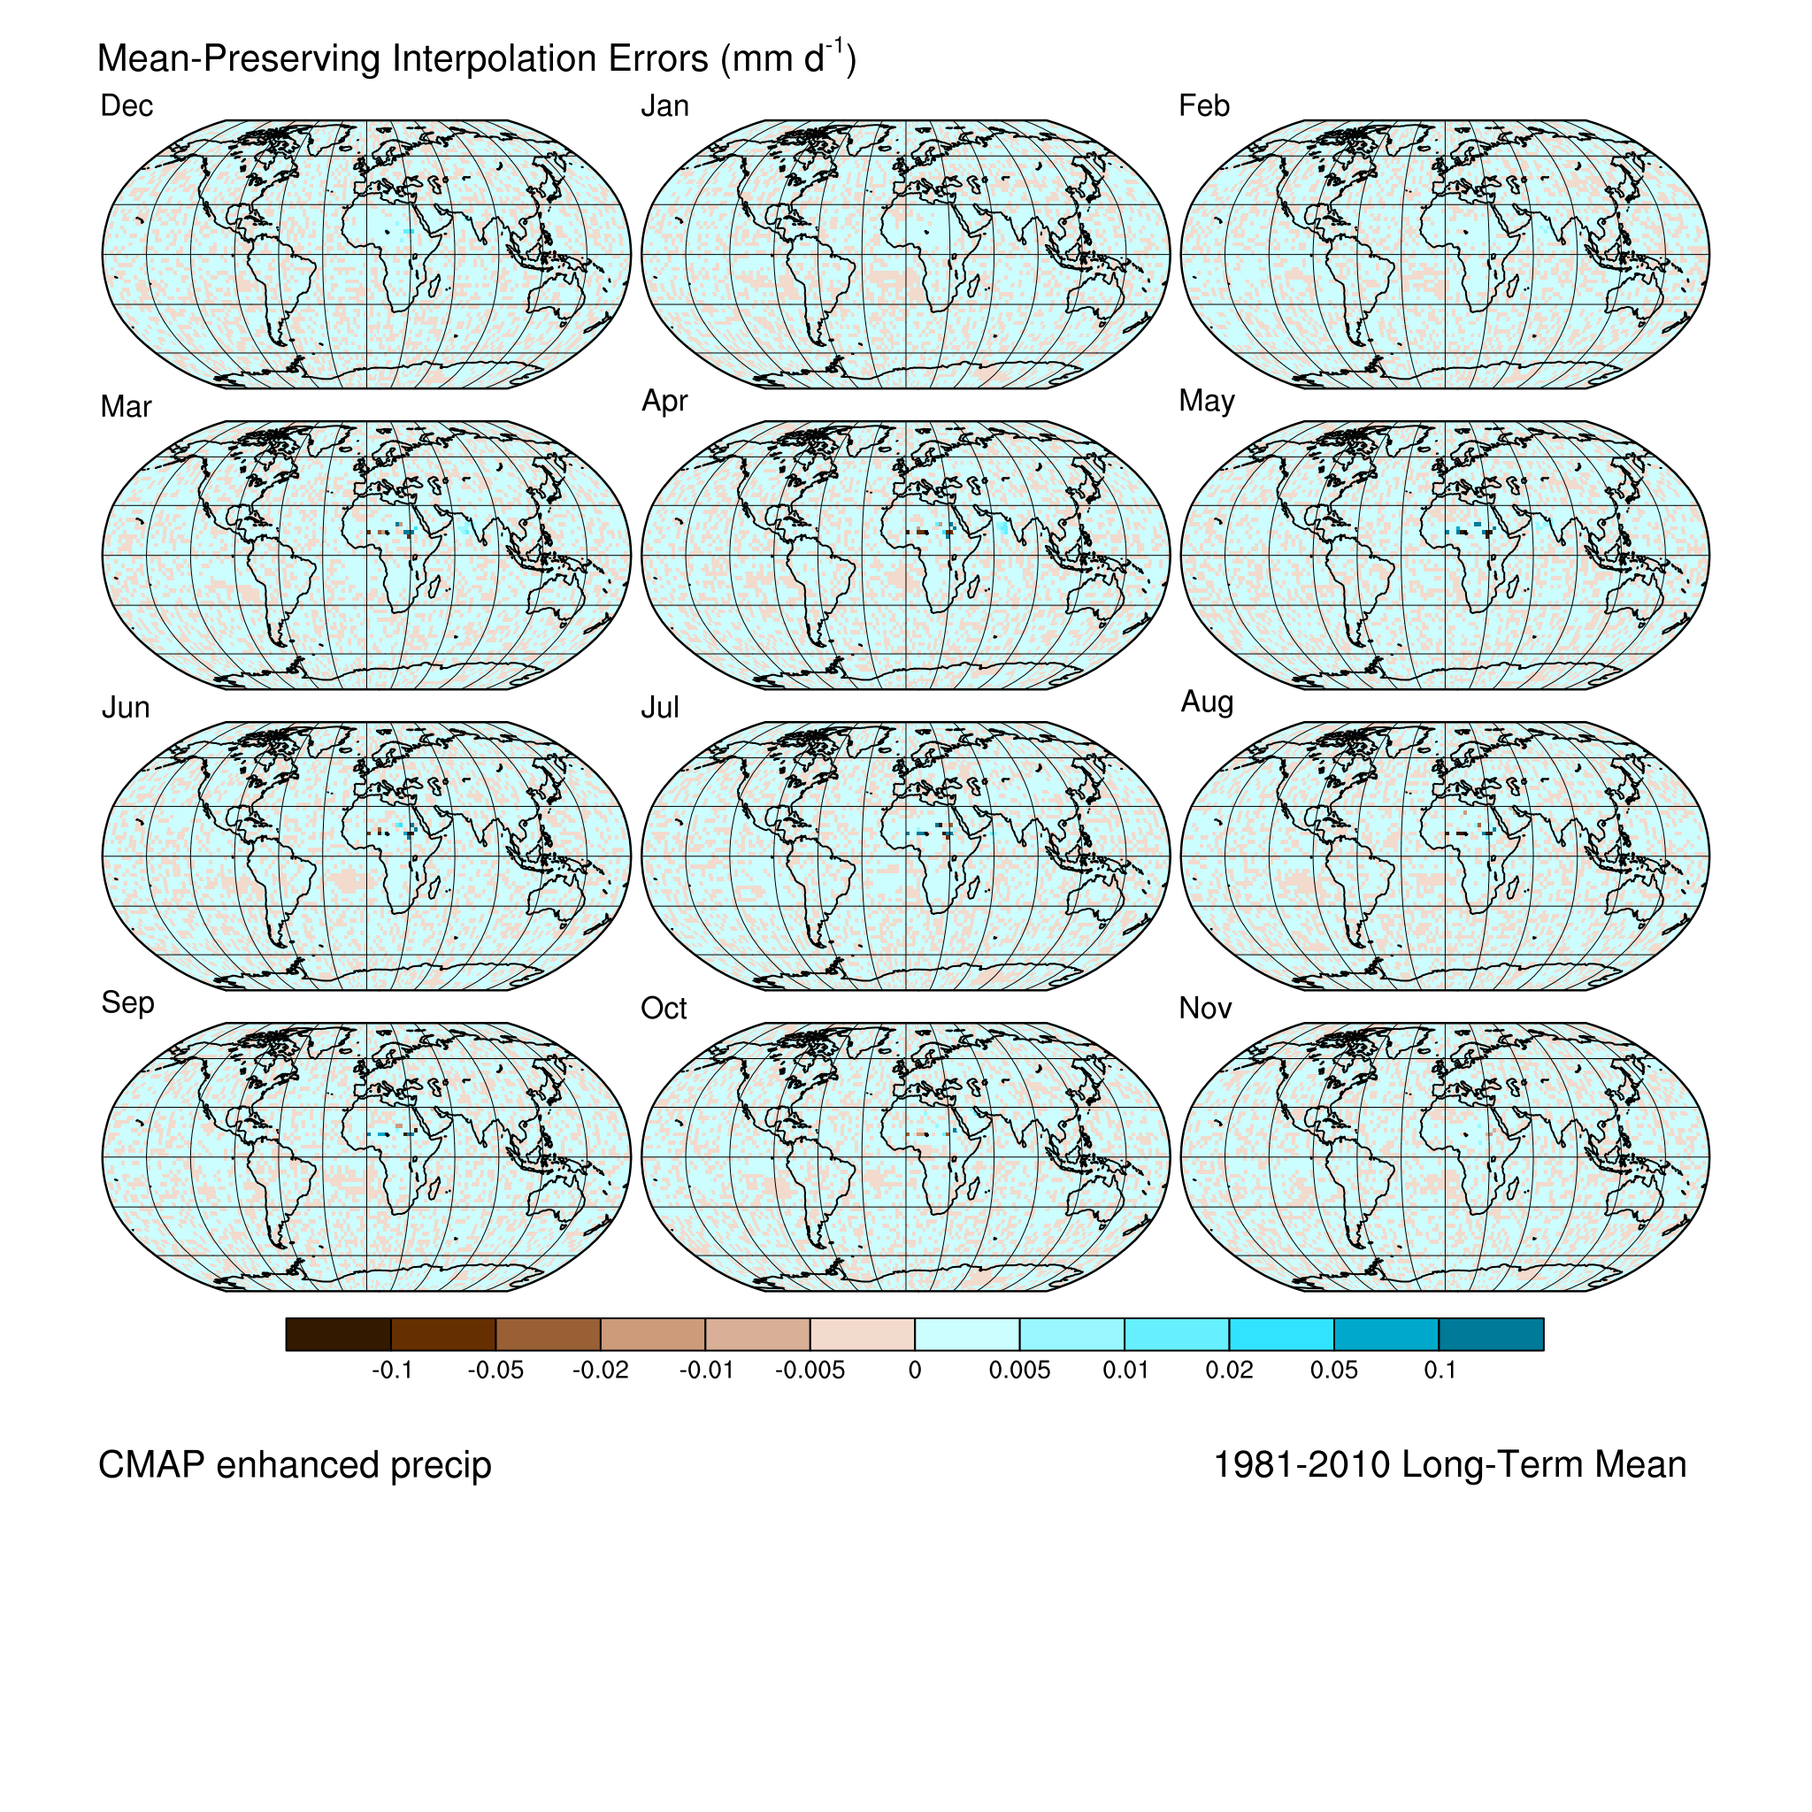
Mean-preserving pseudo-daily interpolation (Epstein, 1991, J. Climate)
Linear interpolation errors
Mean-preserving interpolation errors
CMAP Present-Day Precipitation CFSR Present-Day Temperature
-1 to +1 -0.1 to +0.1
-1 to +1 -0.1 to +0.1

Slide 14
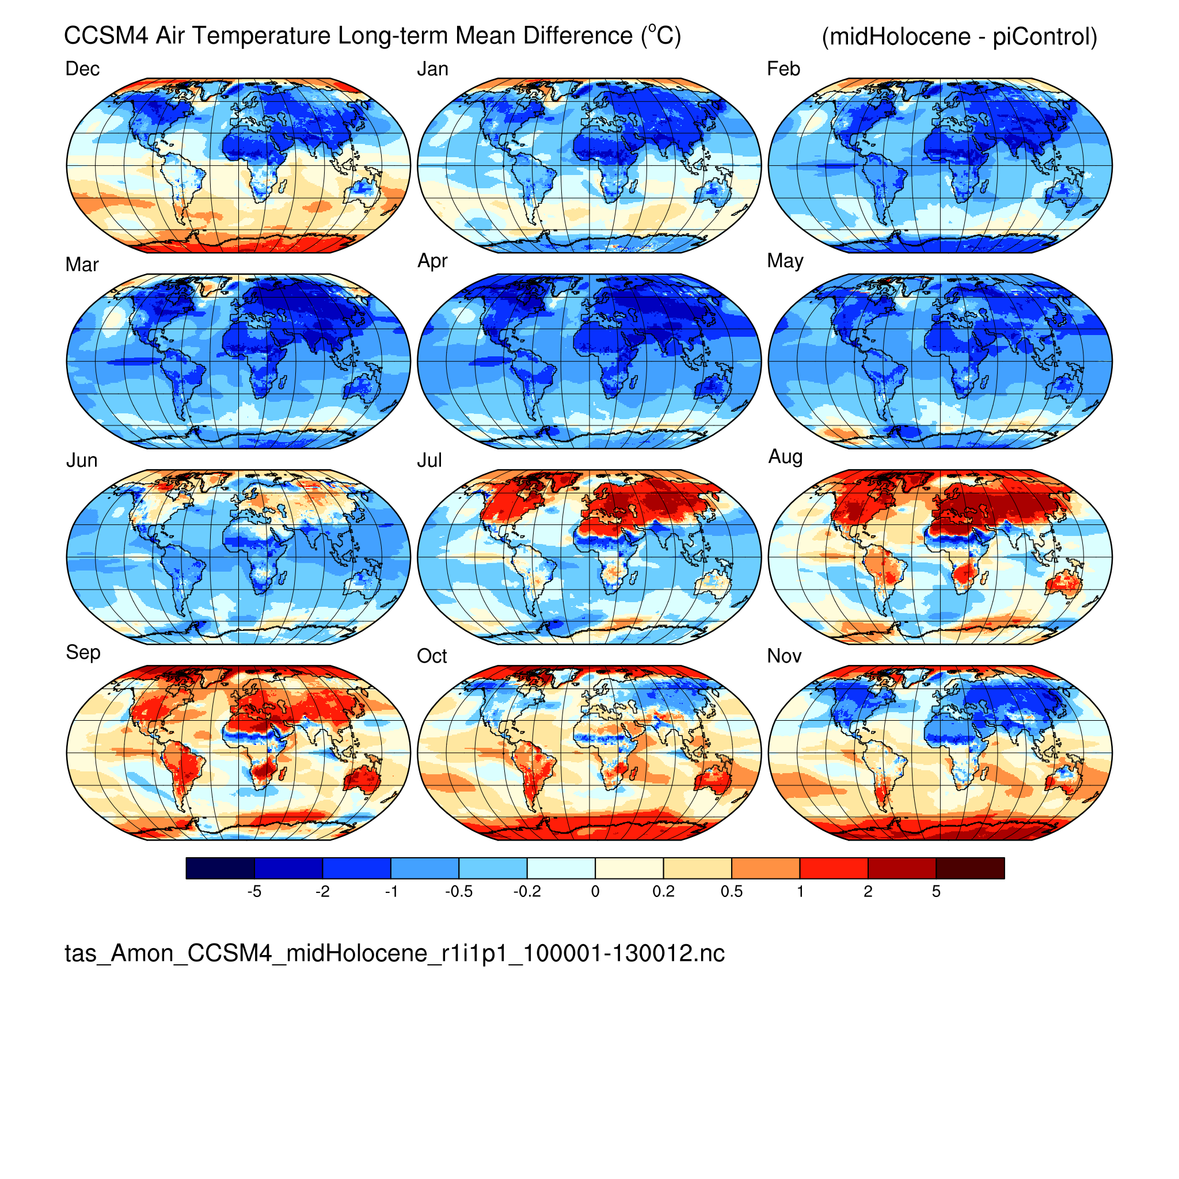
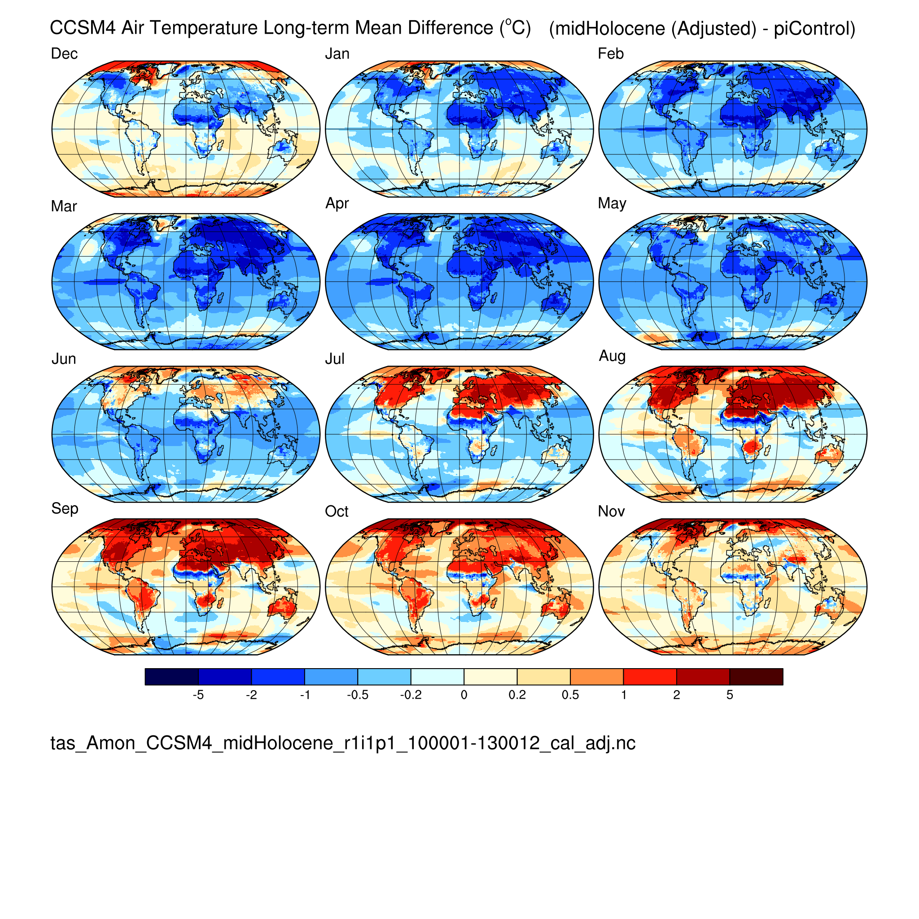
Near-surface air temperature (tas) CCSM4 midHolocene (6 ka)
(not adjusted) (adjusted)

Slide 15
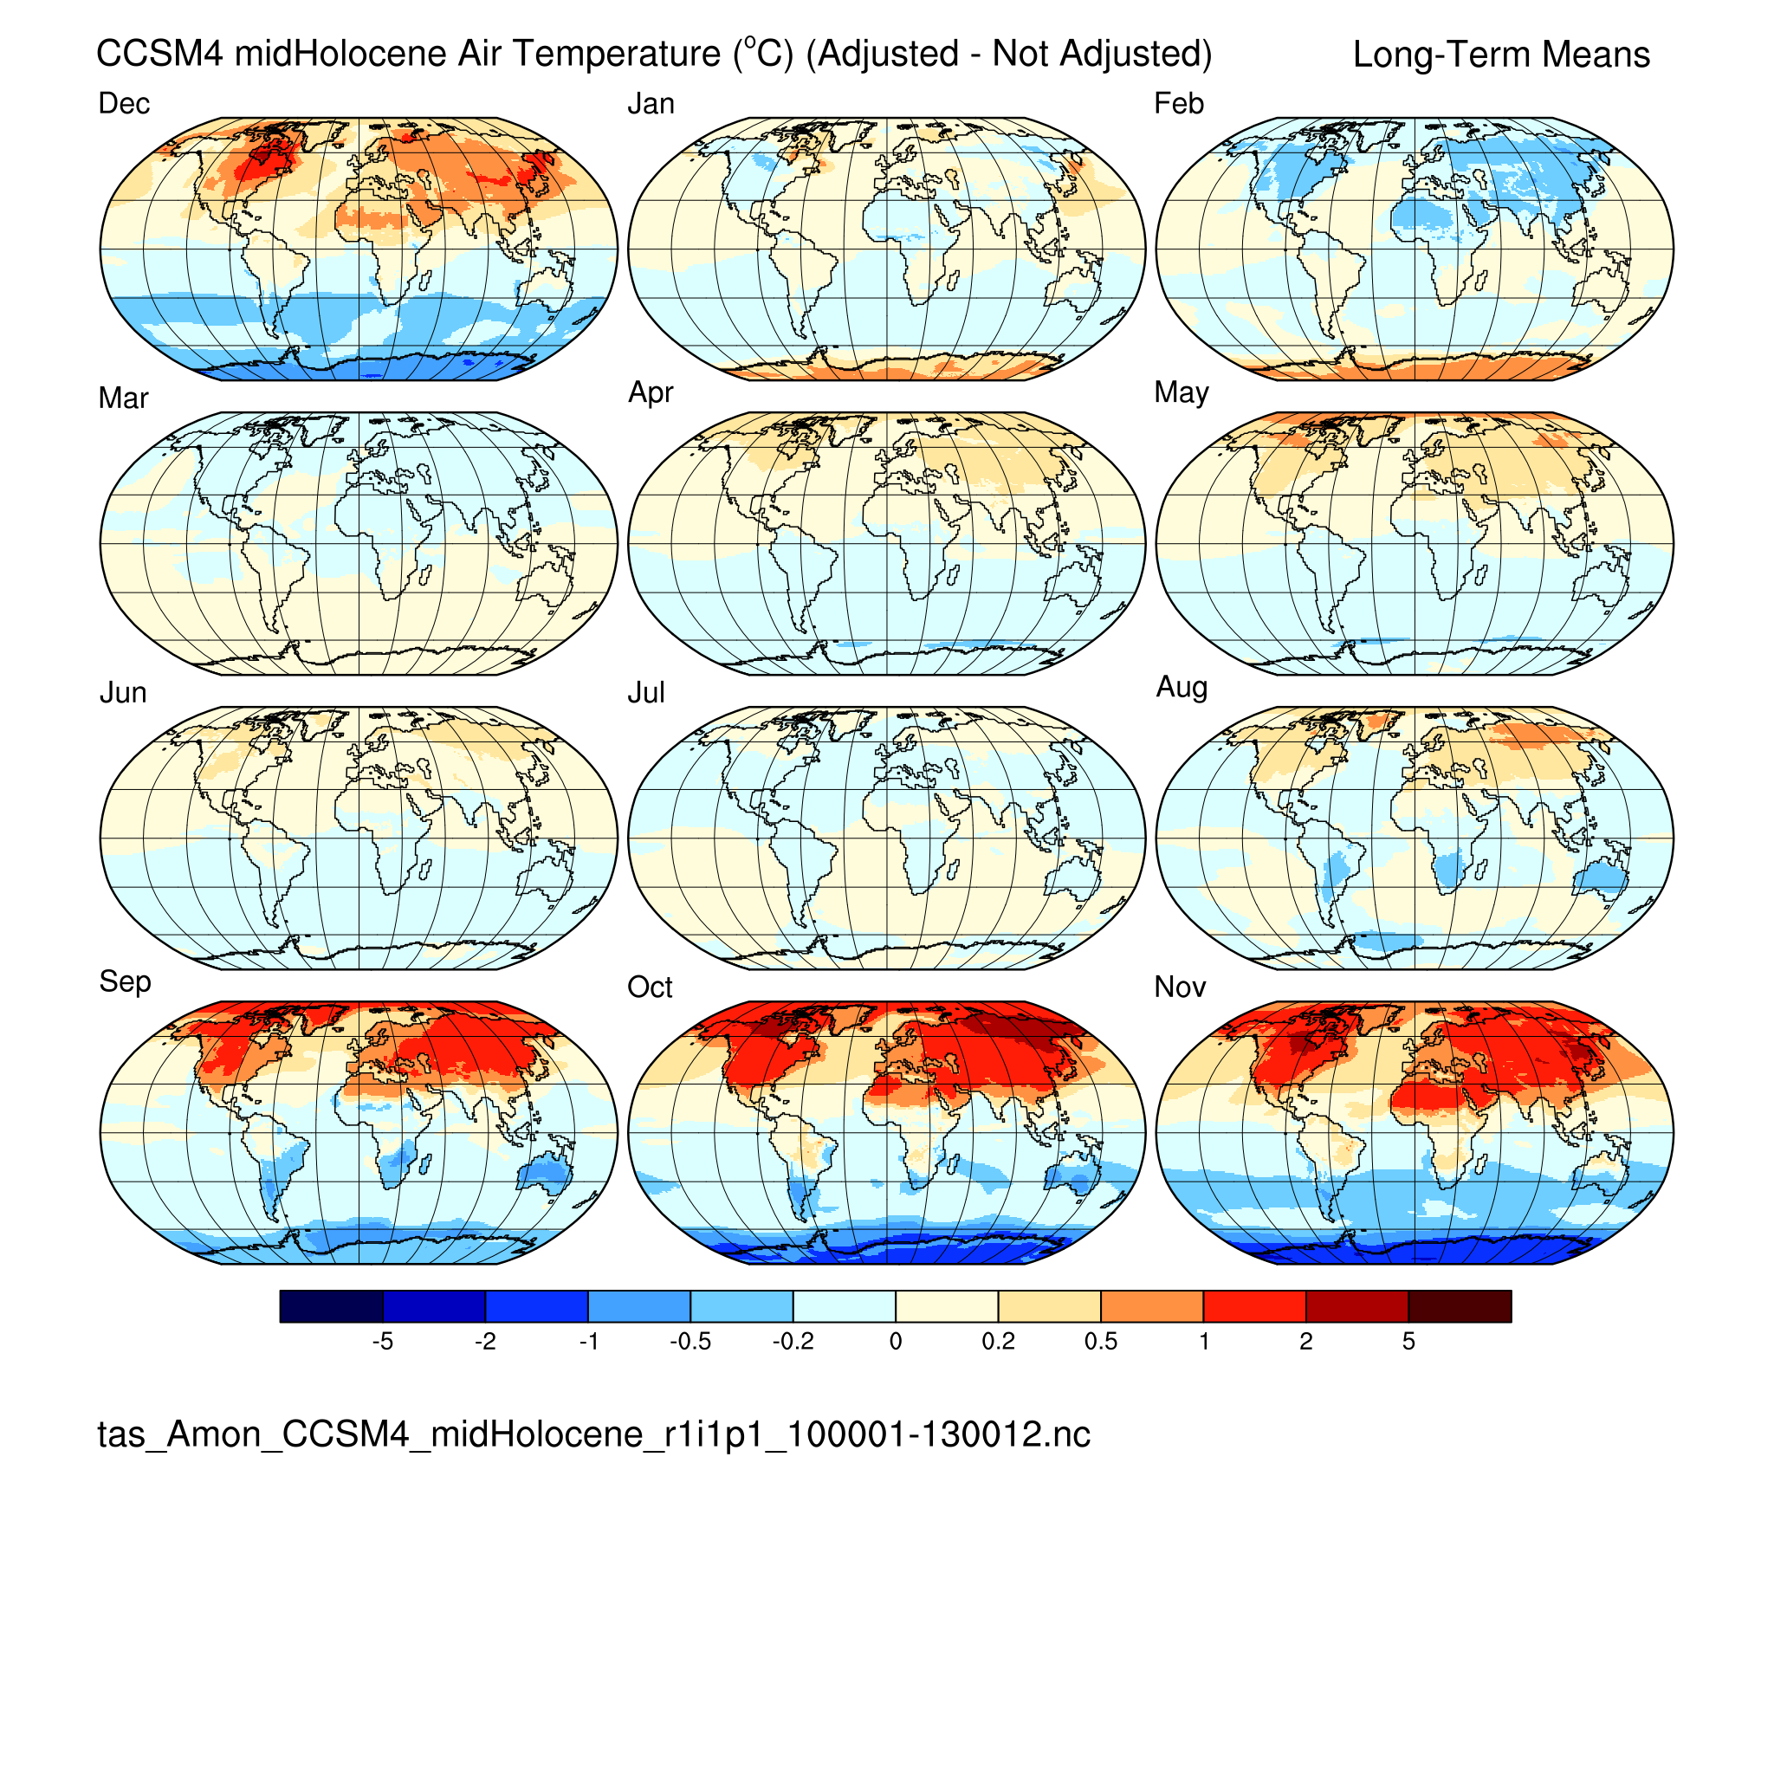
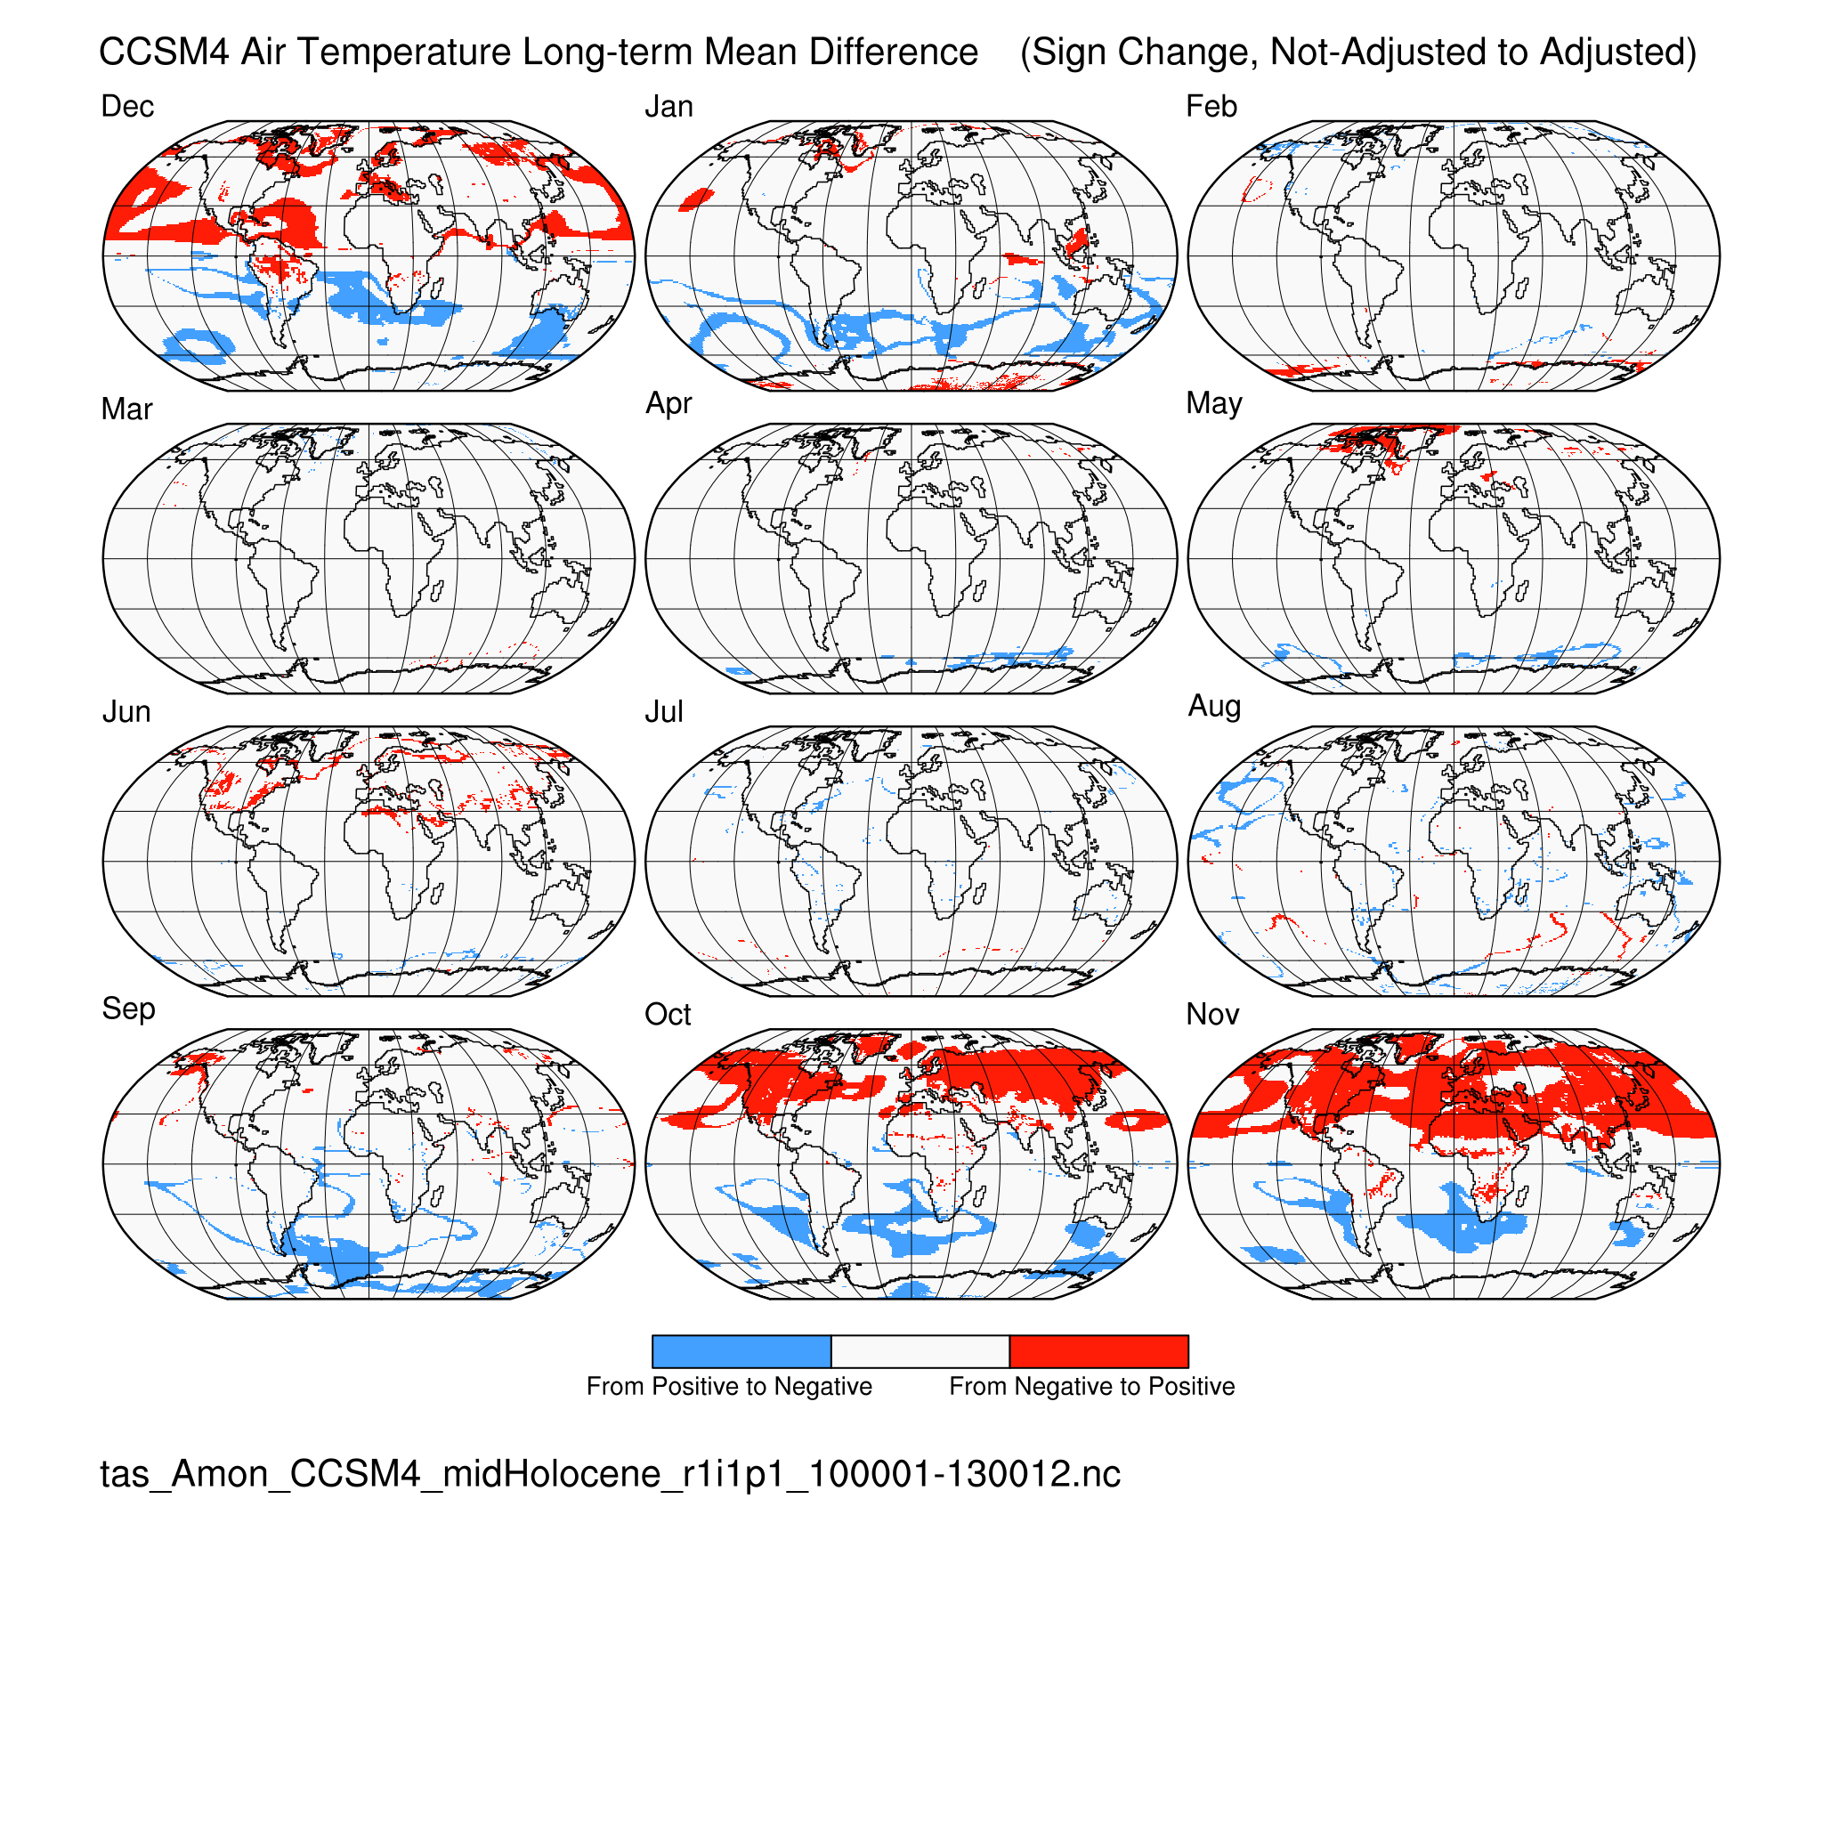
Near-surface air temperature (tas) CCSM4 midHolocene (6 ka)
Calendar Effect: (difference) (sign change)

Slide 16
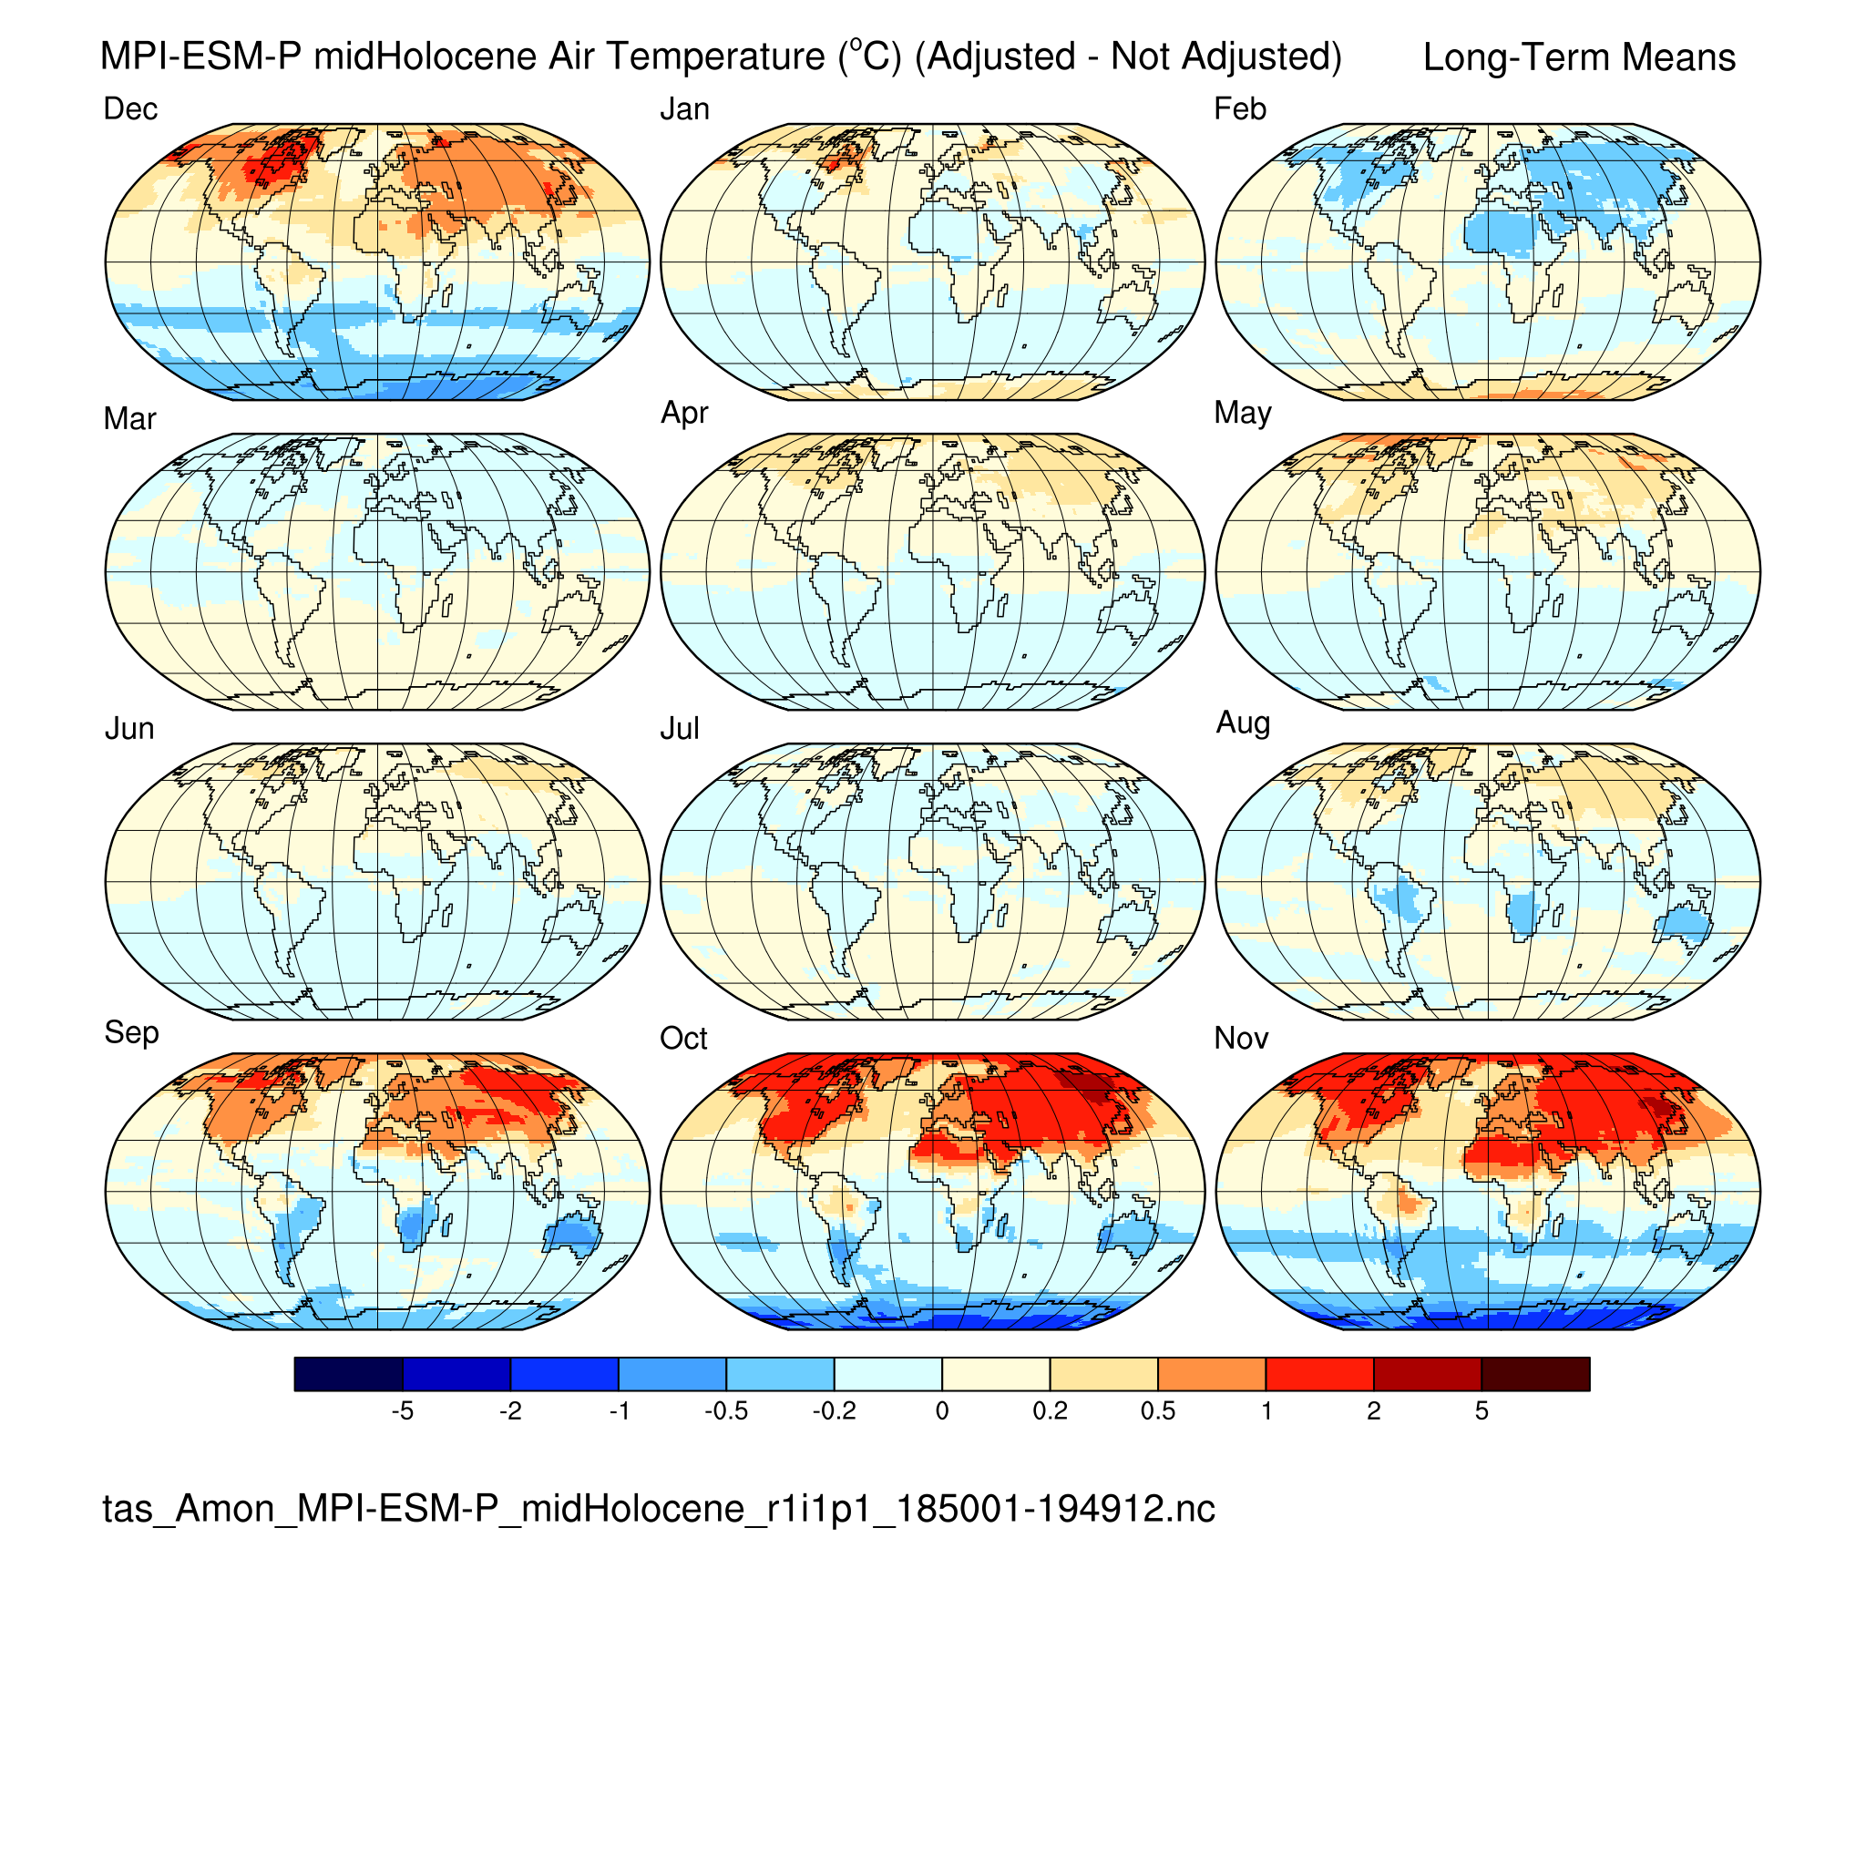
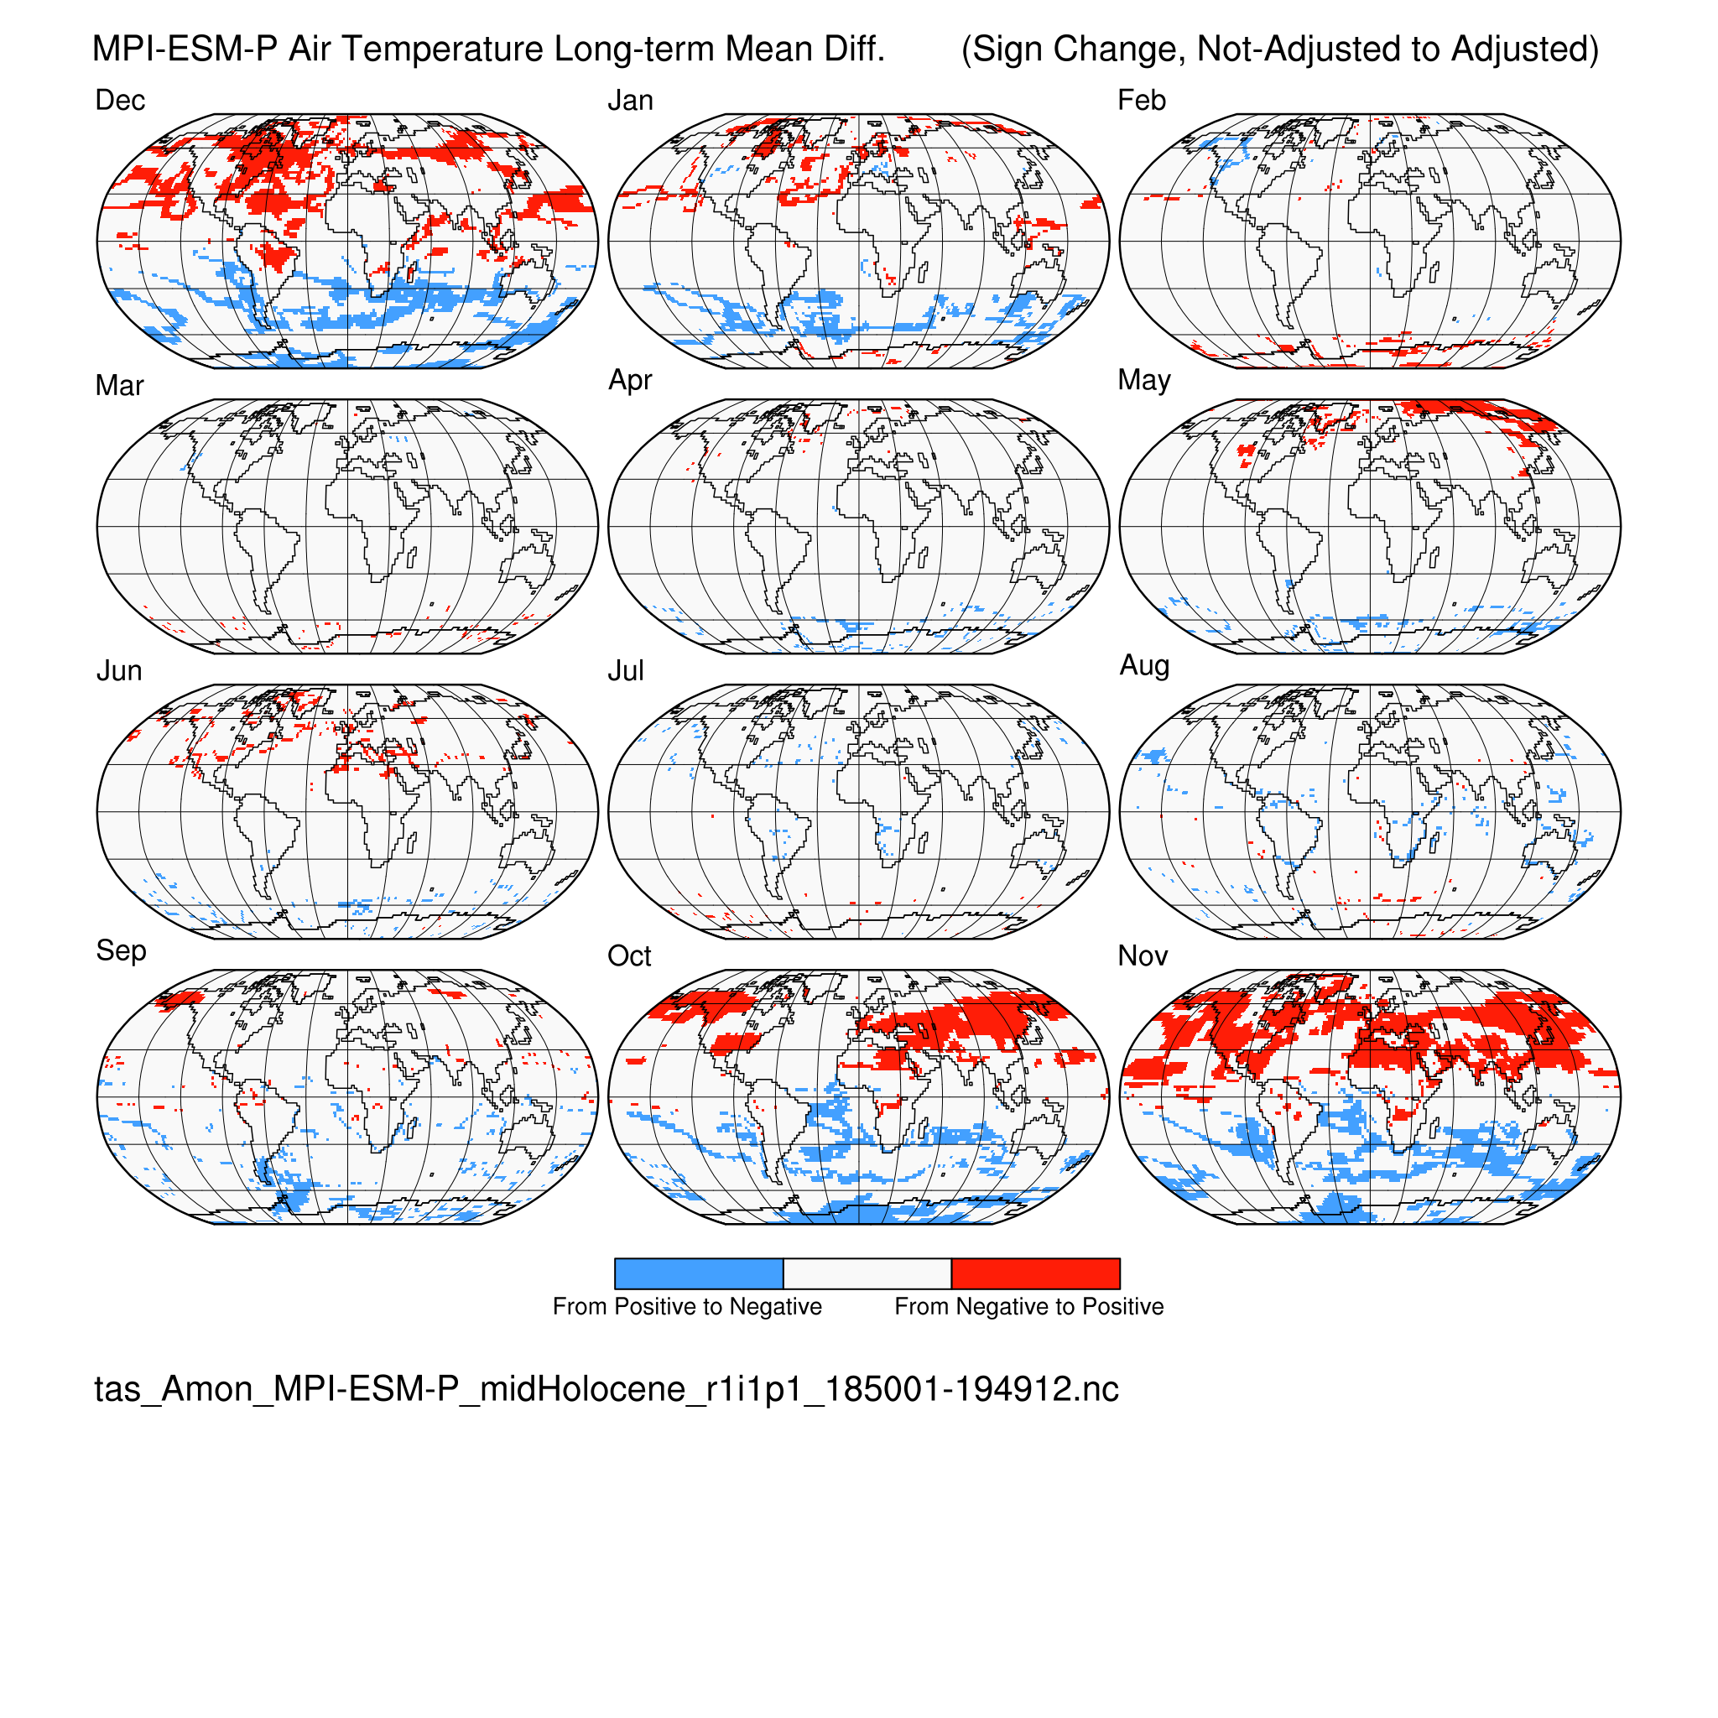
Near-surface air temperature (tas) MPI-ESM-P midHolocene (6 ka)
Calendar Effect: (difference) (sign change)

Slide 17
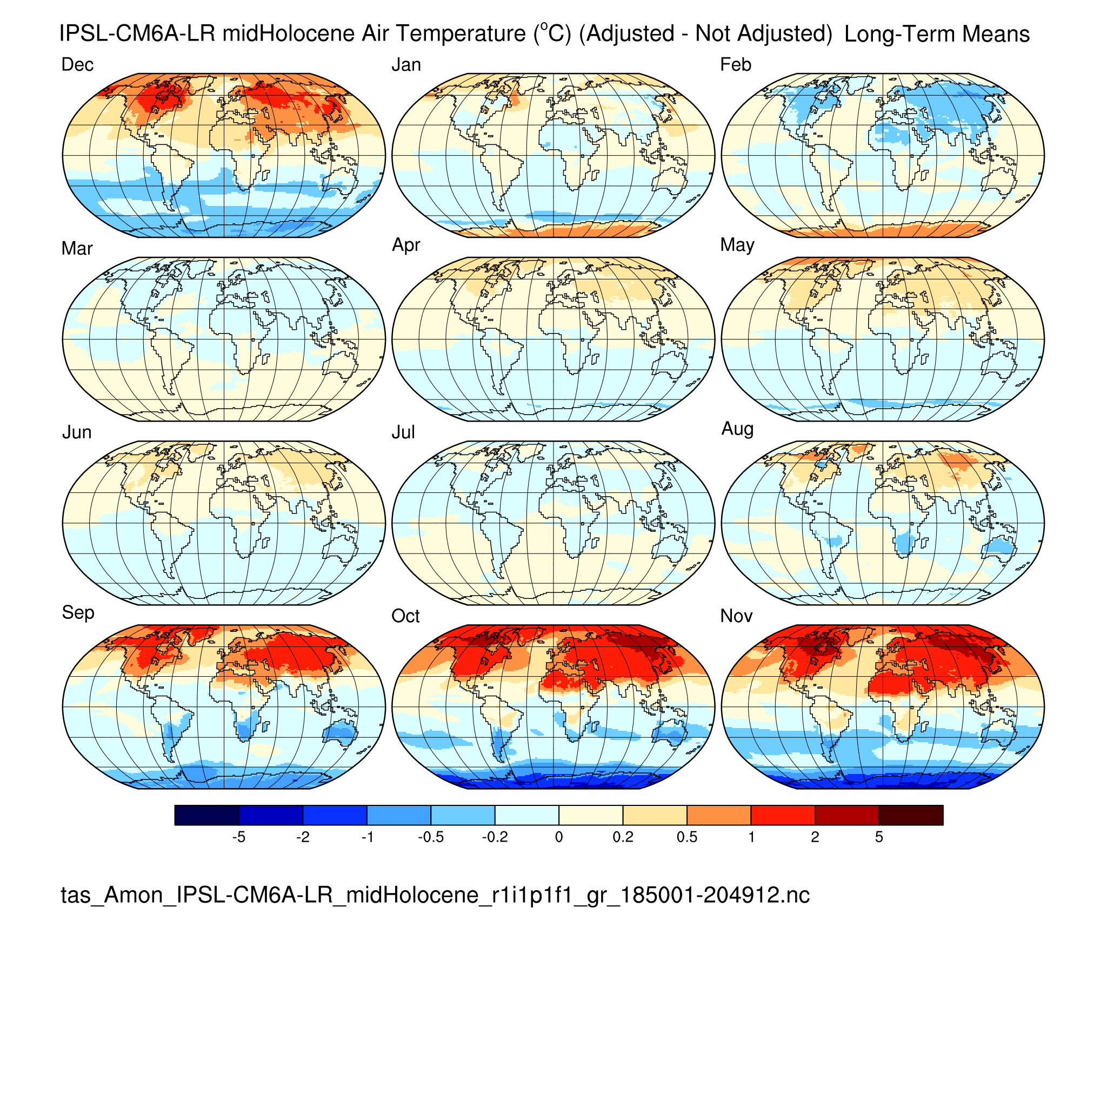
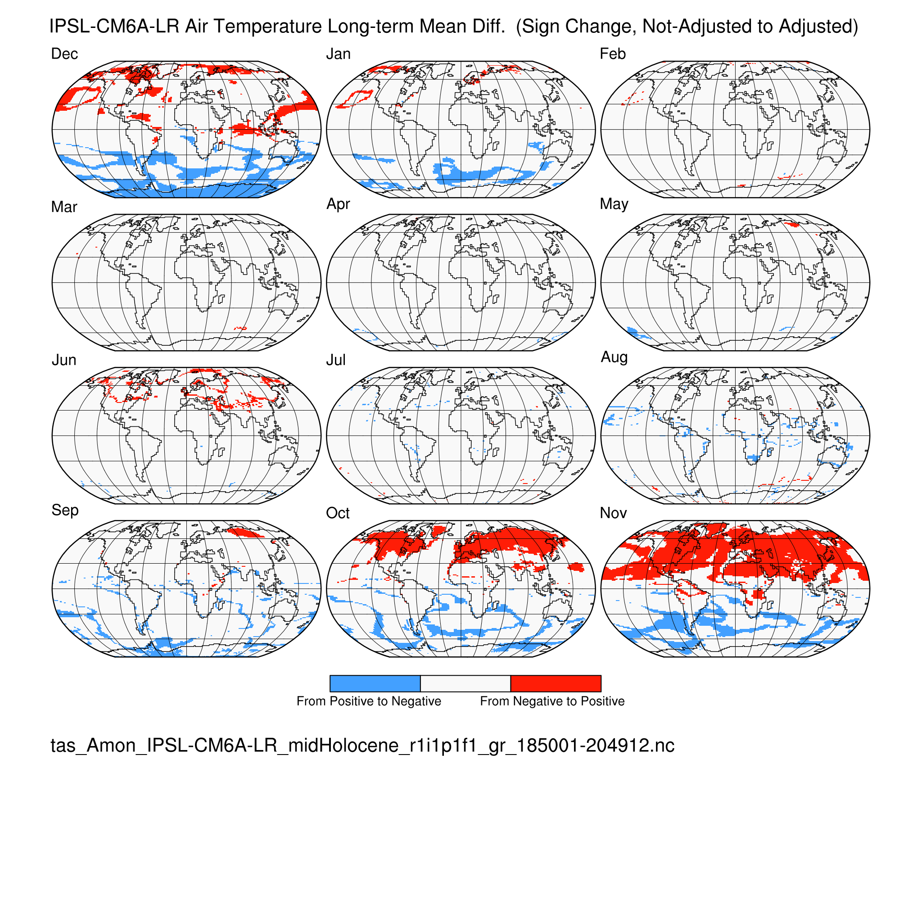
Near-surface air temperature (tas) IPSL-CM6A-LR midHolocene (6 ka)
Calendar Effect: (difference) (sign change)

Slide 18
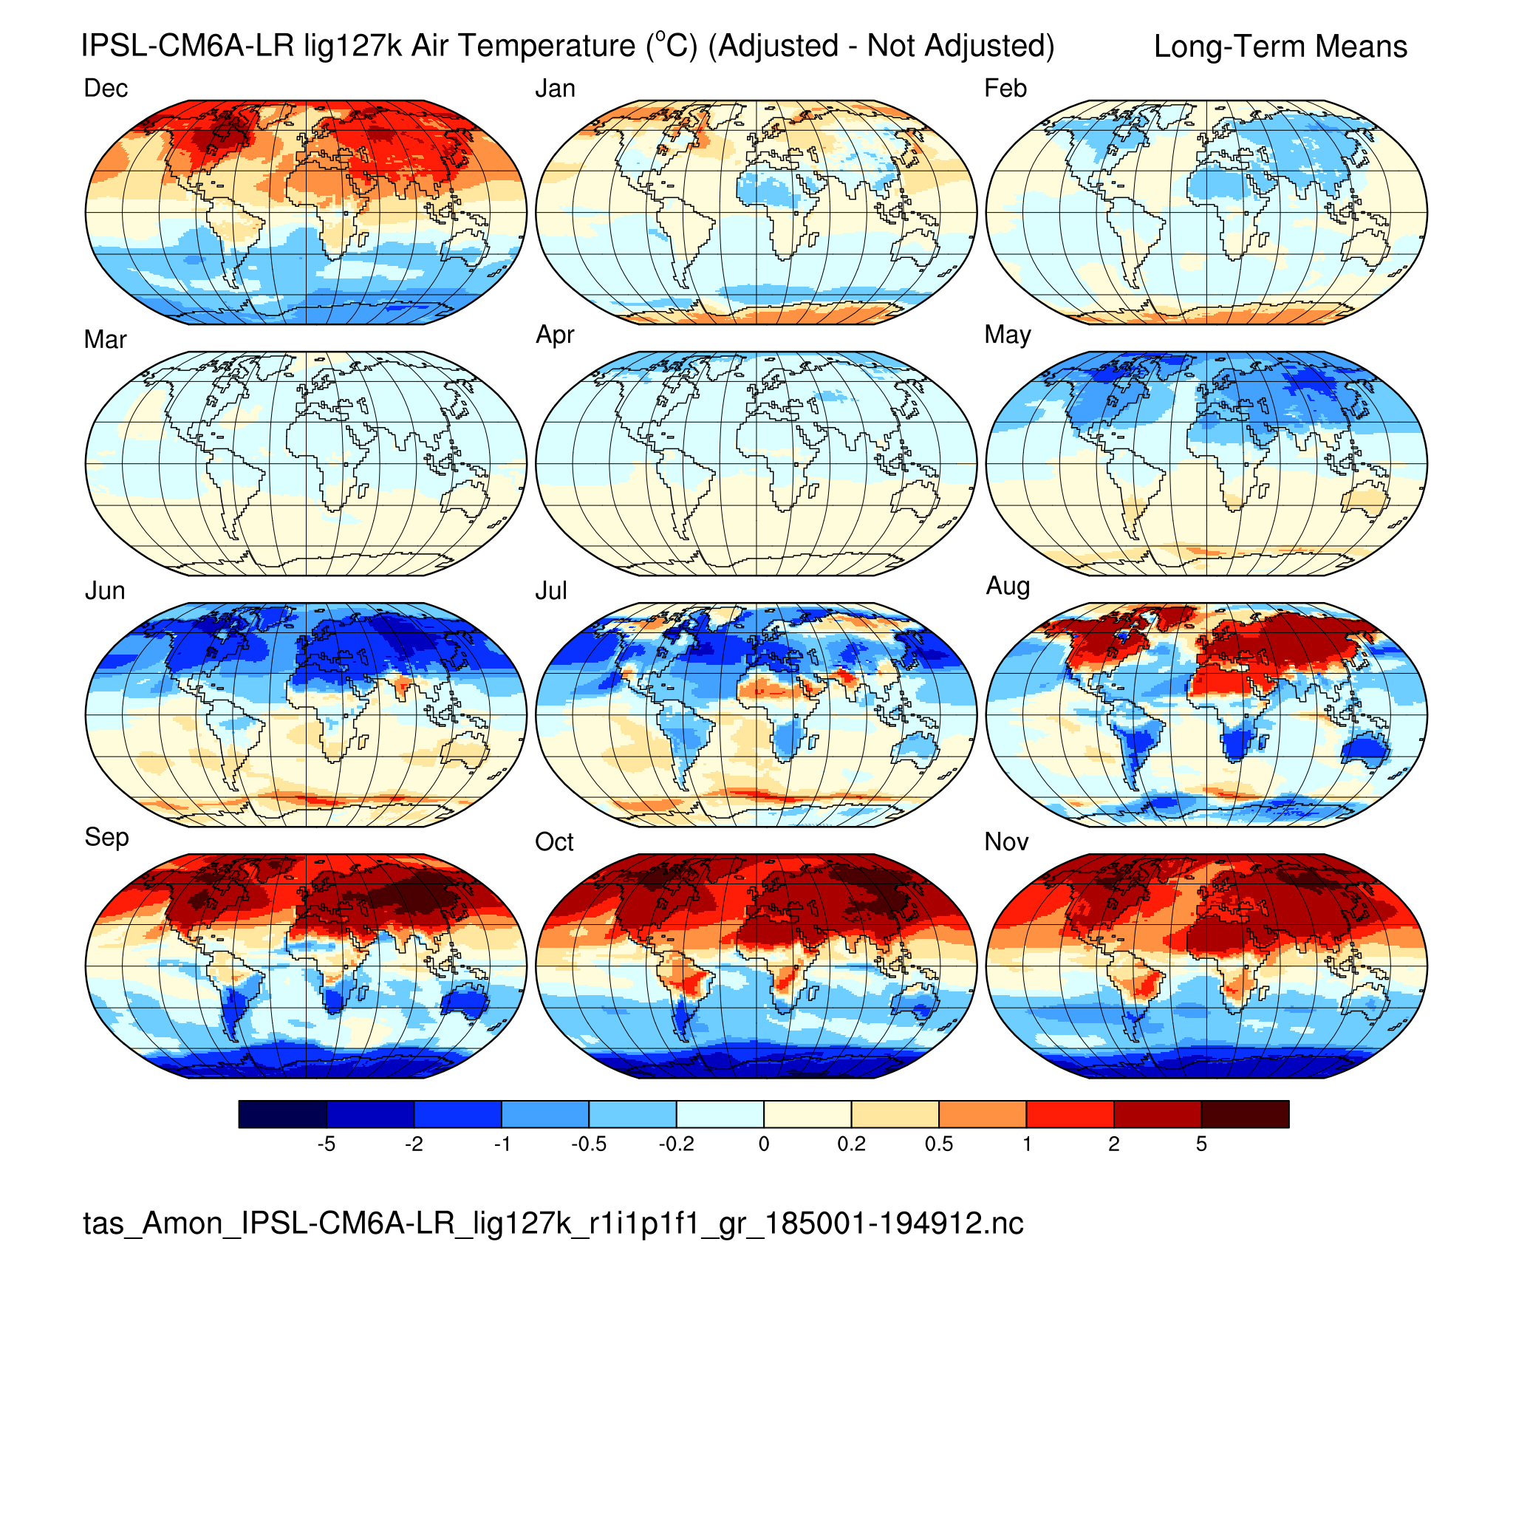
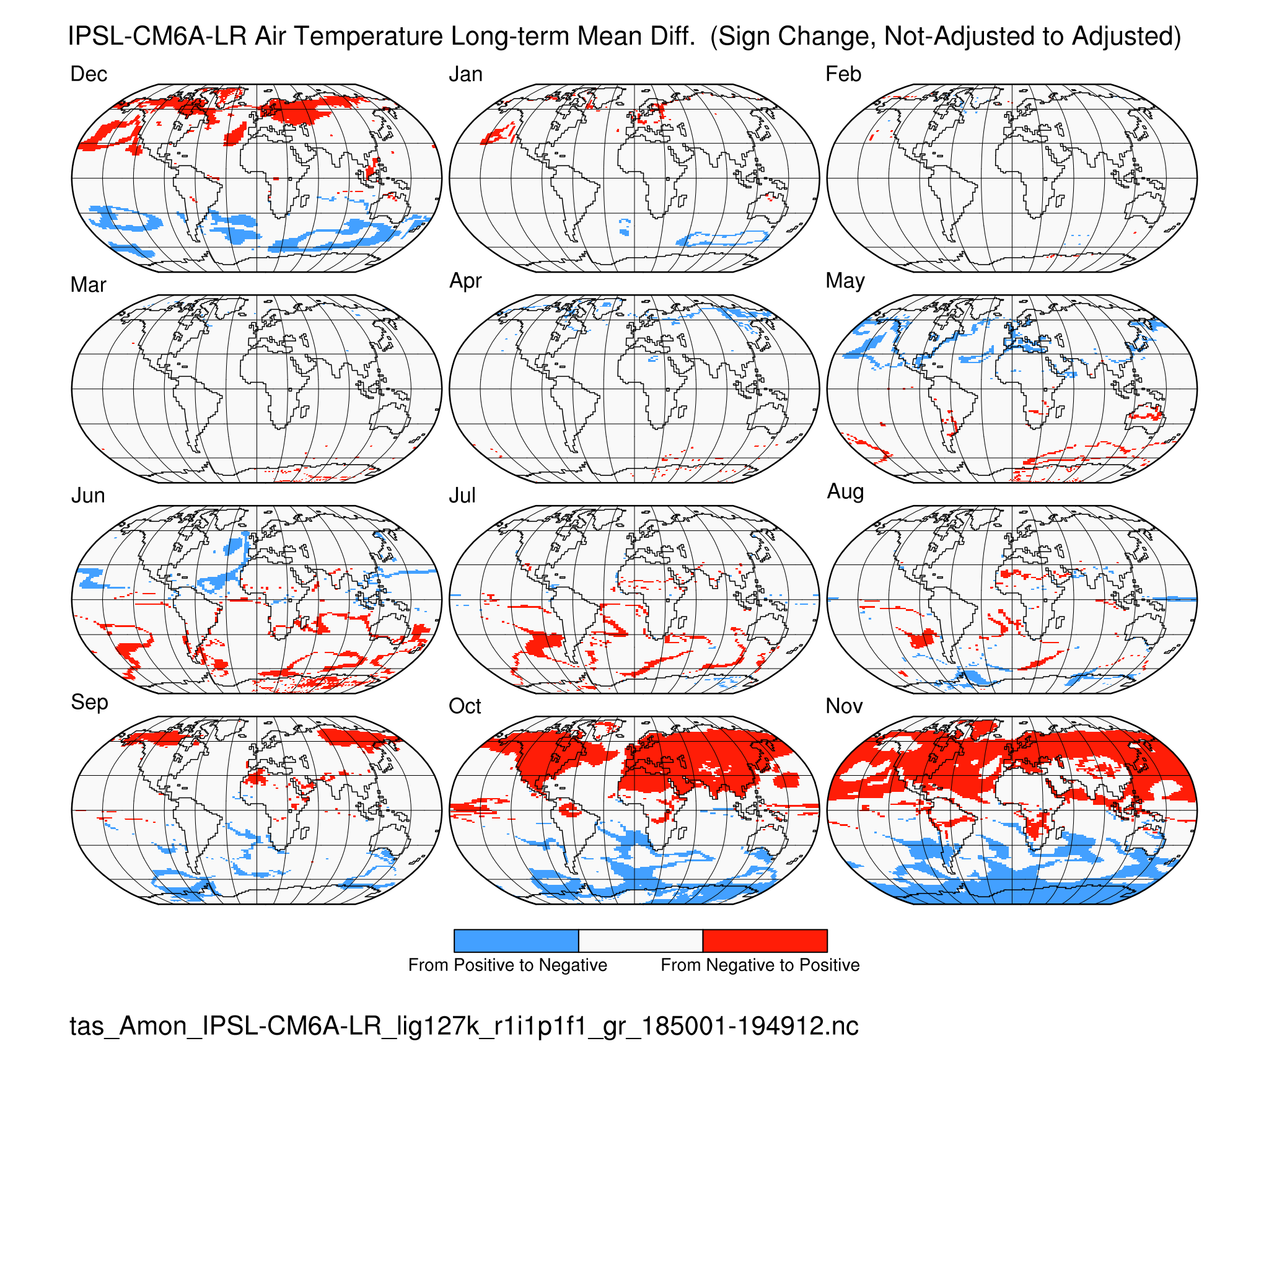
Near-surface air temperature (tas) IPSL-CM6A-LR lig127k (127 ka)
Calendar Effect: (difference) (sign change)
Main effect on temperature: interhemispheric and continent-ocean contrasts

Slide 19
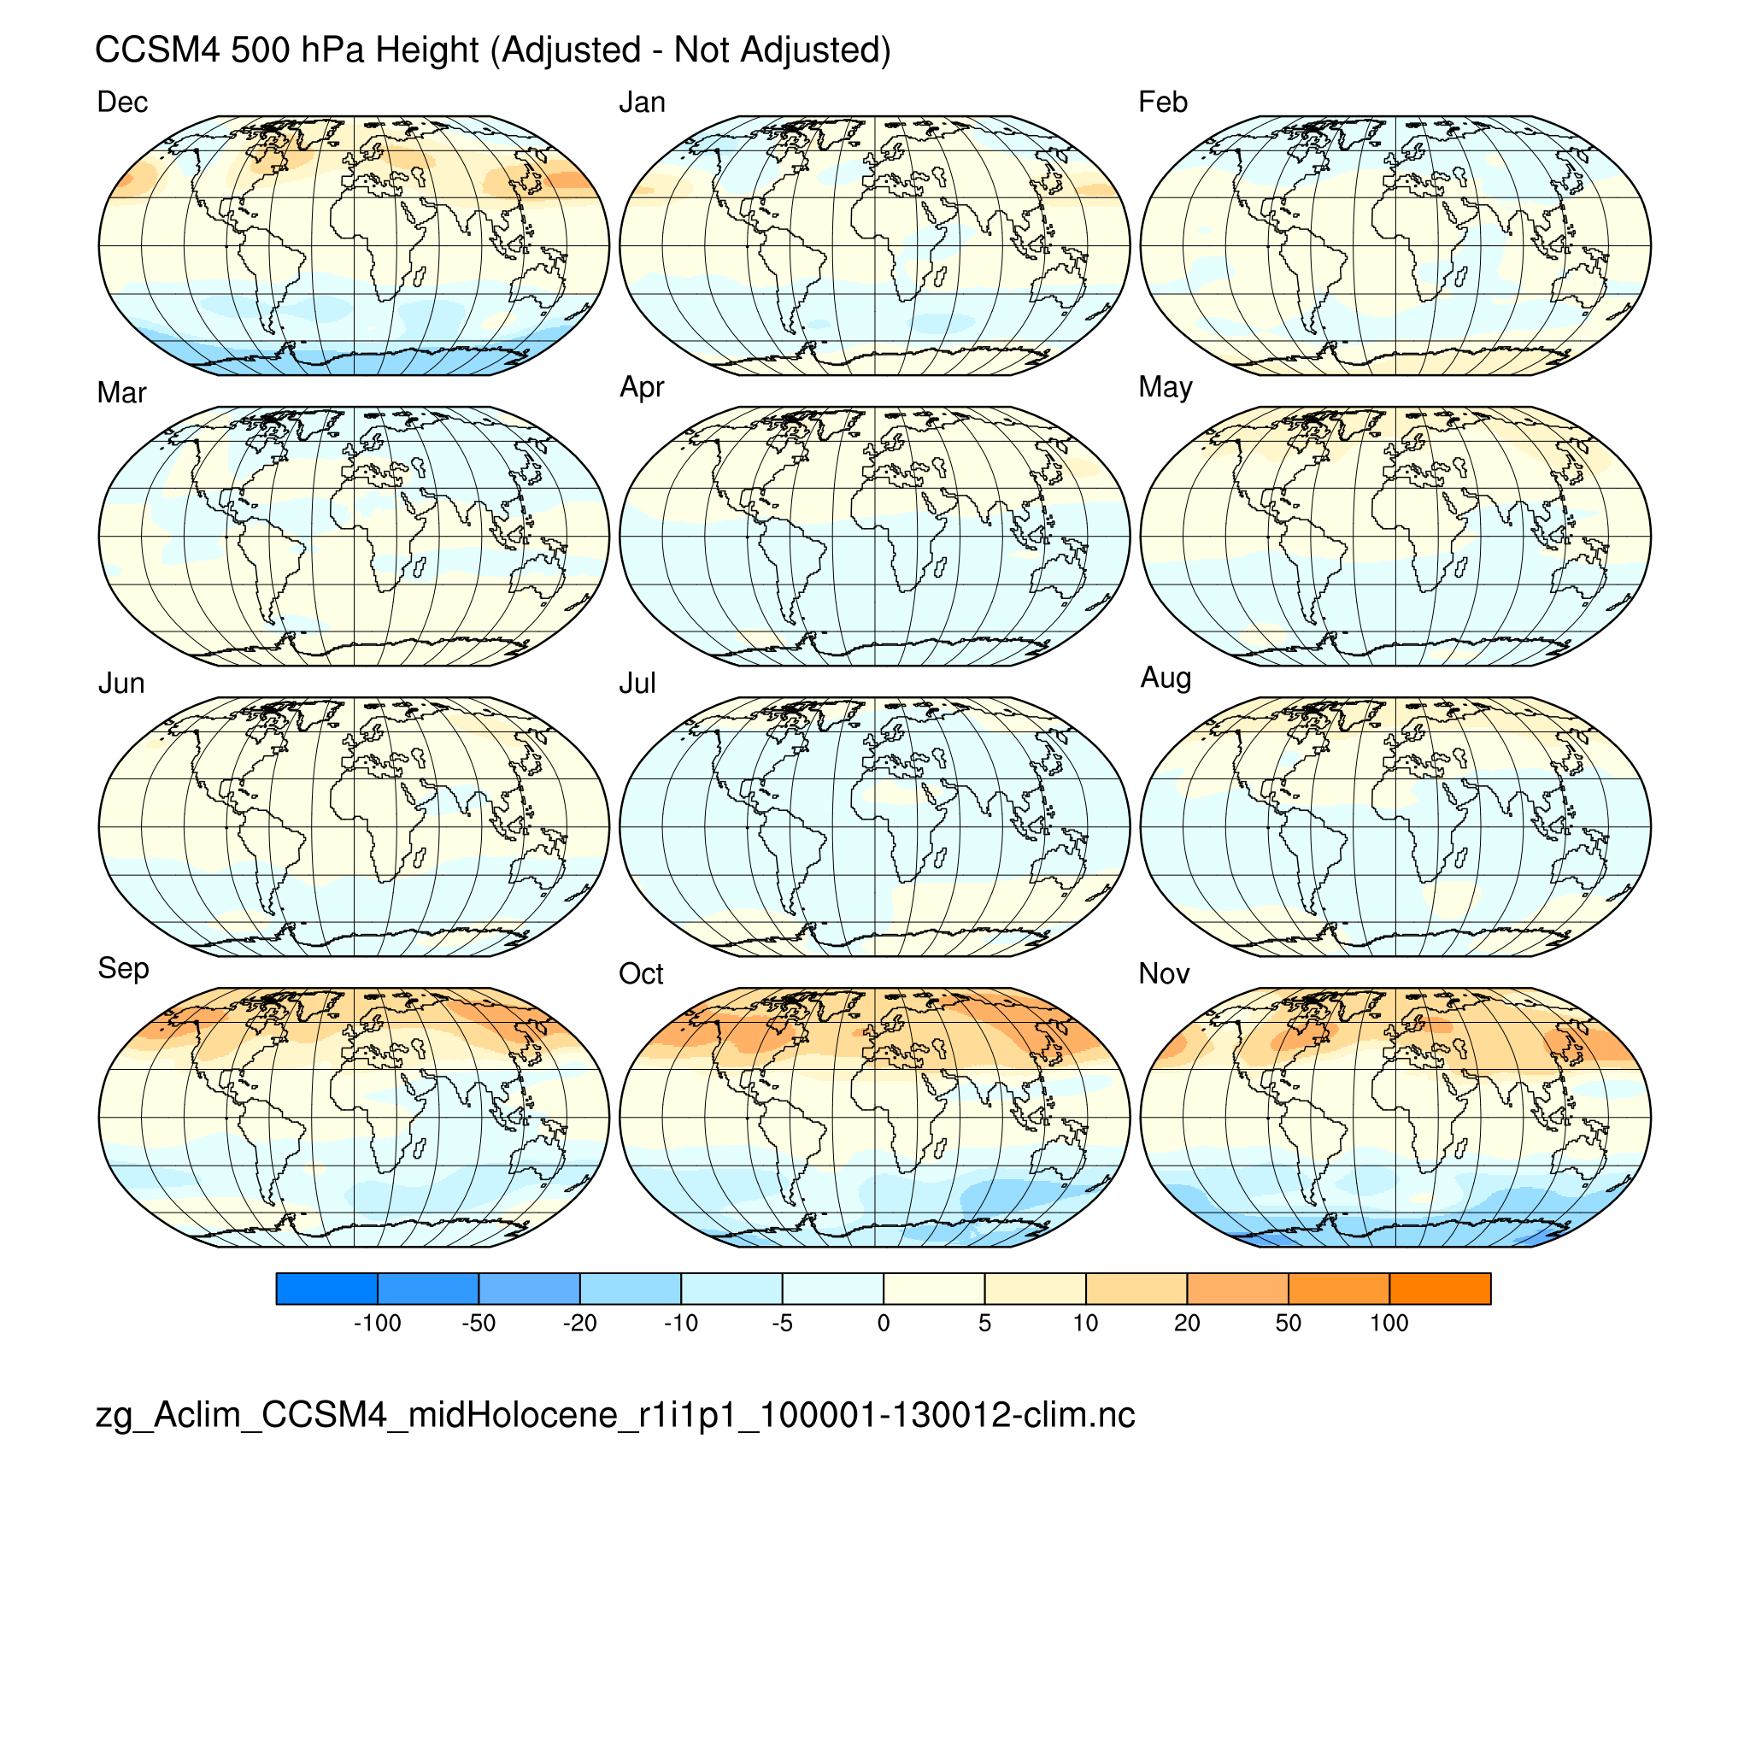
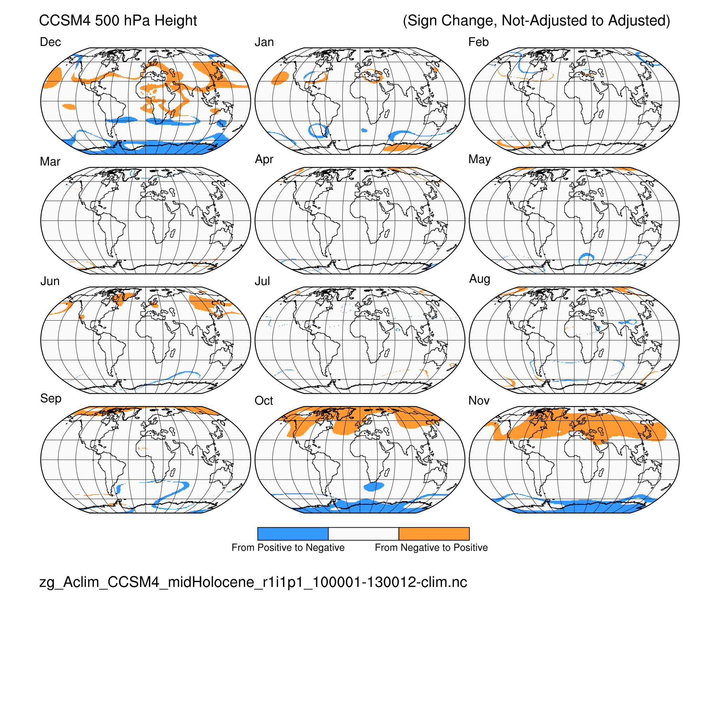
500 hPa heights (zg) CCSM4 midHolocene (6 ka)
Calendar Effect: (difference) (sign change)
500 hPa (temperature related): interhemispheric and some continent-ocean contrasts

Slide 20
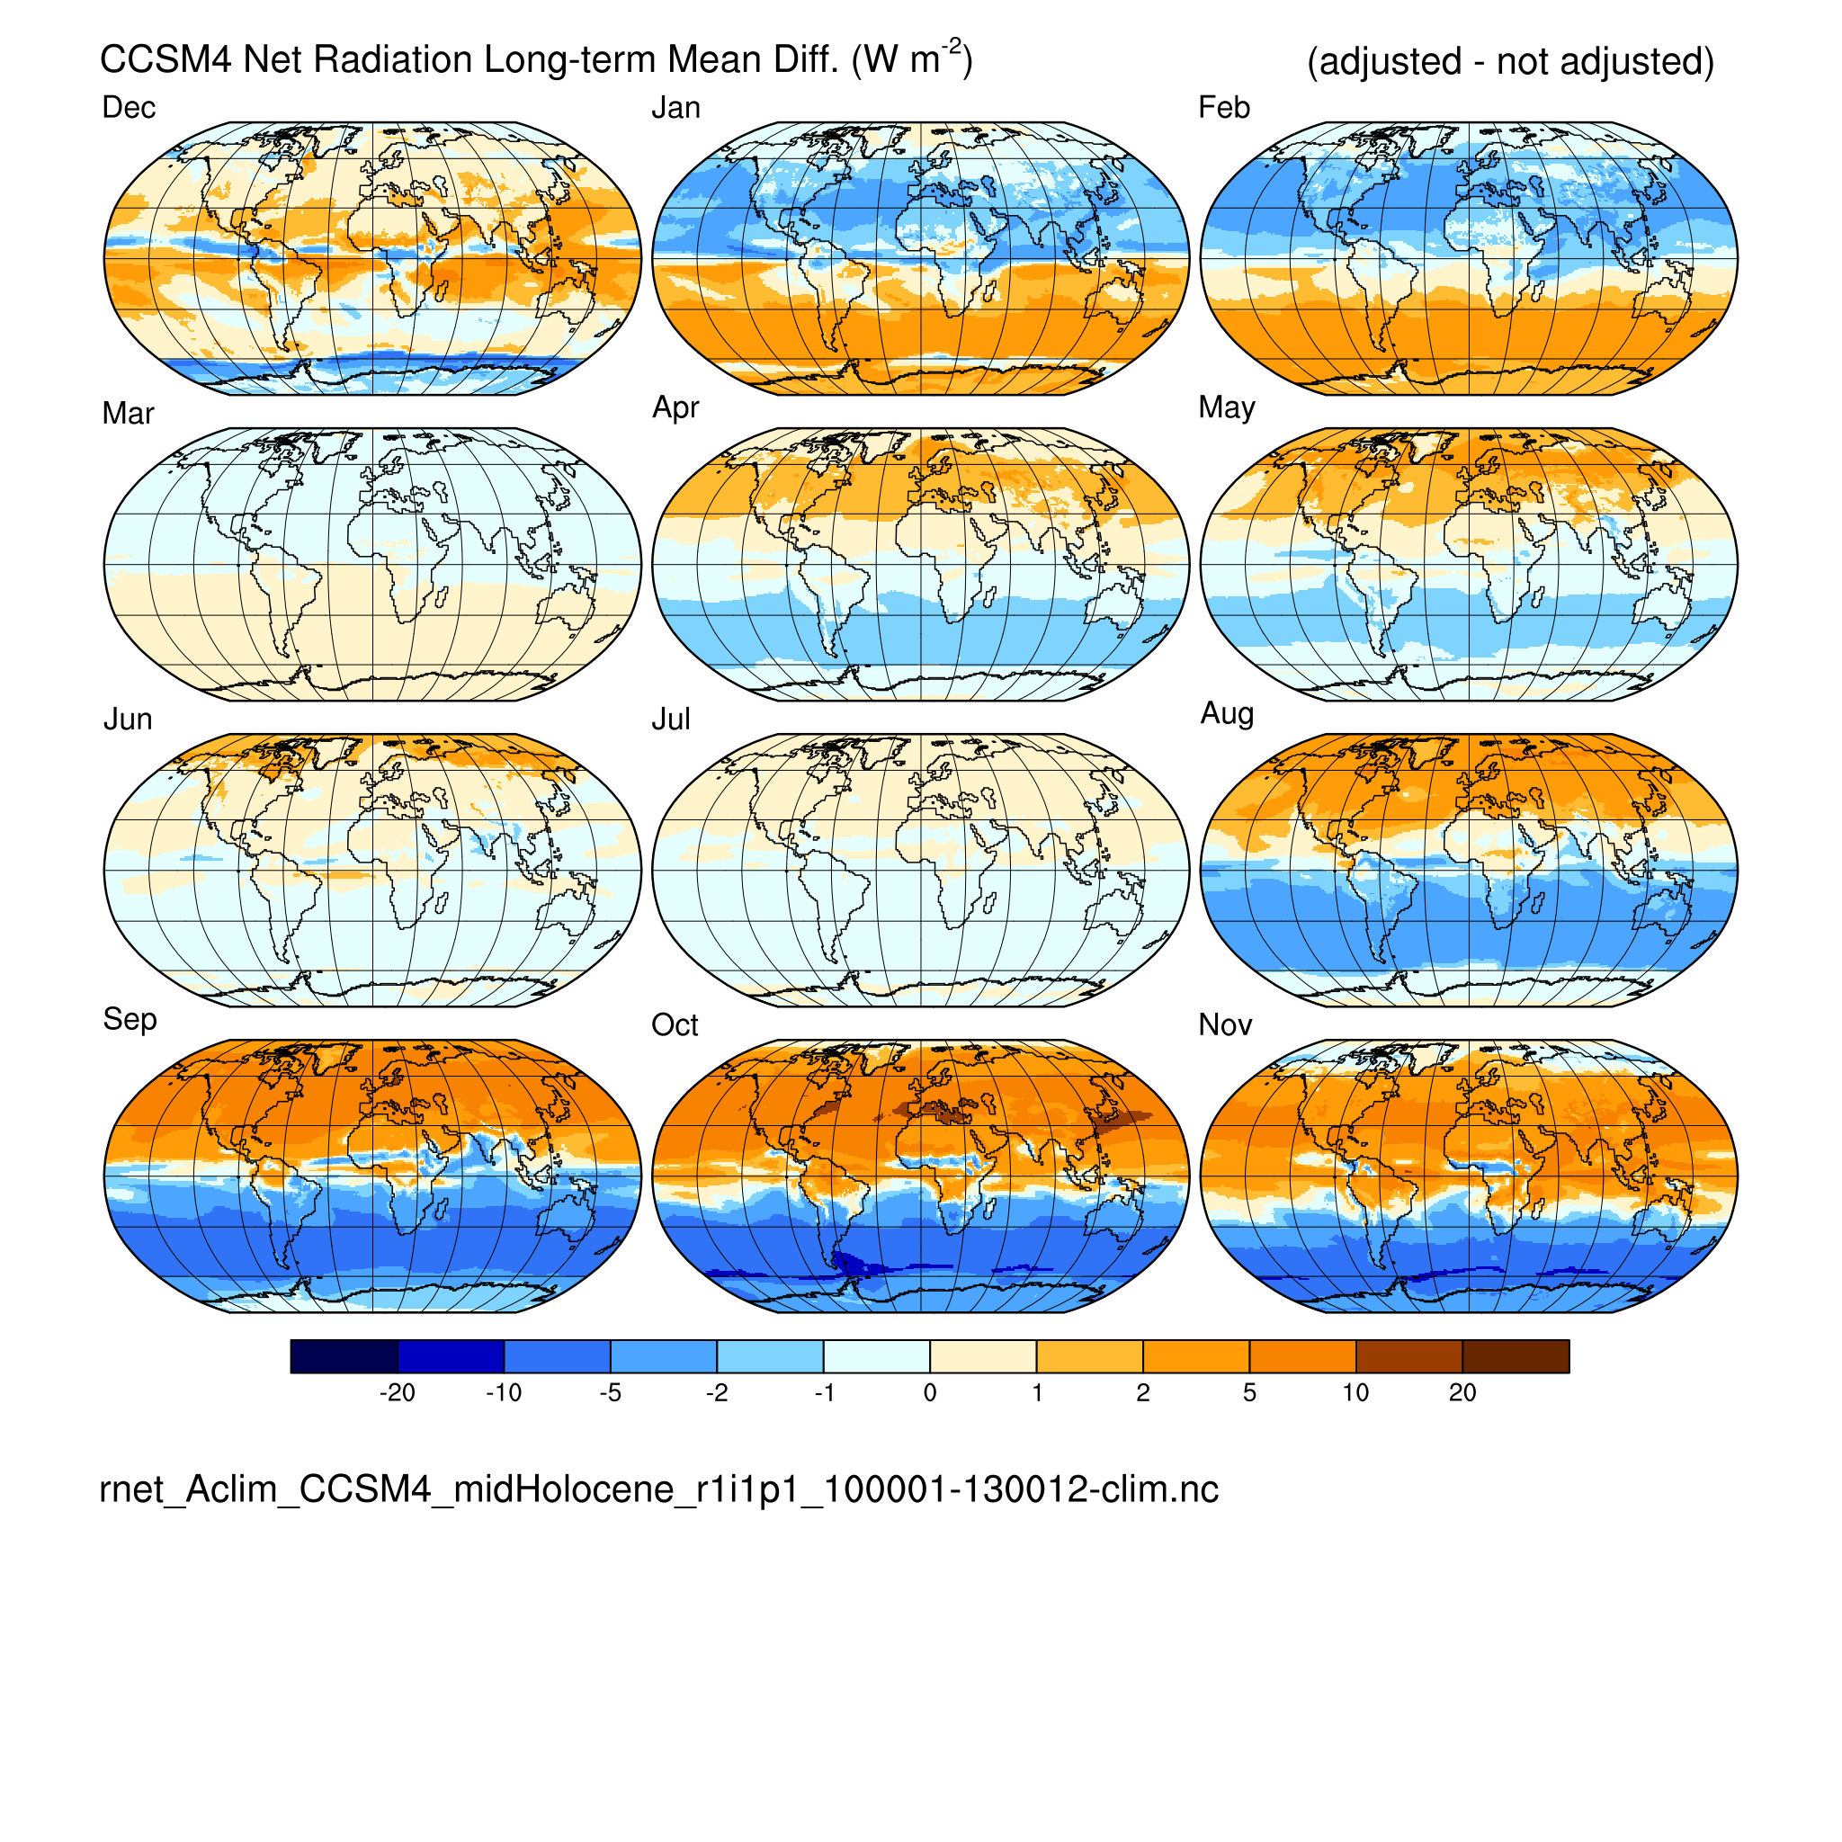
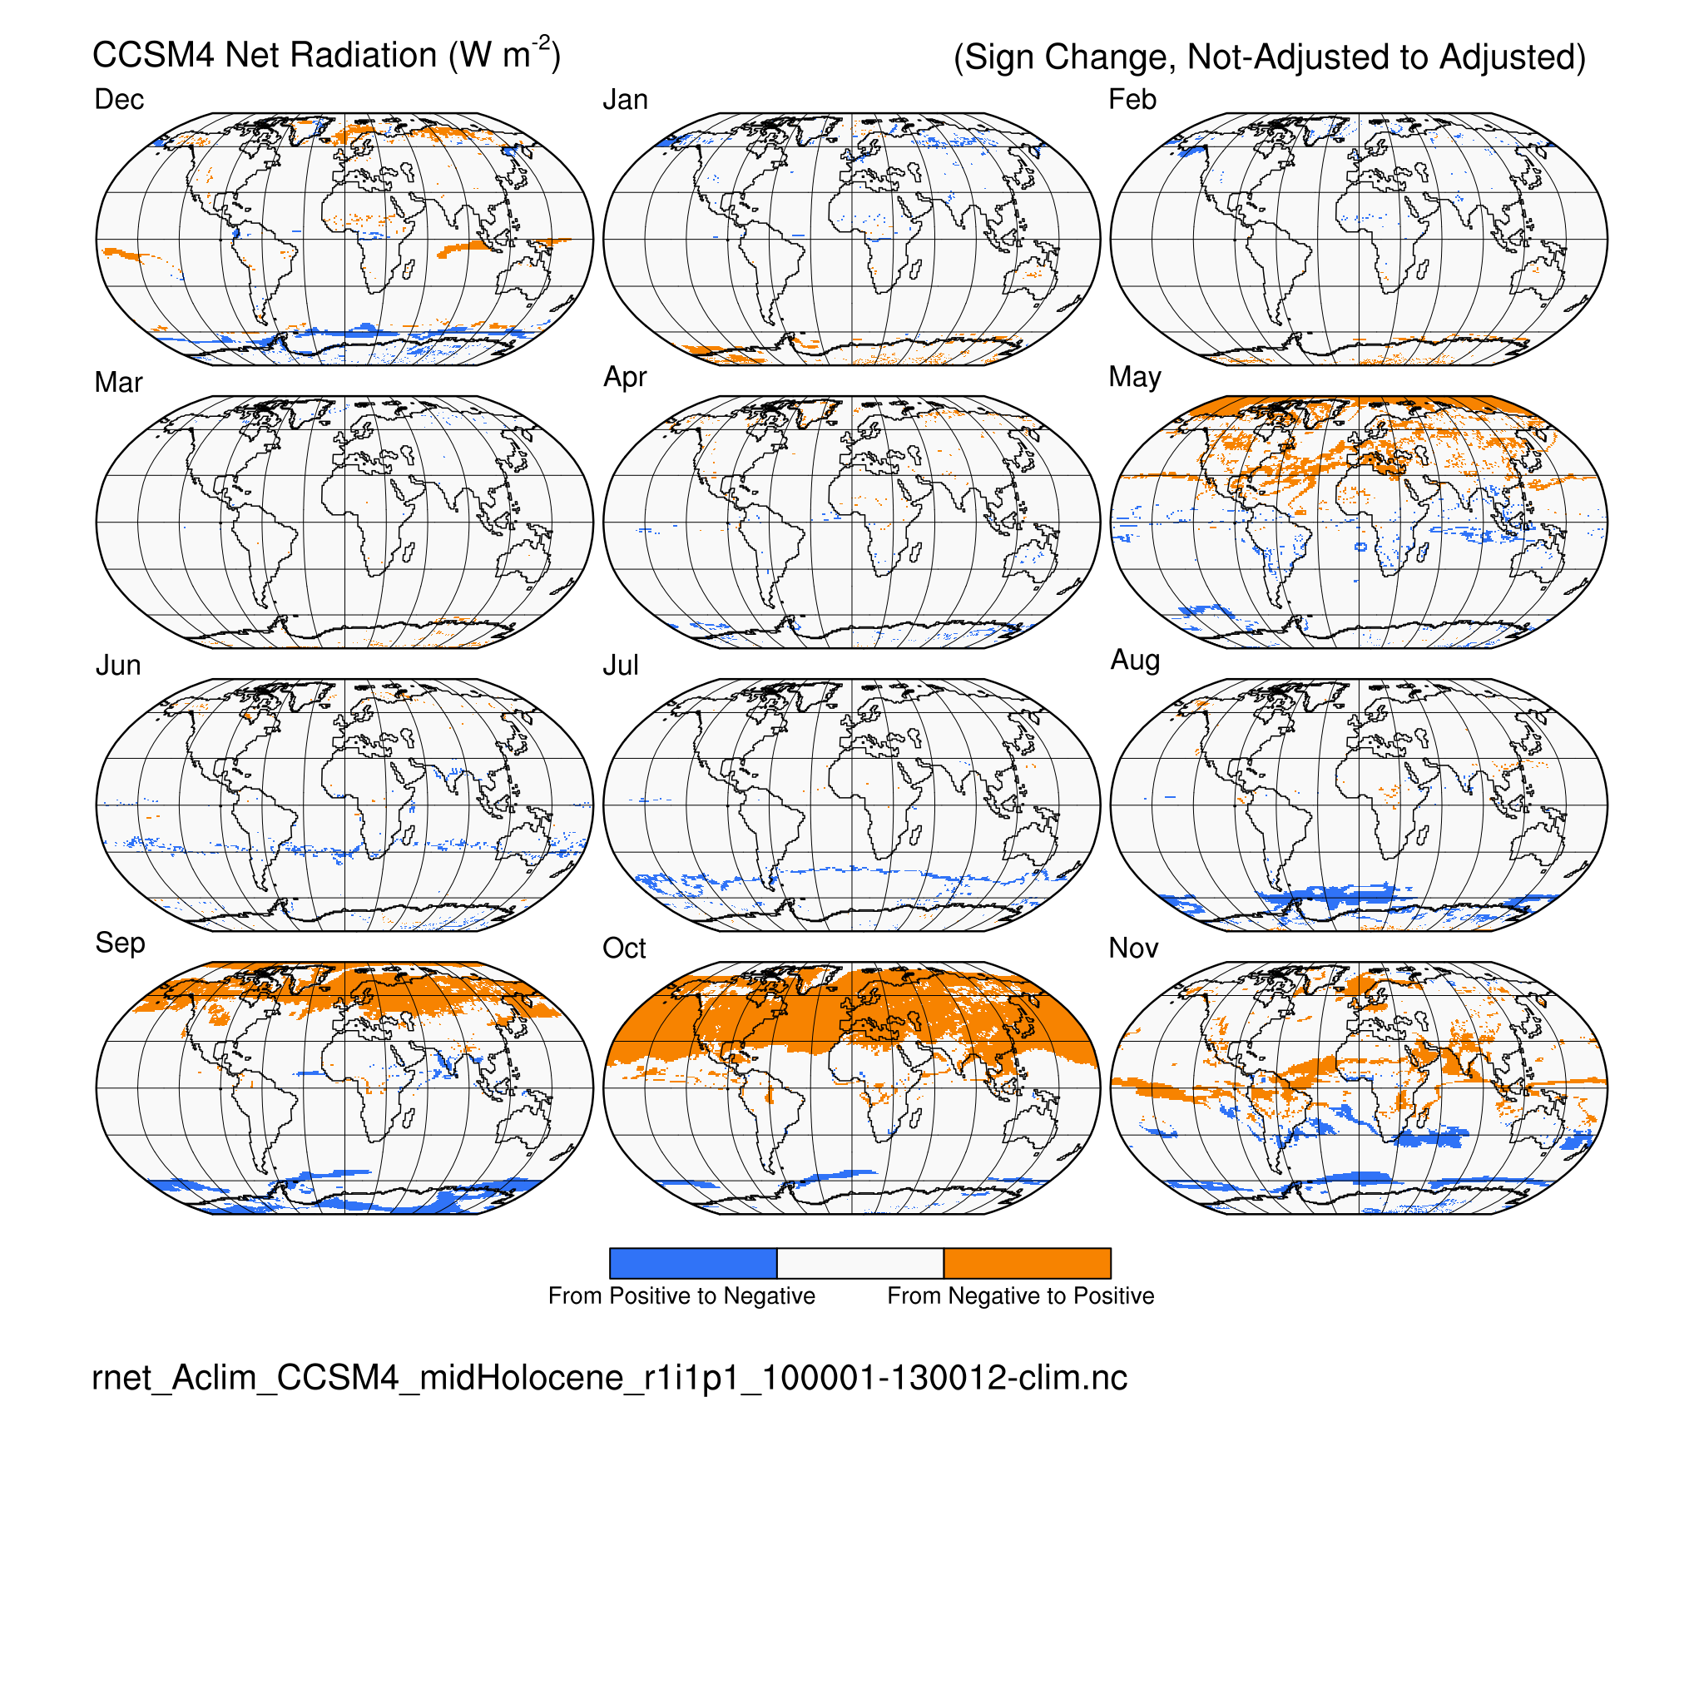
Net radiation (rnet) CCSM4 midHolocene (6 ka)
Calendar Effect: (difference) (sign change)
Net & net shortwave radiation: simple interhemispheric (N-S) contrasts

Slide 21
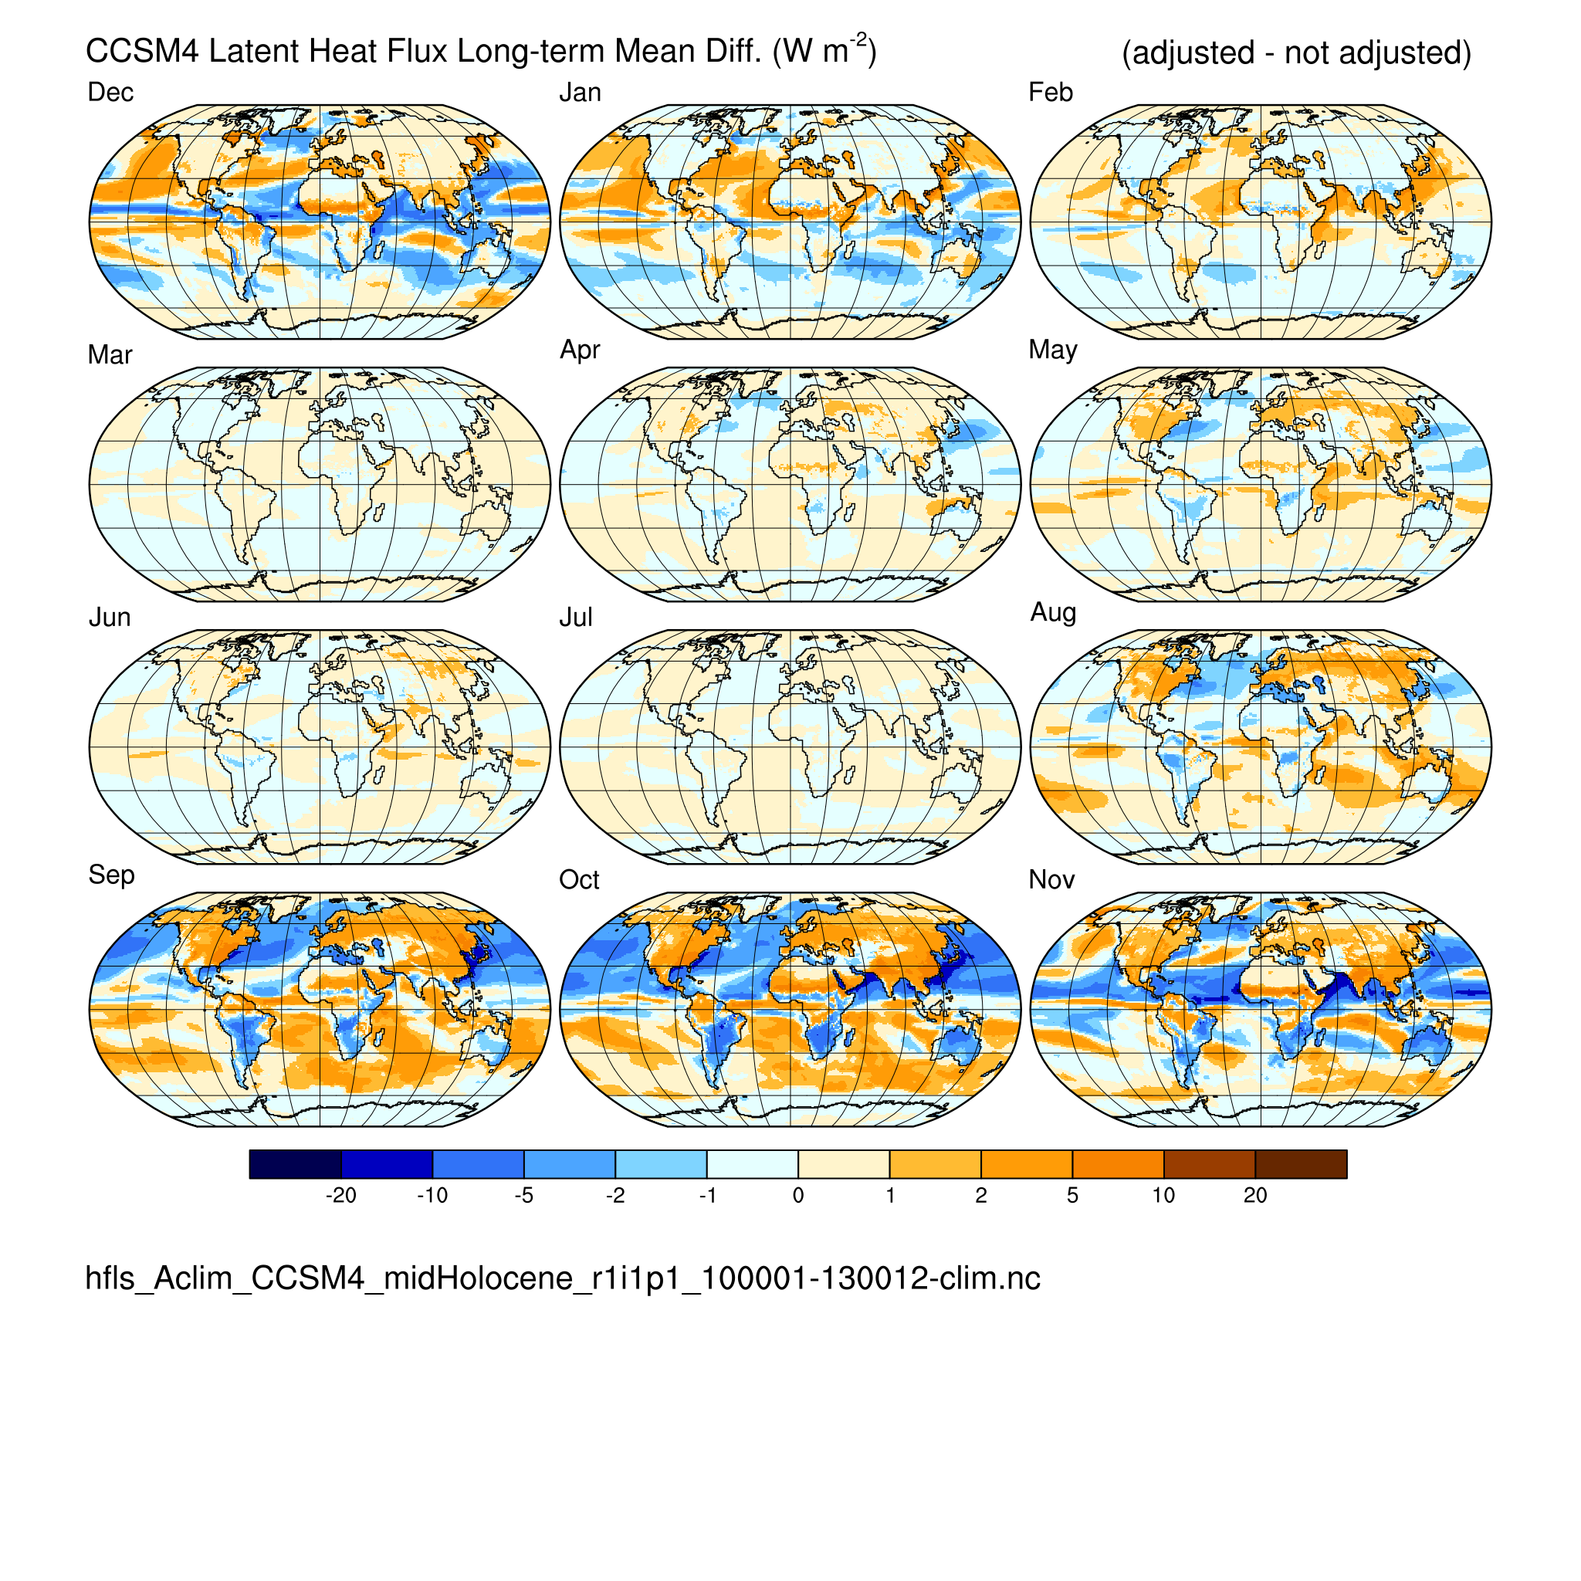
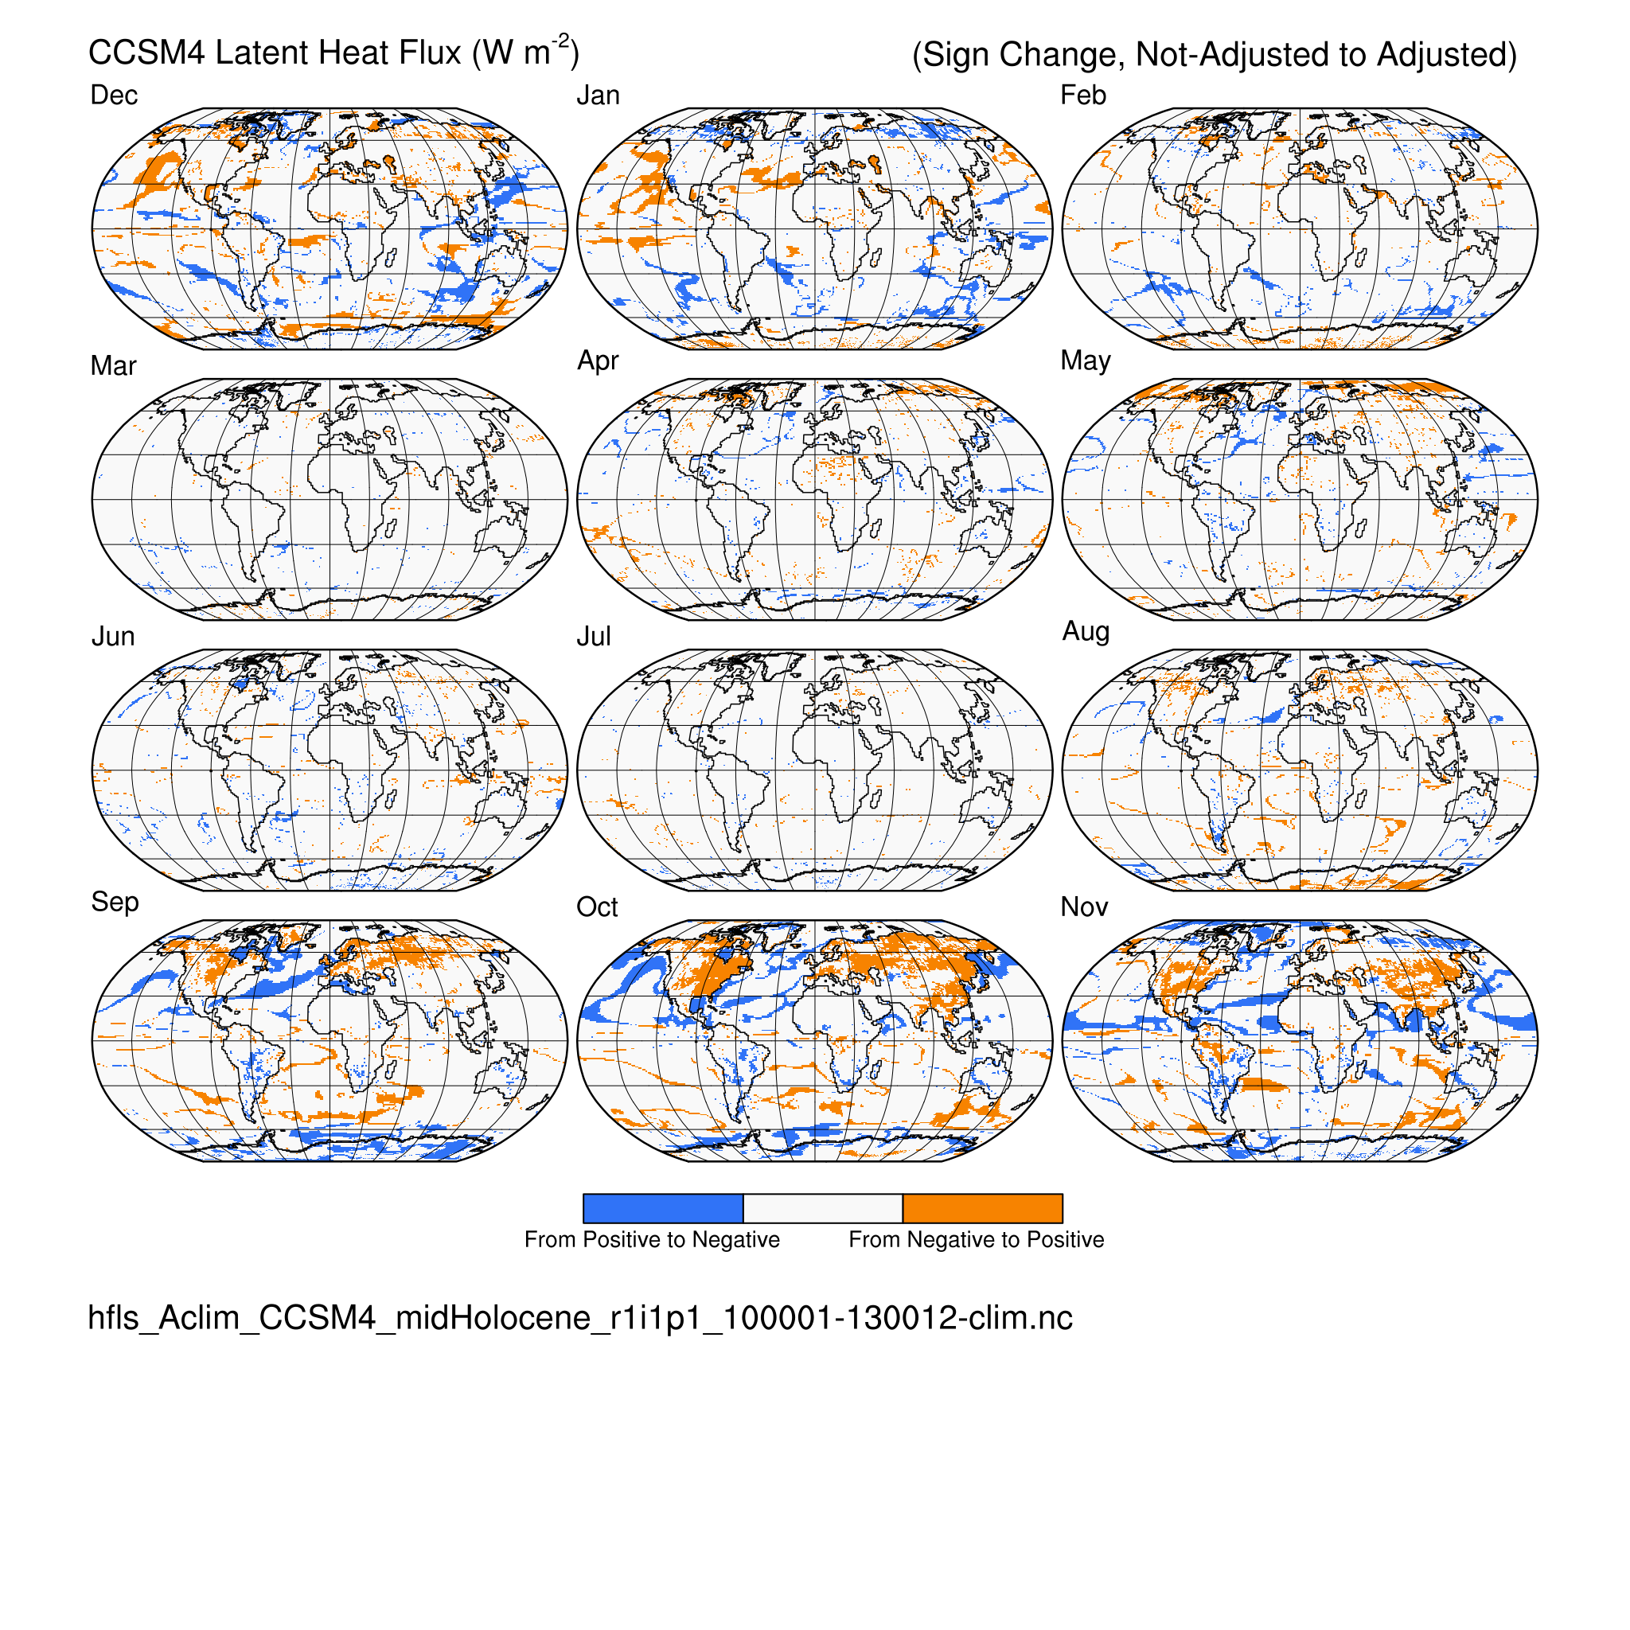
Latent heat flux (hfls) CCSM4 midHolocene (6 ka)
Calendar Effect: (difference) (sign change)

Slide 22
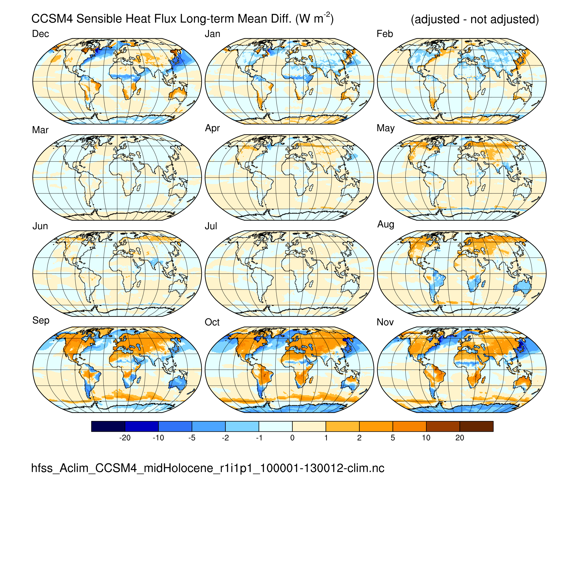
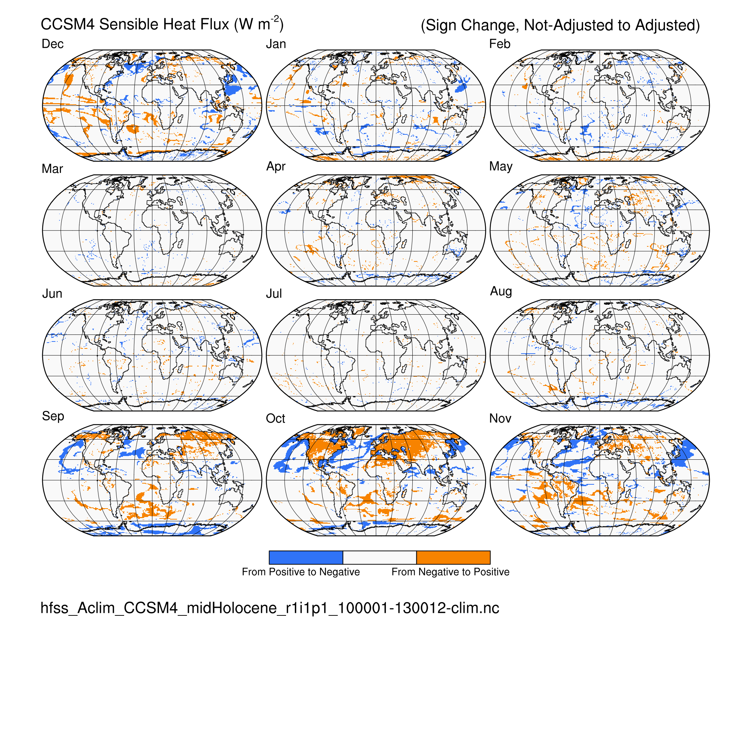
Sensible heat flux (hfss) CCSM4 midHolocene (6 ka)
Calendar Effect: (difference) (sign change)
Latent & sensible heat flux: land – ocean contrasts

Slide 23
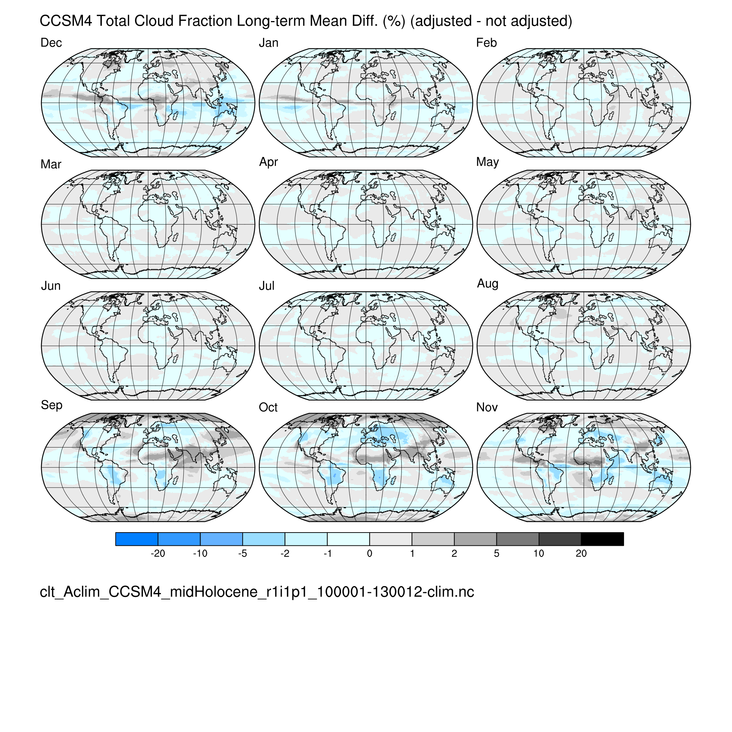
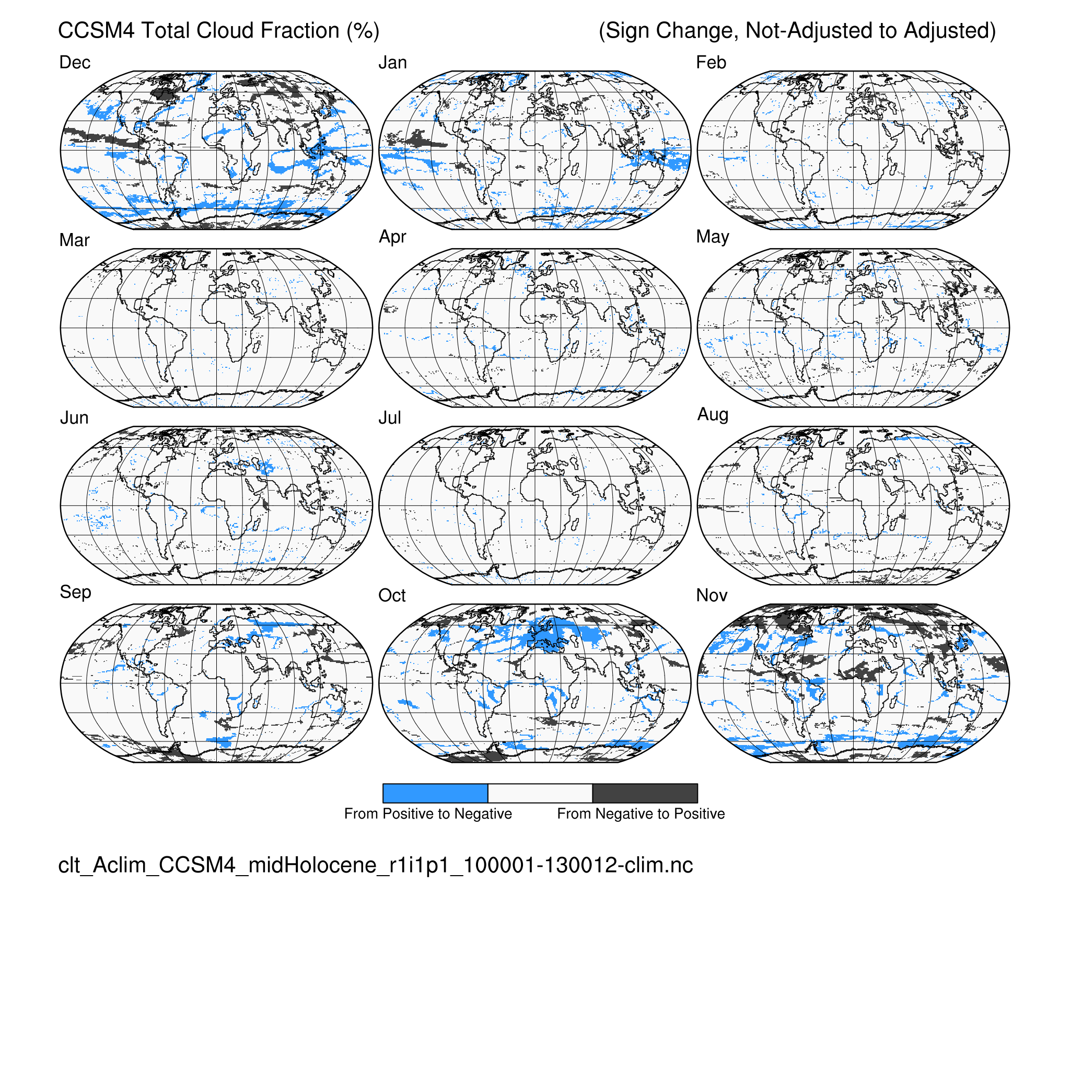
Total cloud (clt) CCSM4 midHolocene (6 ka)
Calendar Effect: (difference) (sign change)

Slide 24
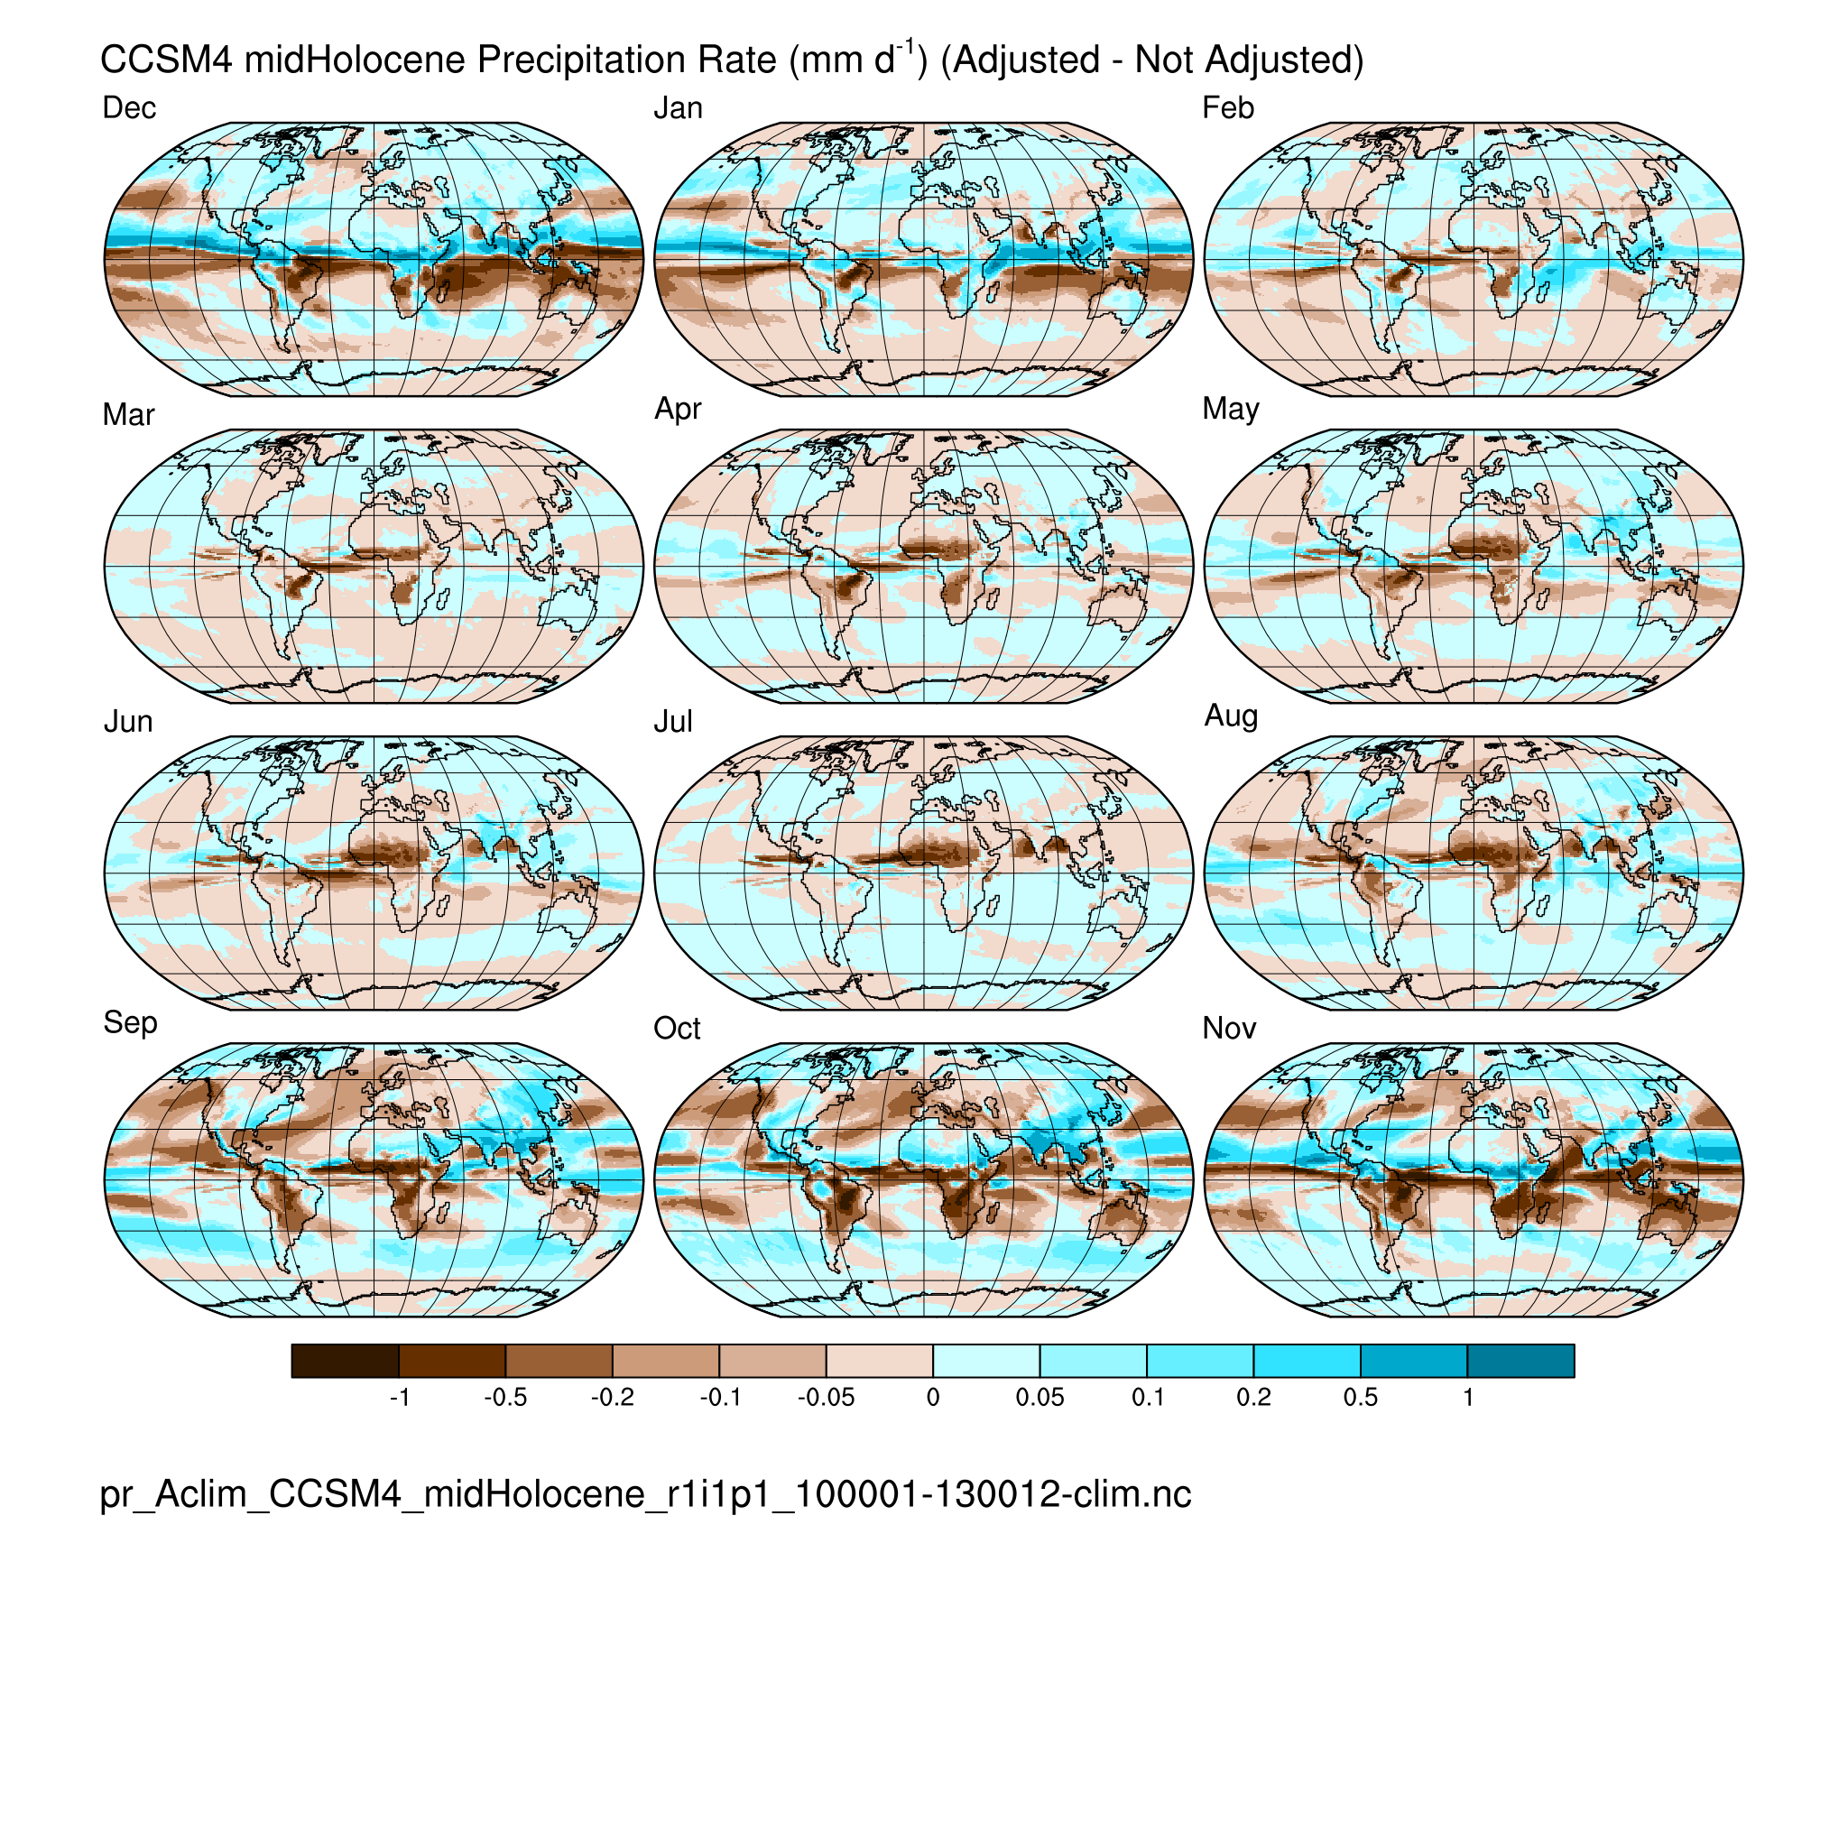
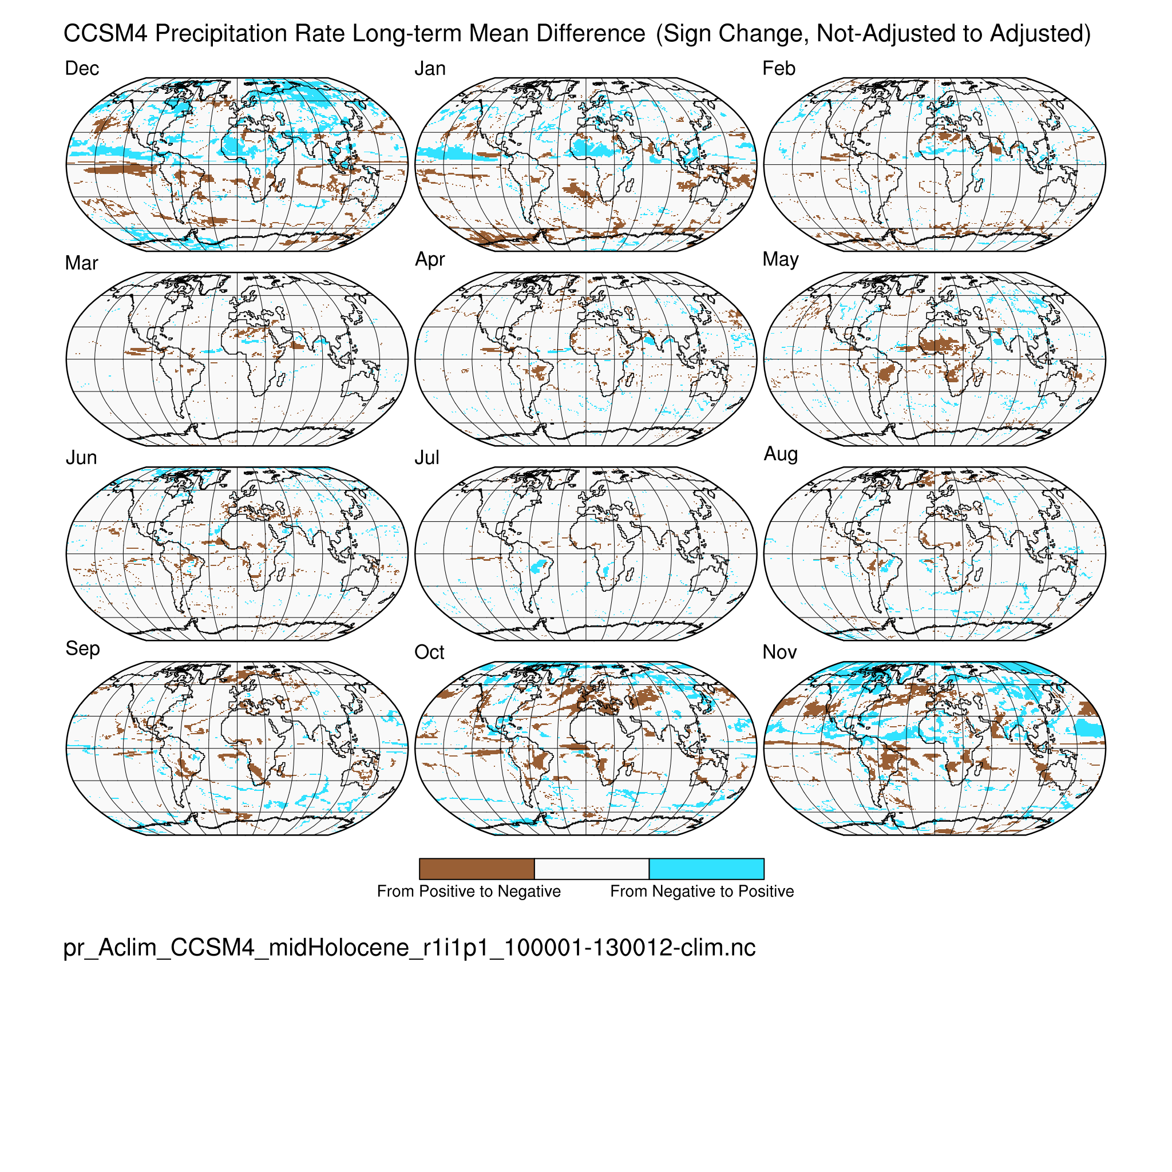
Precipitation rate (pr) CCSM4 midHolocene (6 ka)
Calendar Effect: (difference) (sign change)
Precipitation-related variables: spatially heterogeneous, but appearing as the
expression of typical mechanisms like ITCZ / monsoon / STH / westerly shifts

Slide 25
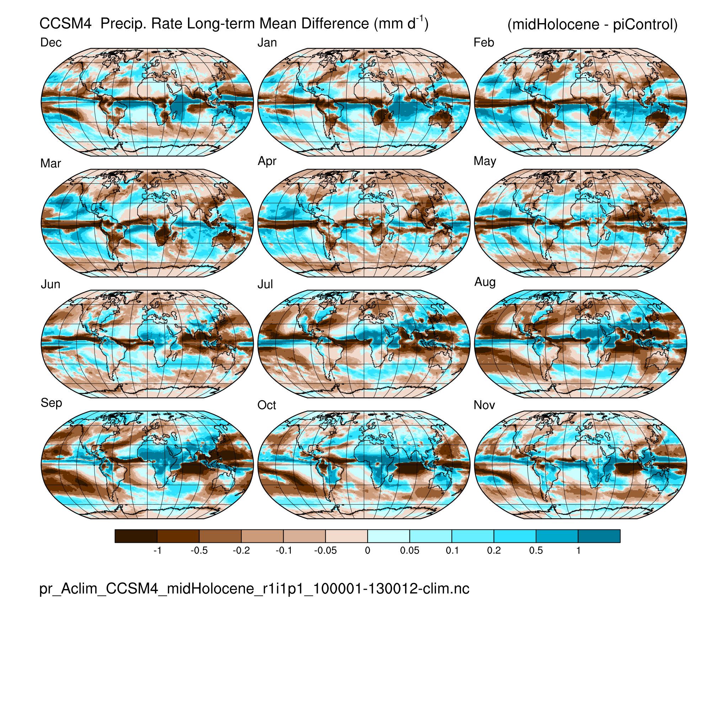
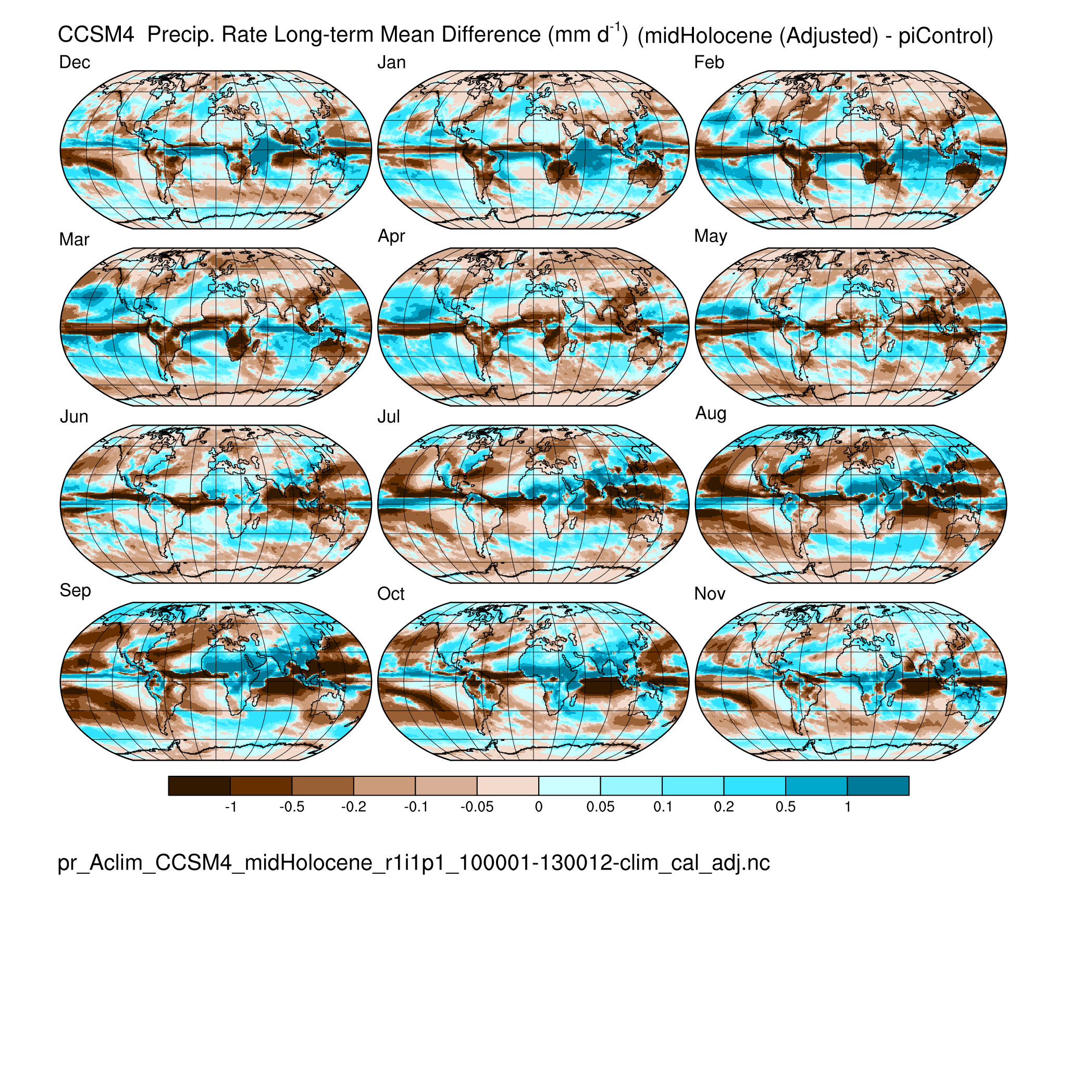
Precipitation rate (pr) CCSM4 midHolocene (6 ka)
(not adjusted) (adjusted)

Slide 26
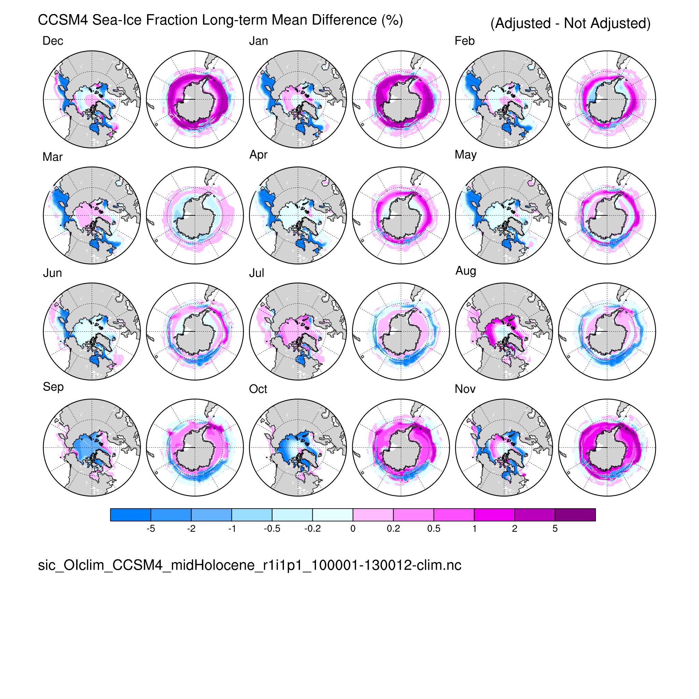
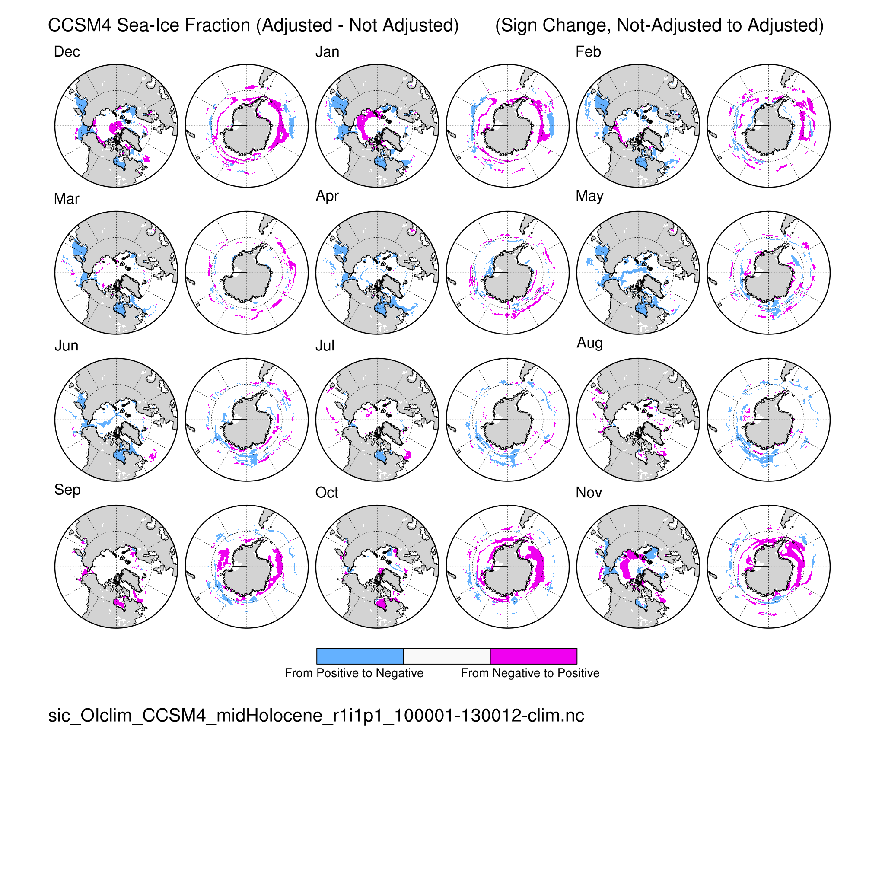
Sea-ice fraction (sic) CCSM4 midHolocene (6 ka)
Calendar Effect: (difference) (sign change)
Sea ice: Arctic: seasonal cycle of ice cover; Antarctic: latitudinal extent

Slide 27
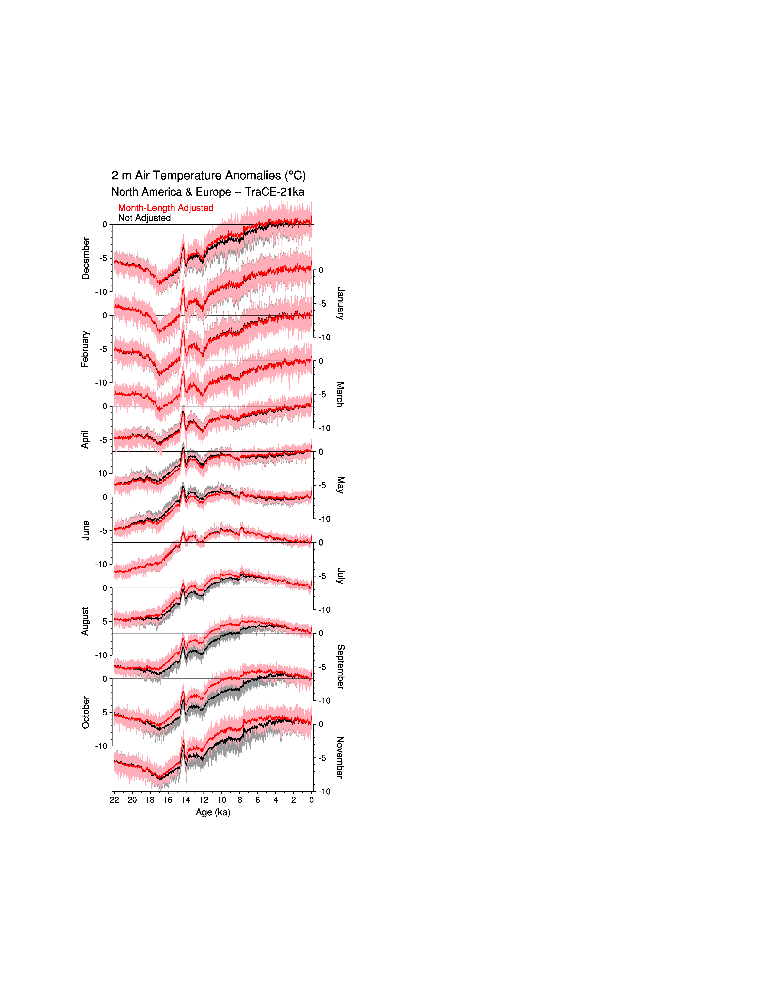
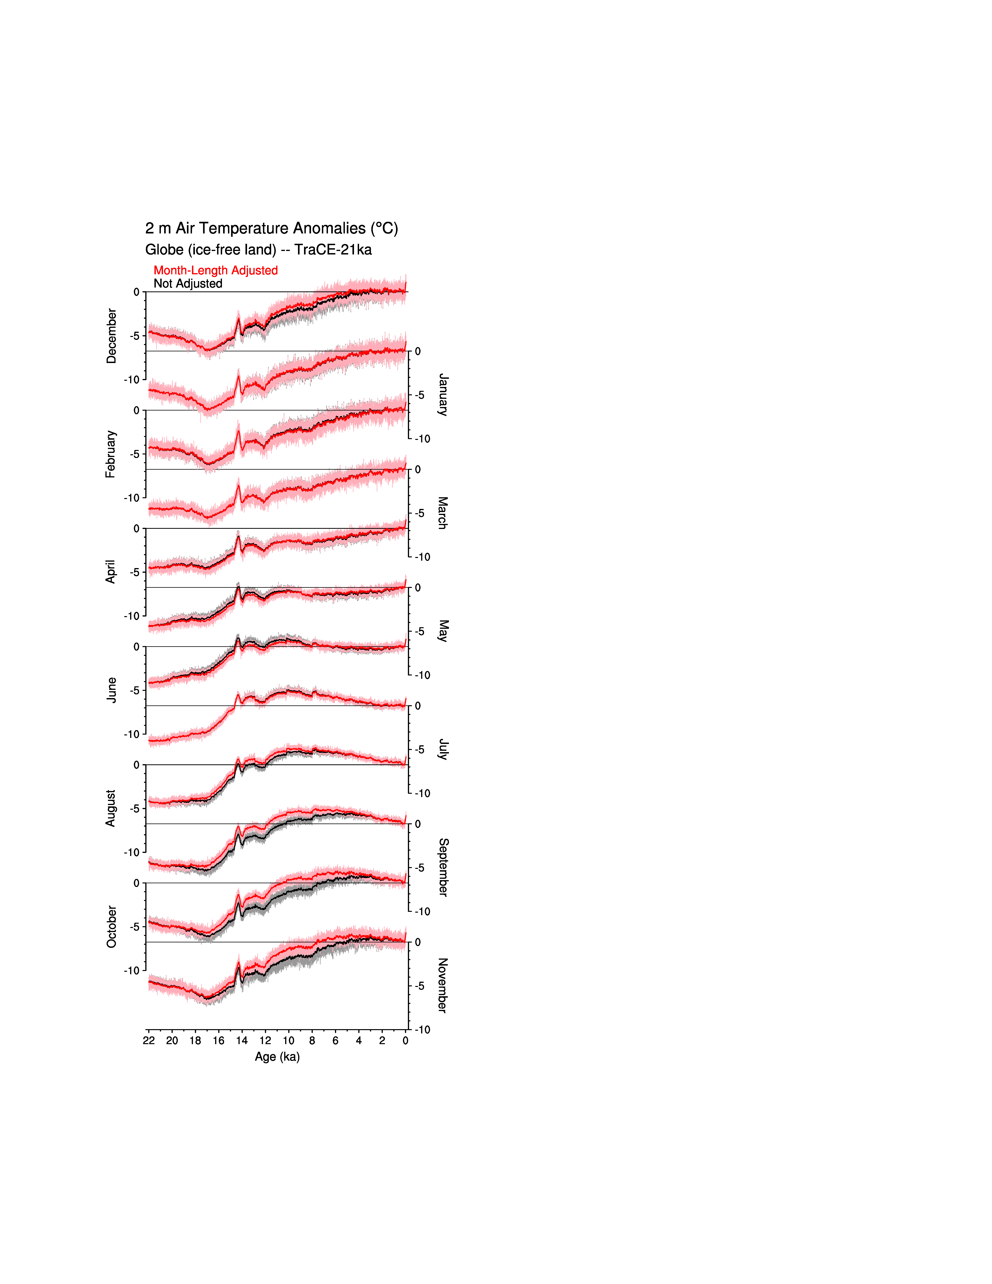
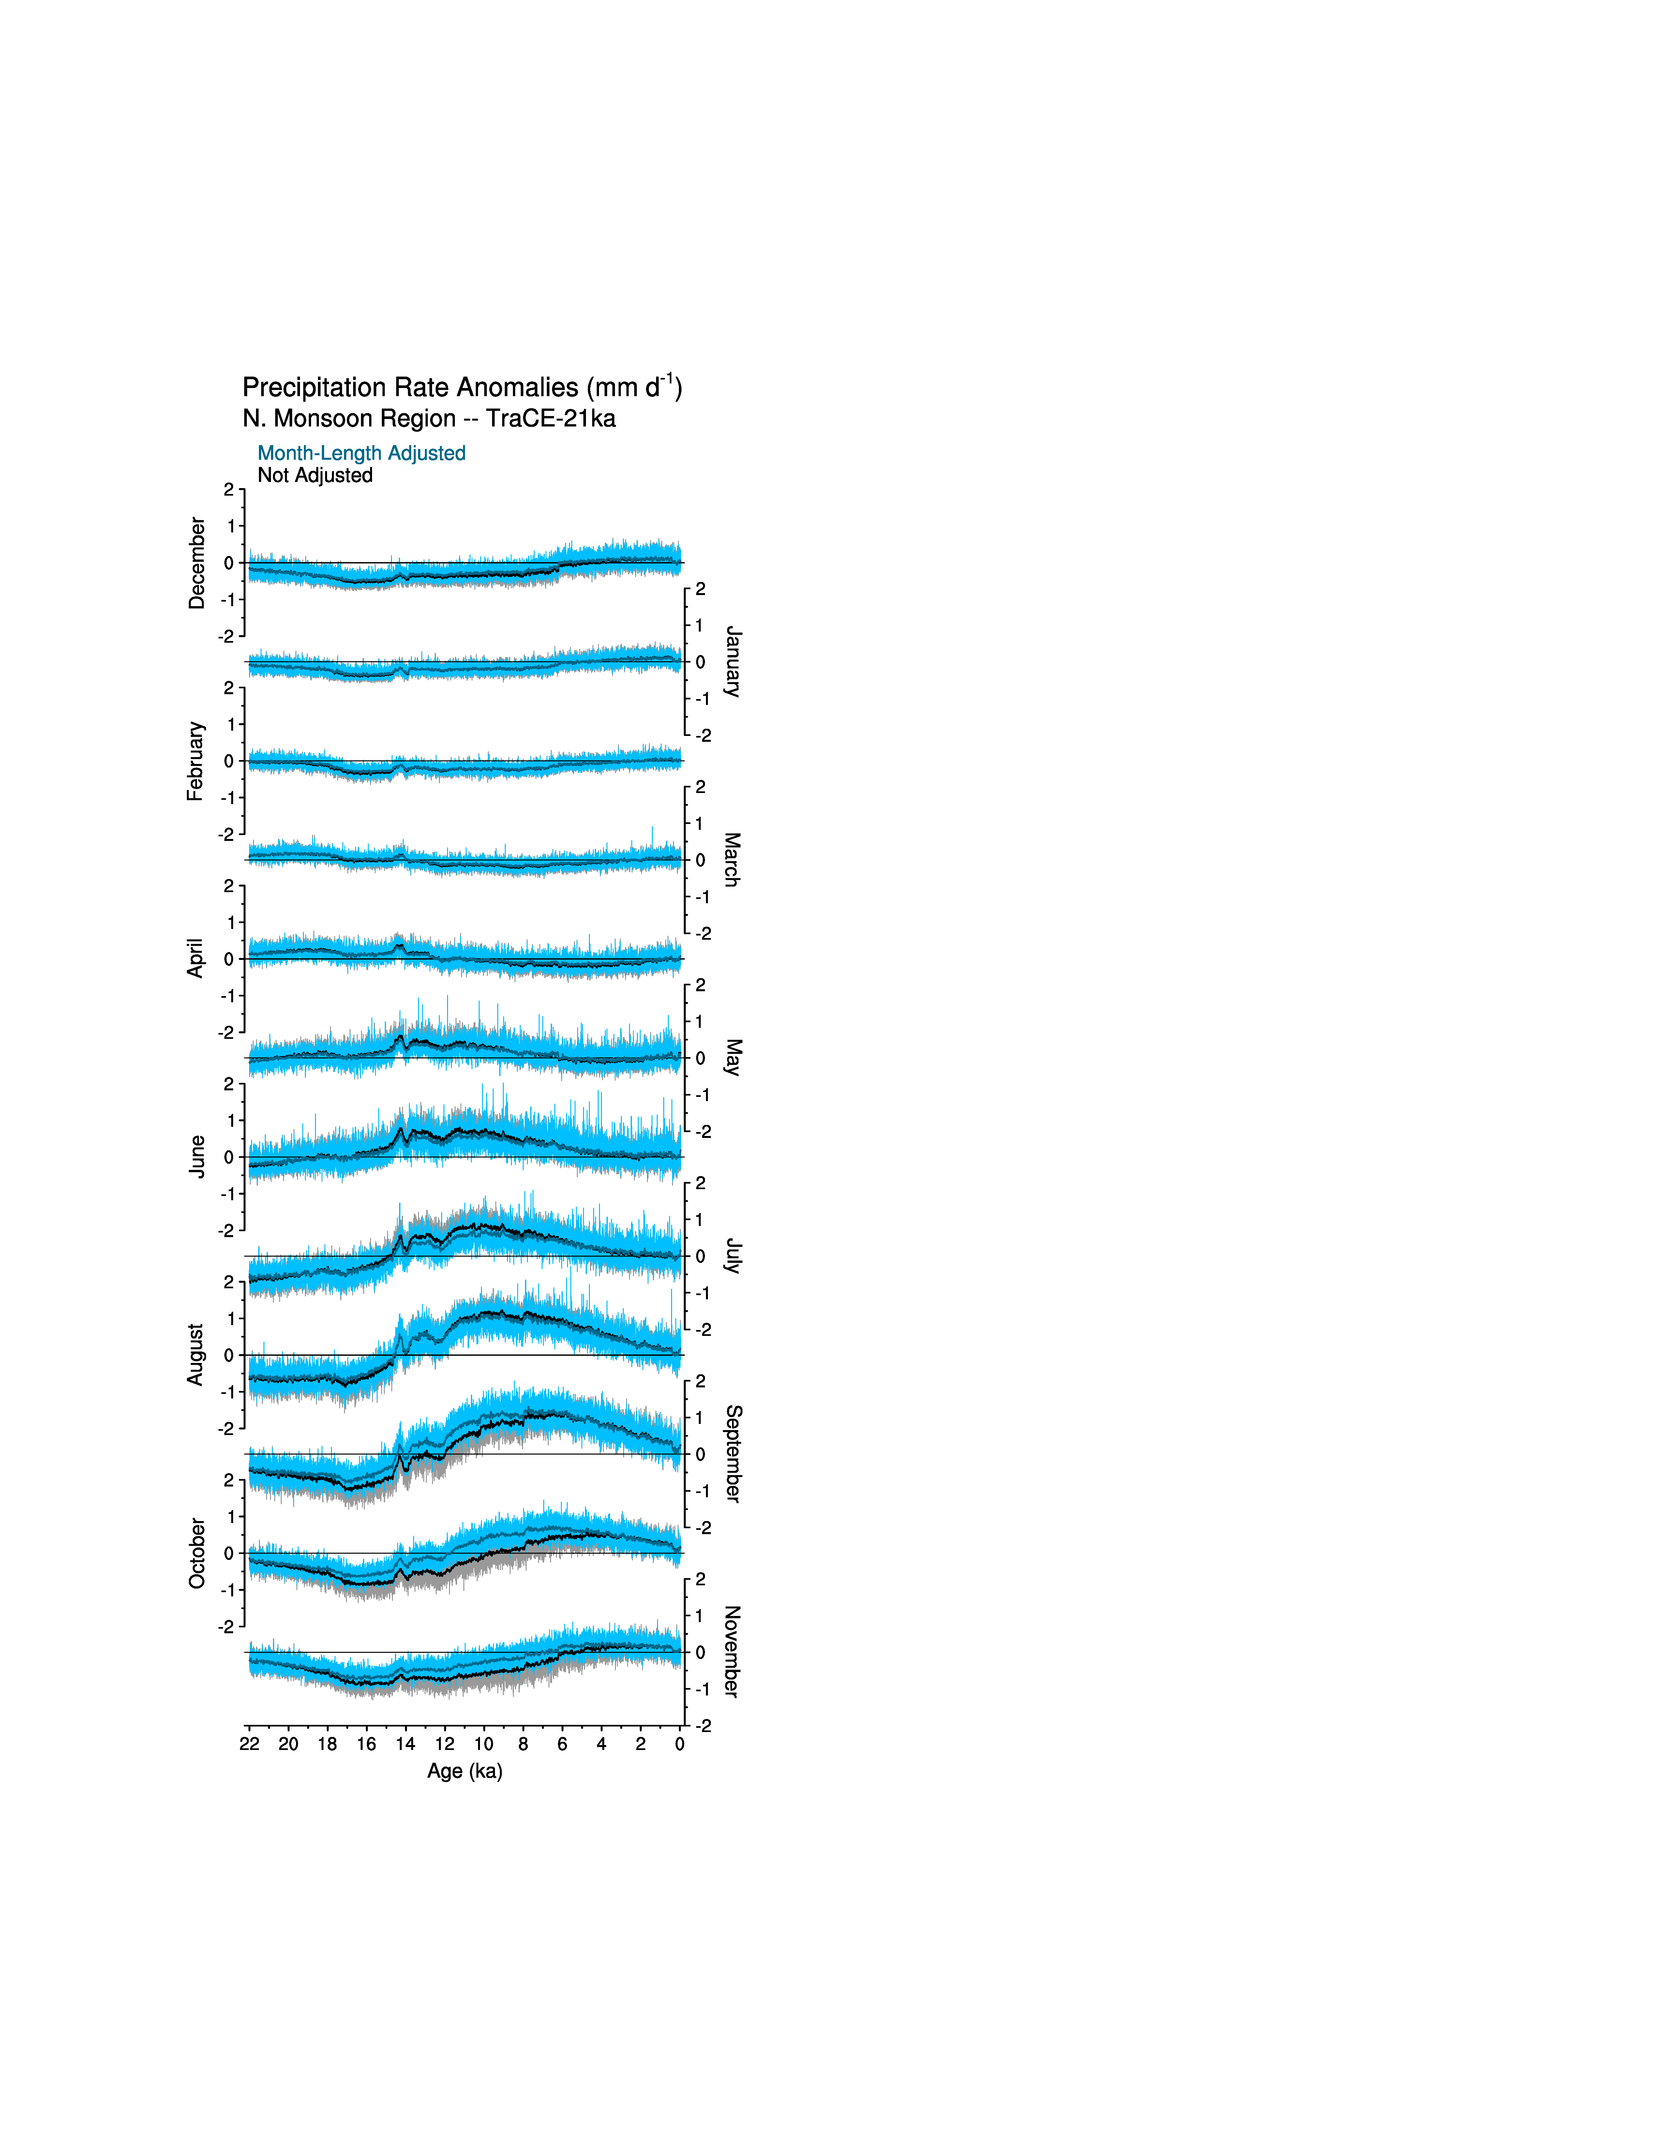
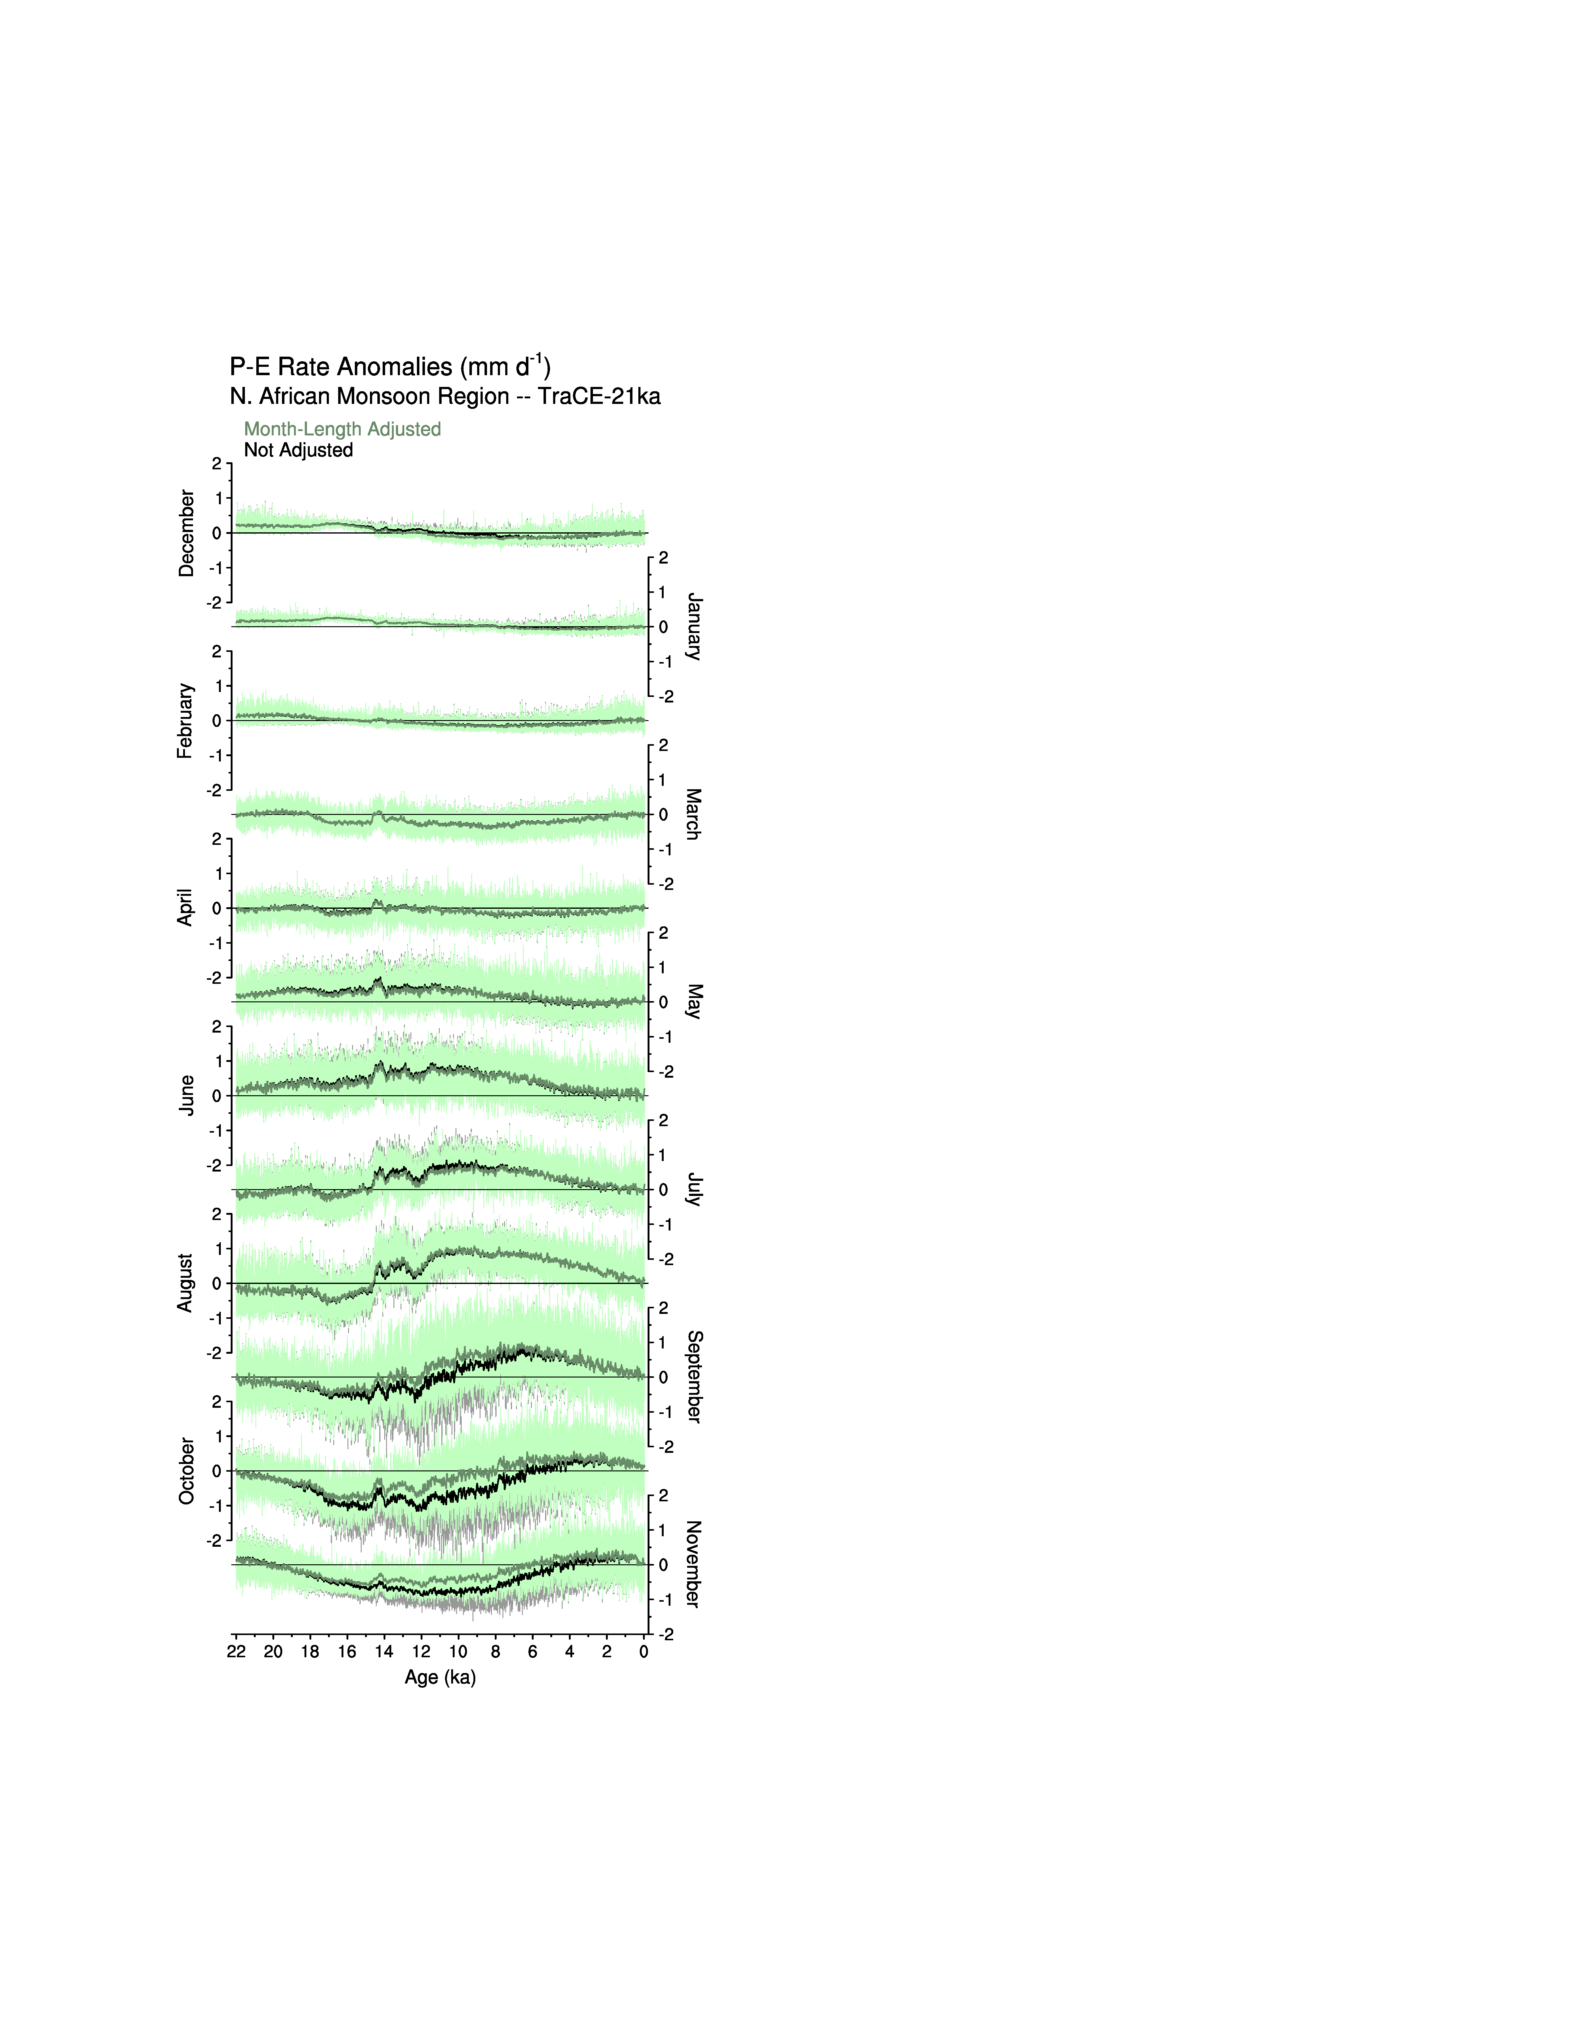
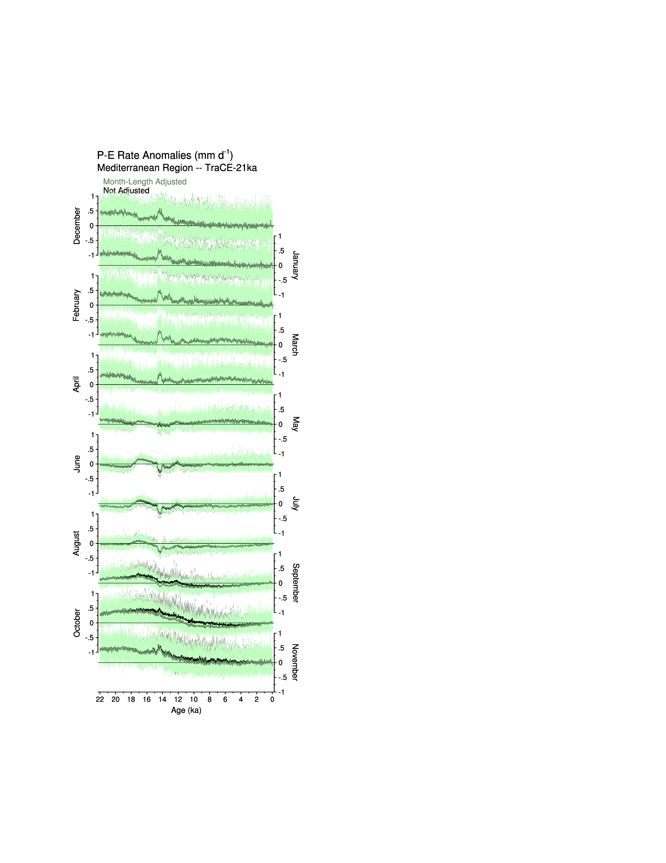
TraCE-21ka transient simulations (annual values)
colors: adjusted
grays: not adjusted
N. Amer. & Europe (tas) Globe (tas) N. Monsoon region (pr) W. African Monsoon (P-E) / Mediterranean (P-E)

Slide 28
Summary
The “paleo calendar effect,” can have large consequences for the summarization of climate-model output and comparisons with paleoclimatic data.
The effect can produce apparent patterns that may be mistaken for the expression of various climatic mechanisms.
In transient simulations, the effect can change the temporal relationships among variables and alter the timing of maxima and minima of different series.
In many instances, the effect can even reverse the sign of experiment-minus-control long-term mean differences.

Slide 29
Summary
There are four basic types of calendar-effect patterns:
Simple hemispheric (N-S) contrasts, as displayed by net radiation and net shortwave radiation;
Land-ocean contrasts, as expressed by latent and sensible heat flux and to a lesser extent by sea-level pressure;
Hemispheric and land-ocean contrasts, as displayed by near-surface air temperature and sea-surface temperatures, and by 500 hPa heights;
Spatially heterogeneous patterns related to precipitation mechanisms, including total cloud fraction and 500 hPa omega.
Ignoring the calendar effect could lead to the identification of spurious mechanisms in paleoclimatic simulations that also might be invoked in the interpretation of future simulations.

Slide 30
PaleoCalAdjust
Fortran 90 programs for month-length calculations and calendar-effect adjustment
Designed to work on CMOR-ized CMIP5/PMIP3 and CMIP6/PMIP4 files
(3-D and 4-D, native and rotated poles)
GitHub:
https://github.com/pjbartlein/ PaleoCalAdjust
Zenodo:
https://doi.org/10.5281/zenodo.1478824
Bartlein & Shafer (2019, GMD)

